Slide 1
Robot Combat 101
Mike Jeffries
Near Chaos Research
Mike@NearChaos.net
http://nearchaos.net/
https://www.facebook.com/NearChaosResearch
https://twitter.com/NearChaos
https://www.instagram.com/nearchaosmike/
https://www.twitch.tv/nearchaosmike
https://www.youtube.com/c/MikeNCR

Slide 2
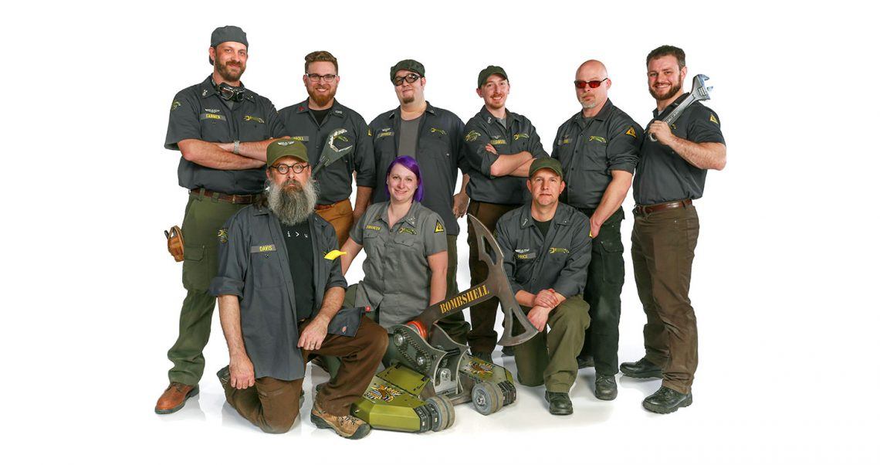
Who Am I?
Captain & Driver – Bombshell, Battlebots 2016 and 2018
Head of Near Chaos Research
Independent Rules Consultant, BattleBots (2021-Present)
Match Steward, BattleBots (2022)
Robot Battles Minion (2012-Present)

Slide 3
Agenda
Finding Events
Rules
  General Rules
  Robot Battles Rules
  Highlighted Robot Battles Rules
  Plastic Ant Rules
Parts of a Combat Robot
Basics
  Wiring
  Power Transmission
Parts Selection & Resources
Design Resources
Information Resources
Open Questions

Slide 4
Finding Events
Robot Combat Events
  Registration for events all over the world
  https://www.robotcombatevents.com/
BuildersDB
  Database of past and upcoming events and robots
  https://buildersdb.com/
Norwalk Havoc Robot League
  Frequent events with large prize pools in Norwalk, CT
  https://nhrl.io/
Robot Battles
  1lb and 3lb full combat
  12lb and 30lb sumo style combat
  Typically takes place during MomoCon and Dragon Con
  http://robotbattles.com/

Slide 5
General Rules
SPARC
  http://sparc.tools/
Most events in North America use the SPARC rules as written or with slight modifications
If you use these rules as your baseline, you’ll be legal at most events

Slide 6
Robot Battles Rules
Weight Classes
  1lb and 3lb compete in an arena
  12lb and 30lb compete in an open environment
Full rules at http://robotbattles.com/rules.htm
Spinning weapons on 1lb and 3lb robots are not tip speed limited
Spinning weapons on 12 and 30lb robots are limited to a tip speed of 20ft/s
  Tip Speed = RPM x Diameter x .00436
Frankenstein Rule
  If a vehicle proves sufficiently offensive to the audience, the audience may, at their discretion, light torches, take pitchforks in hand, and throw the robot and its operator in the nearest creek or large body of water.
Bad Idea Rule
  If, during the design of your robot, you think that something would be a bad idea, then just don't do it.

Slide 7
Highlighted Robot Battles Rules
Vehicles may be powered by any source socially acceptable for indoor use; all vehicles should be electrically powered. No internal combustion engines will be allowed. All power sources must be 100% contained in the vehicle and packaged appropriately for the expected abuse.
All vehicles, must, at the beginning of each combat, be capable of movement of at least one foot beyond the base radius of the robot in a reasonable amount of time.
Operable vehicles in the one and three pound weight classes must, at full extension, be able fit through the arena pushout(s) in any orientation.
All robots with active weapons must have a Master Kill Switch that deactivates the weapon immediately. The robot or attachments on the robot must not move when radio signal is lost or tether is cut. This is for the safety of the audience and the other competitors.

Slide 8
Parts of a Combat Robot
Chassis
  Frame
  Armor
Electronics
  Transmitter/Receiver
  Motor controllers
  Battery
  Wires
  Power switch
Locomotion
  Wheels
  Drive motors
  Belts/pulleys & Chains/sprockets
Weapon
  Motor
  Controller
  Mechanism

Slide 9
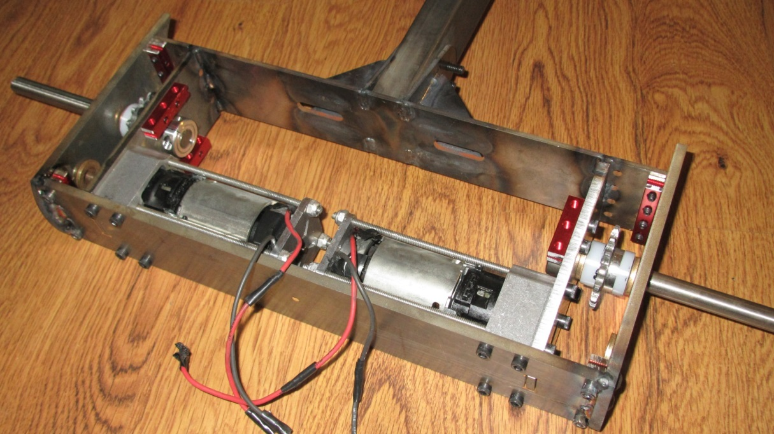
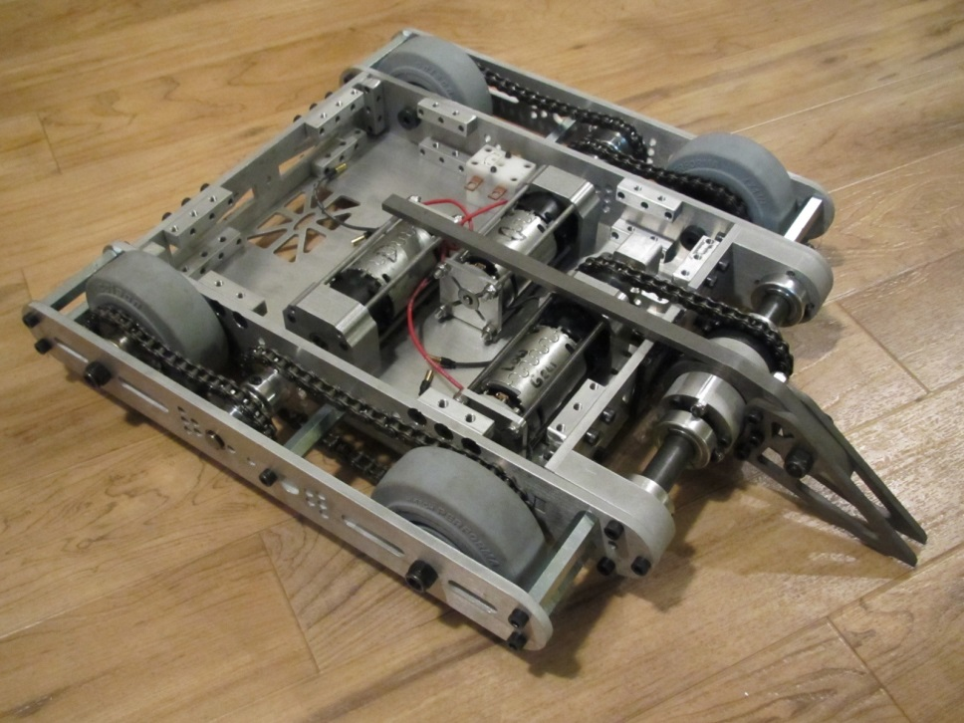
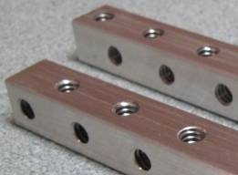
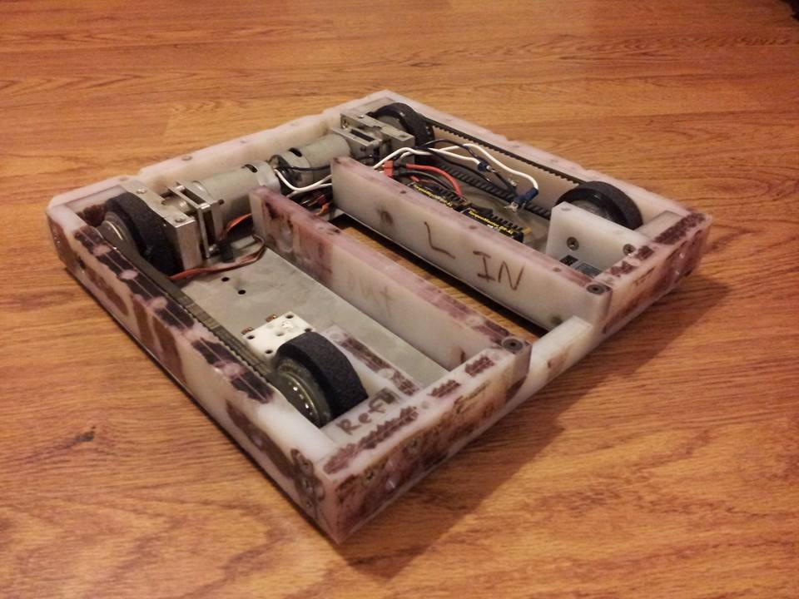
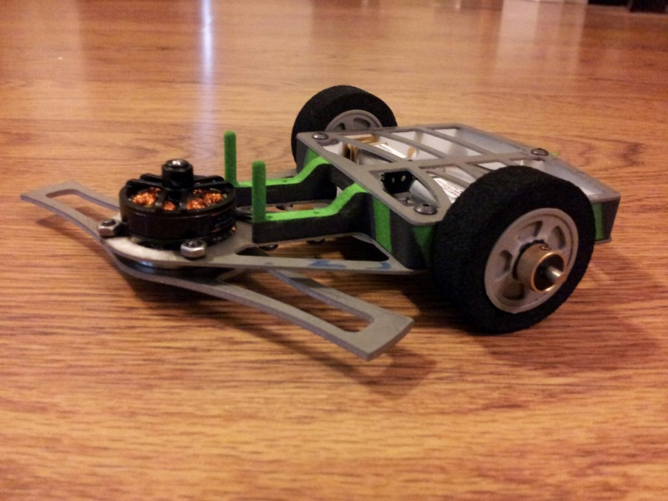
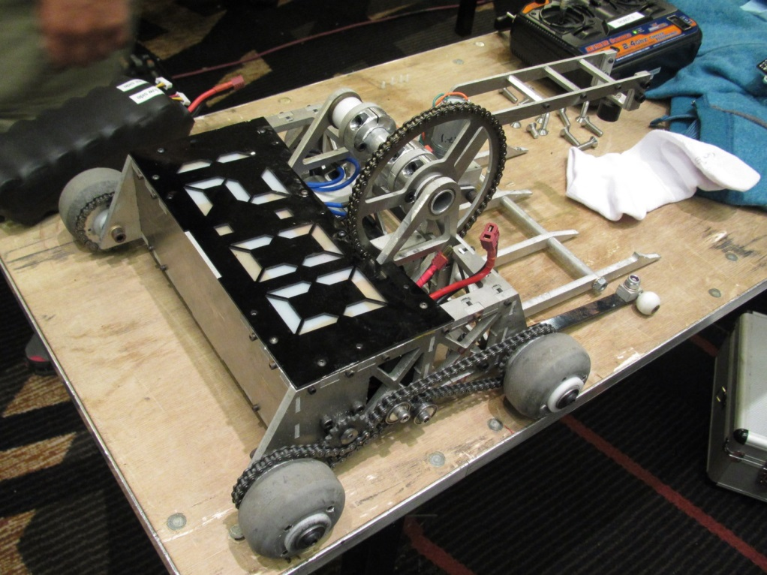
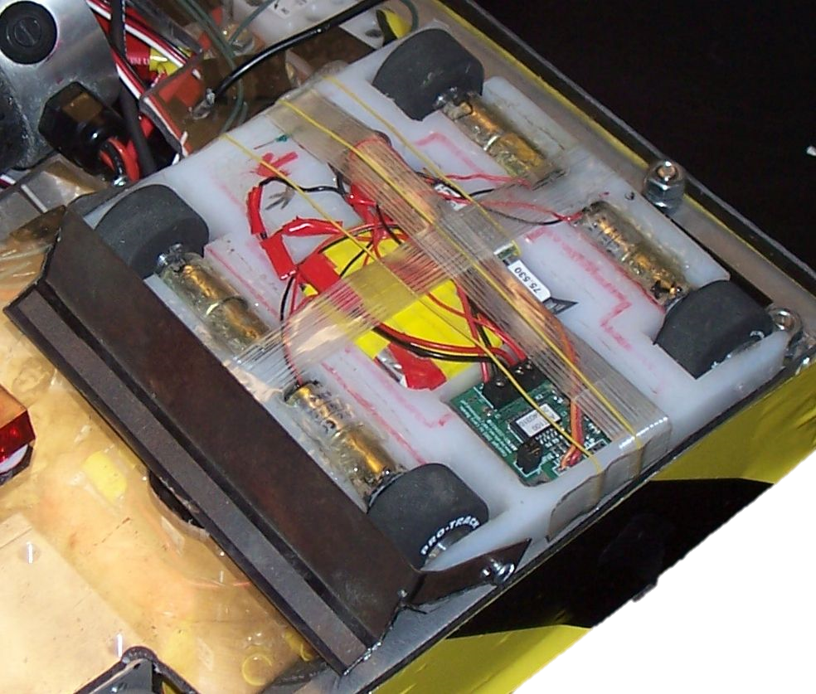
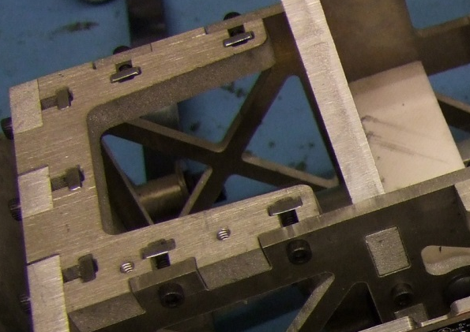
Basics – Chassis
Welded
Nutstrip/Slot & Tab
Tapped Plates
3D Printed
T-Nut
Unibody

Slide 10
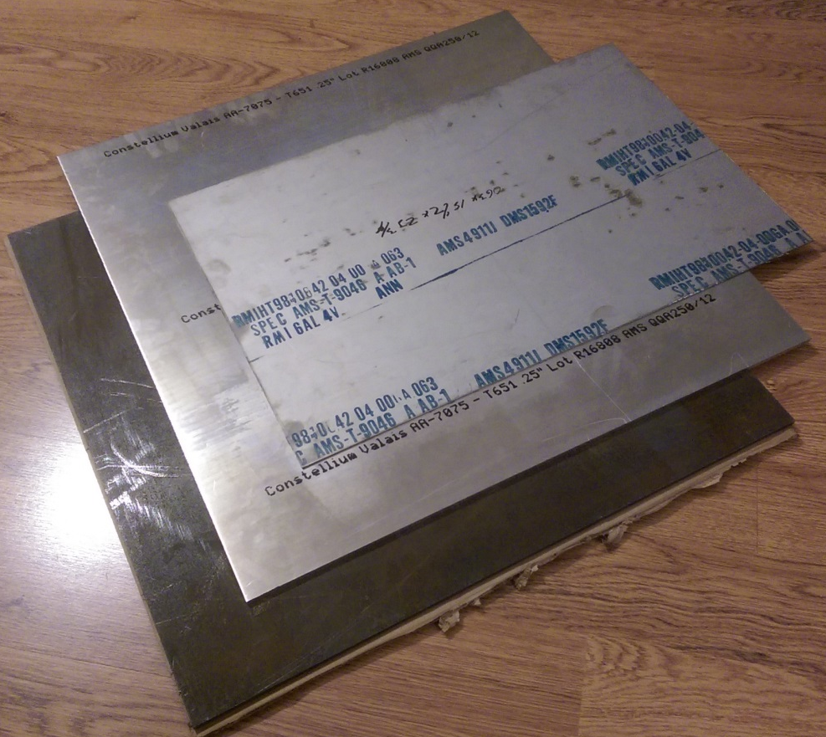
Basics – Materials
Metals
Plastics
Woods
Composites
Vendors
  McMaster-Carr
  Online Metals
  Metal Supermarkets
  ePlastics
  FibreGlast
  Ebay
  DragonPlate

Slide 11
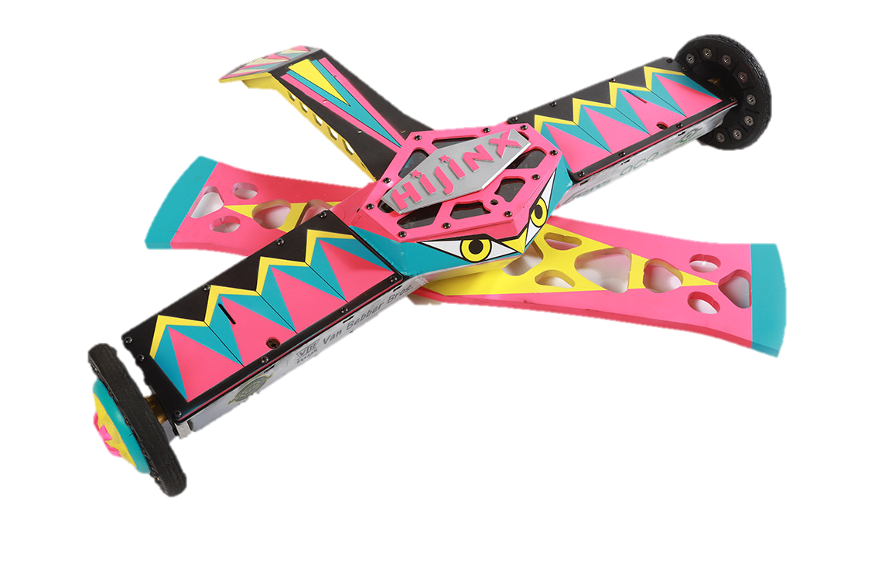
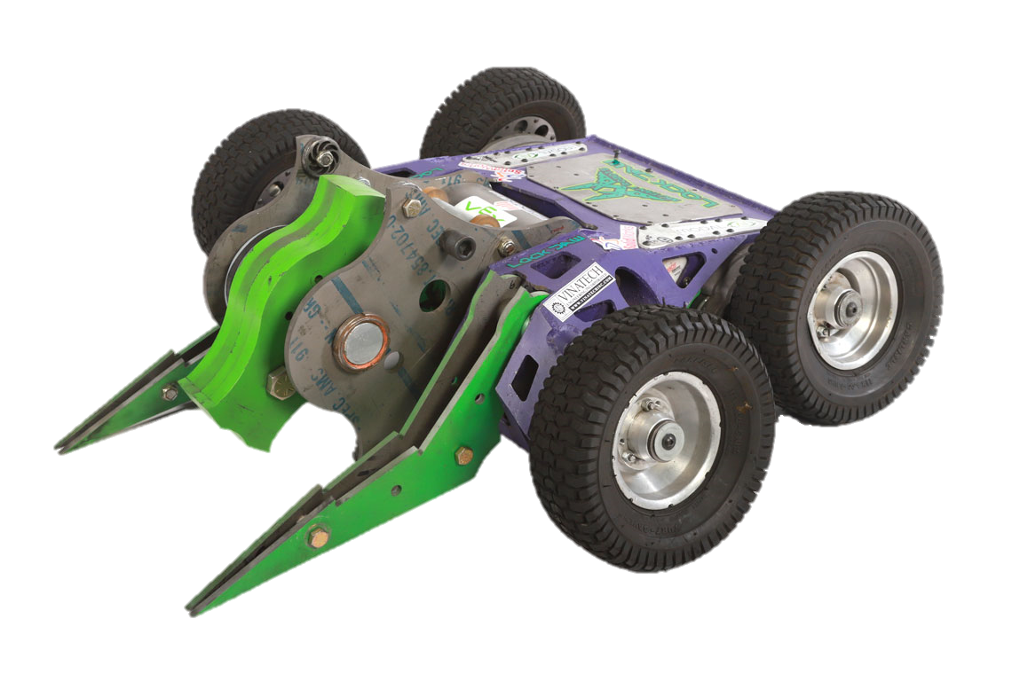
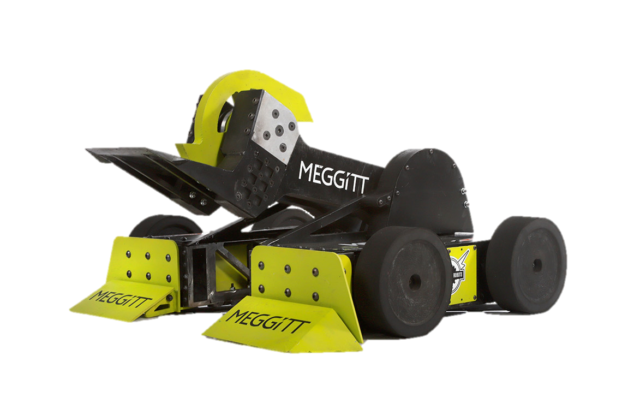
Basics – Materials
Metals
  Steel
    4130
    AR*00
    S7
    Other
  Aluminum
    6061
    7075
    Other
  Titanium
    6al4v (Grade 5)
  Magnesium
    AZ31B

Slide 12
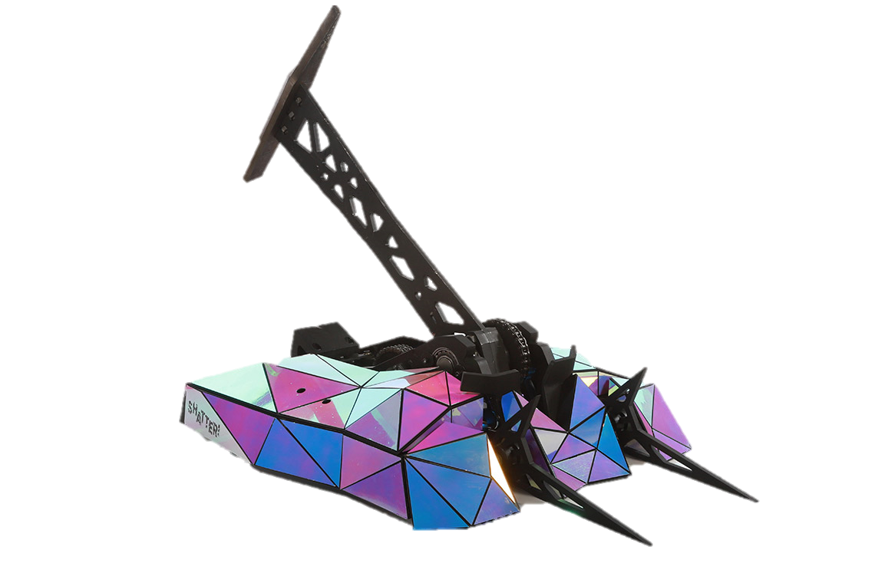
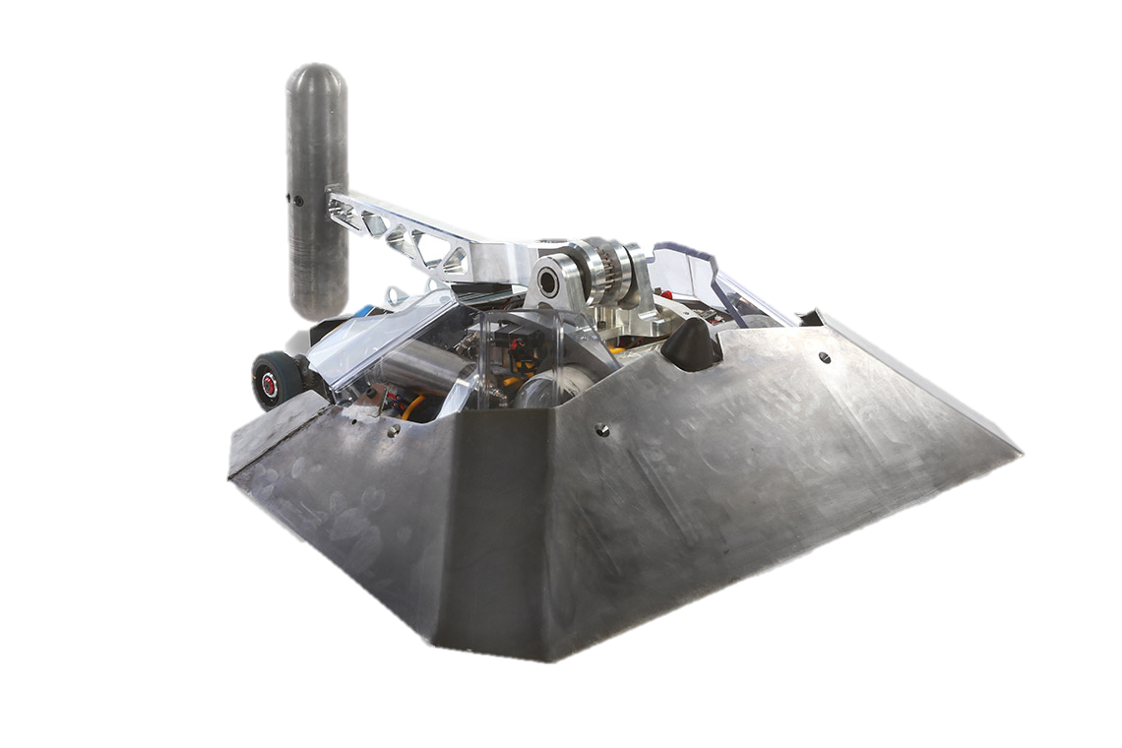
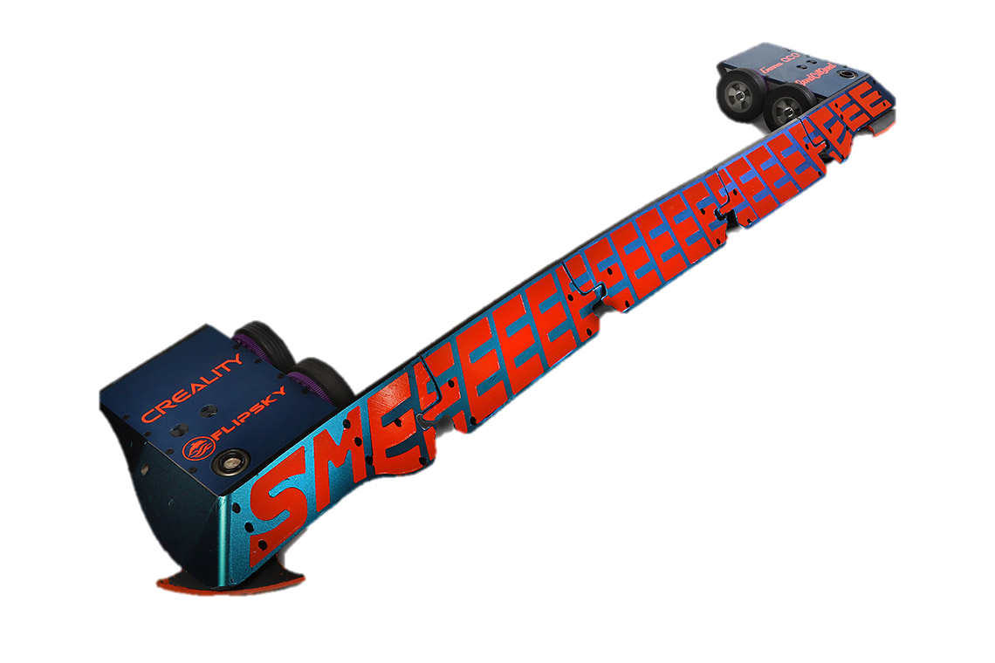
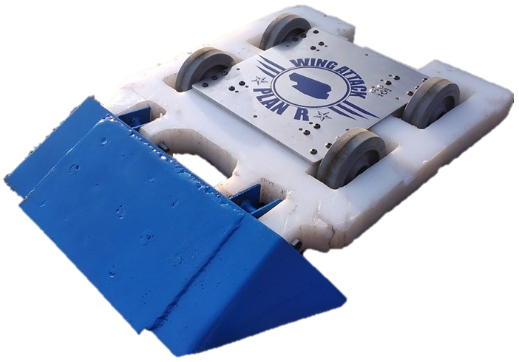
Basics – Materials
Plastics
  UHMW-PE
  HDPE
  Polycarbonate
  Nylon
  Acetal/Delrin
  PTFE/Teflon

Slide 13
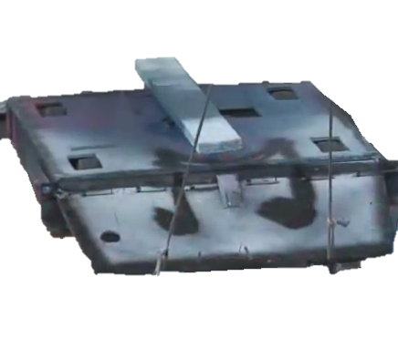
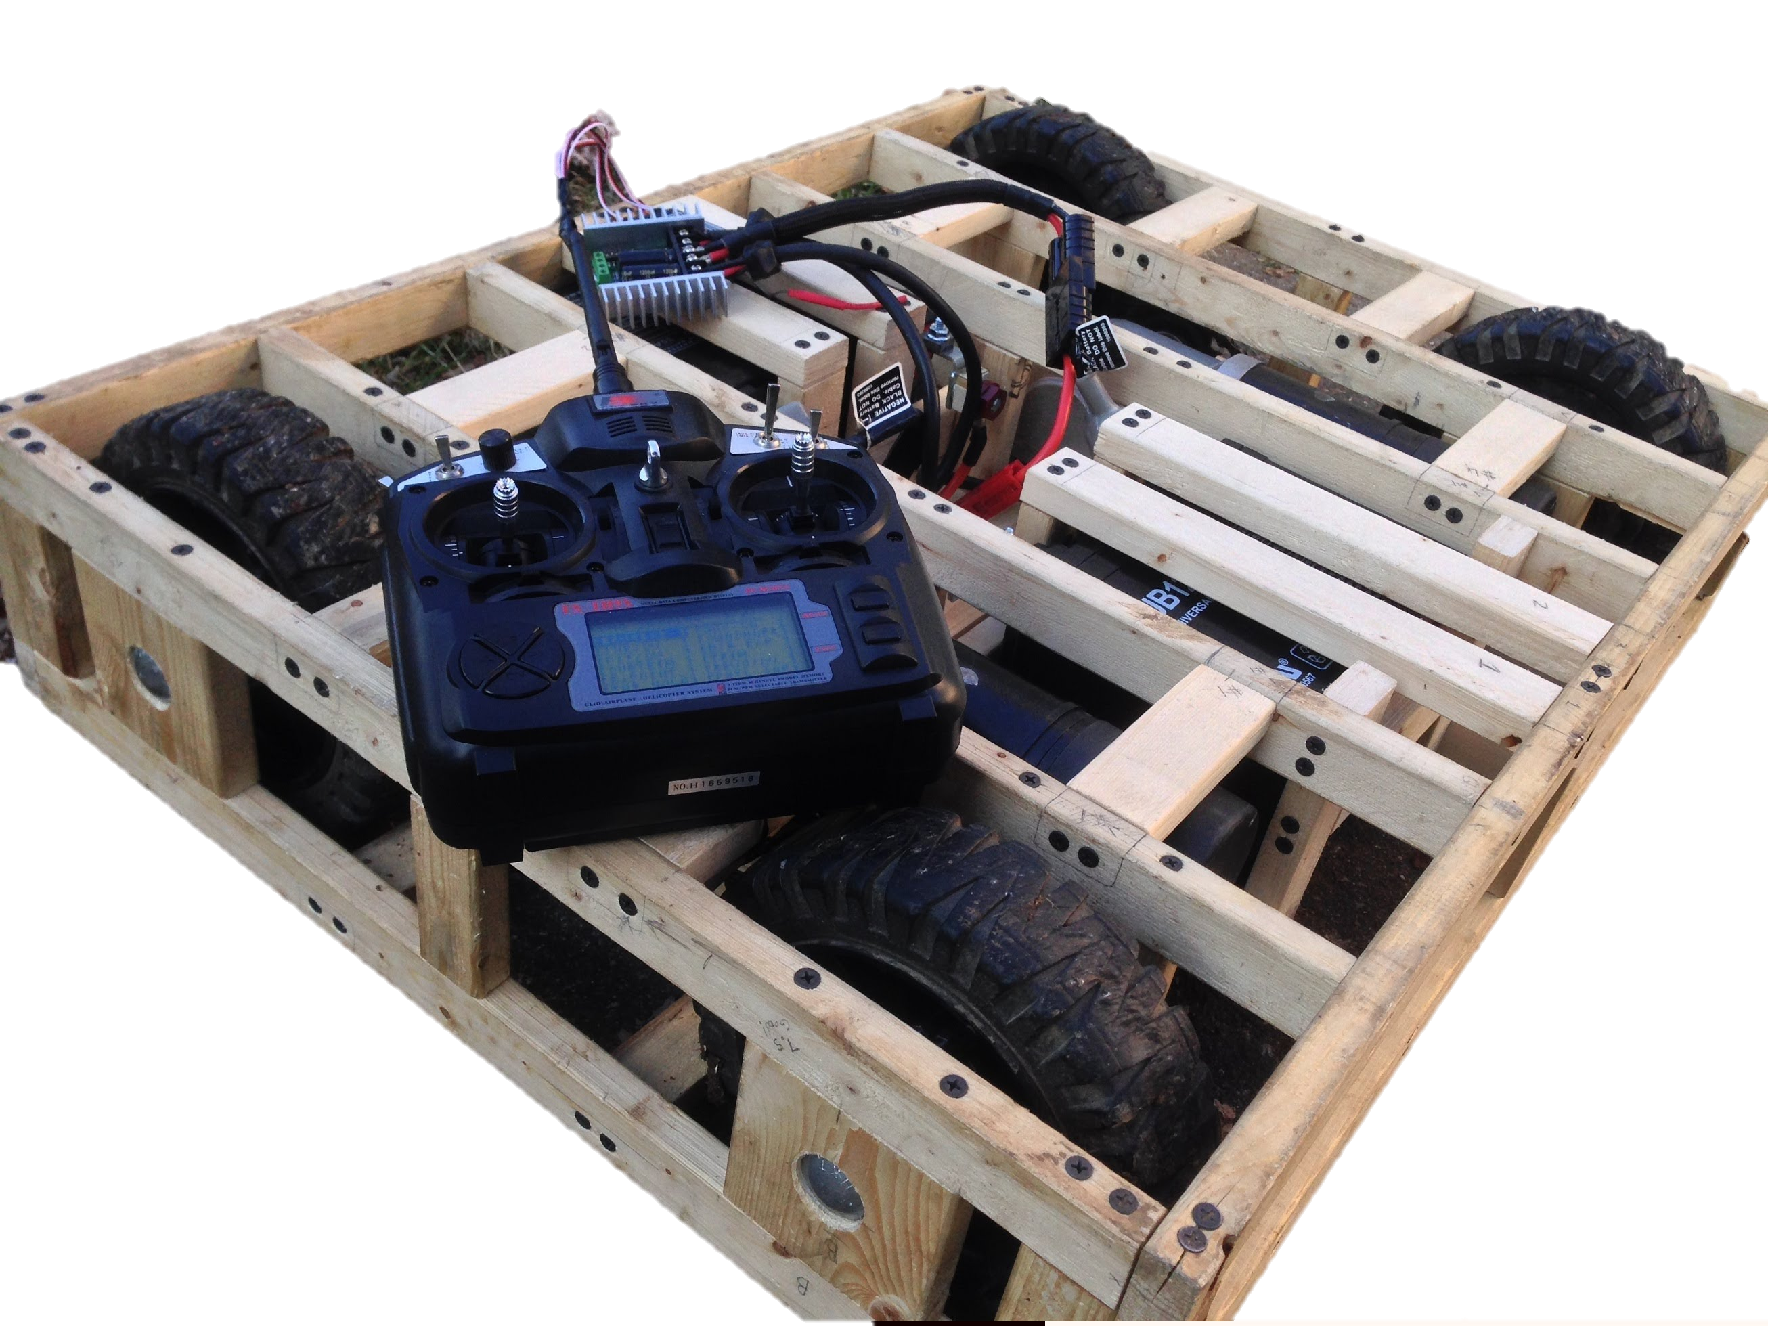
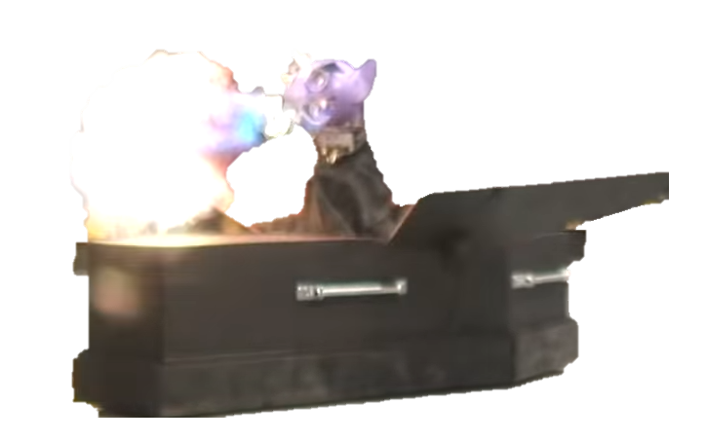
Basics – Materials
Woods
  Baltic Birch Plywood
  Lumber

Slide 14
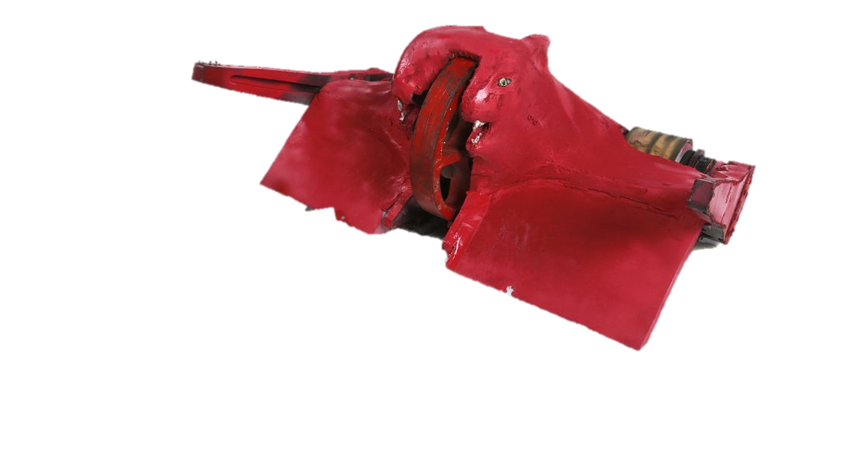
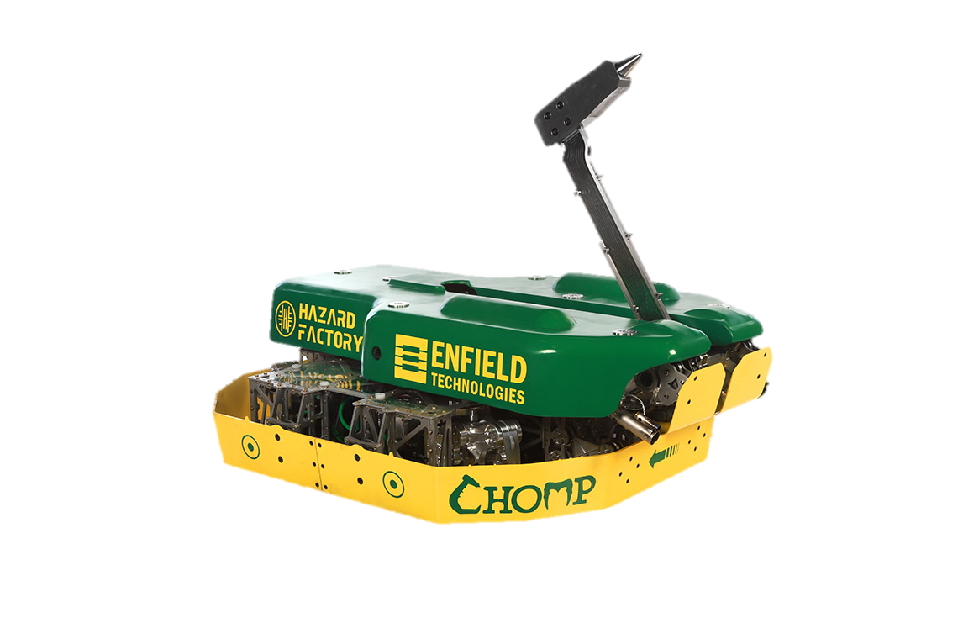
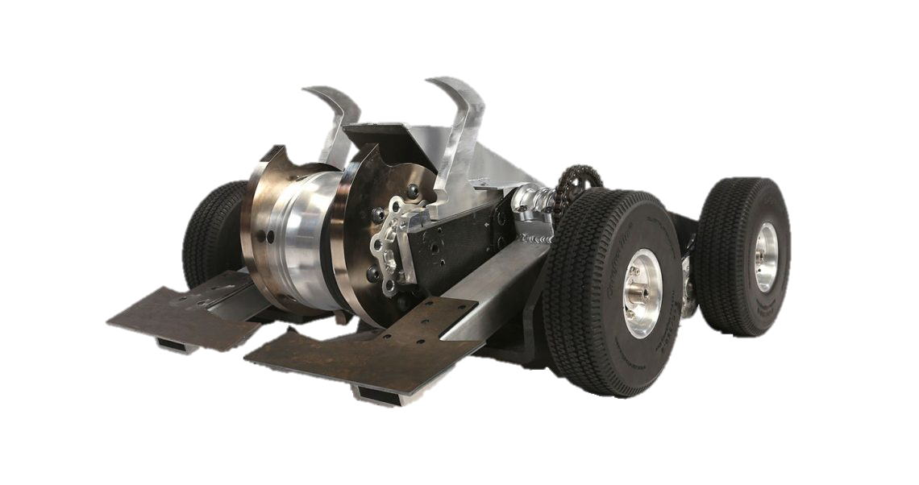
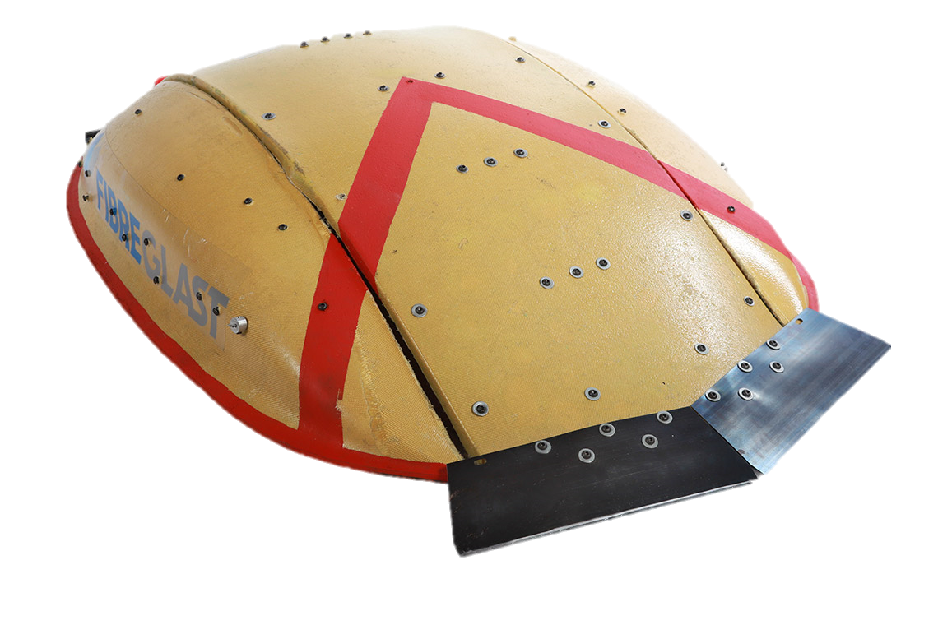
Basics – Materials
Composites
  Fiberglass
  Carbon Fiber
  Kevlar
  Garolite
  Hybrid

Slide 15
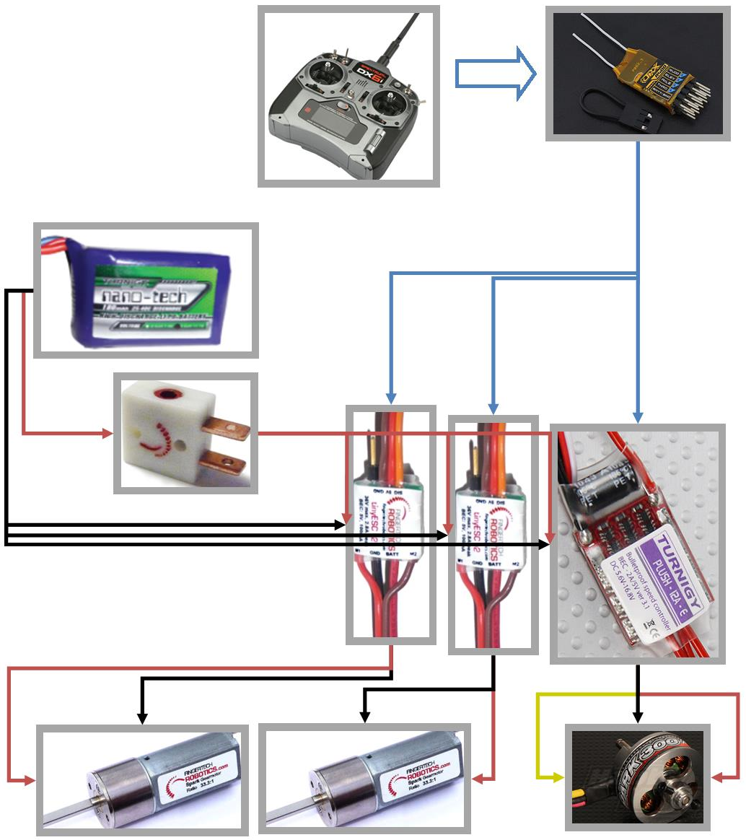
Basics – Wiring
Signal
  TX to RX (wireless)
  RX to ESCs
Power
  Battery to Switch/Link
  Switch/Link to ESCs
  ESCs to Motors

Slide 16
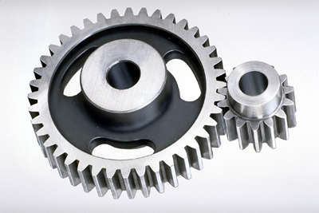
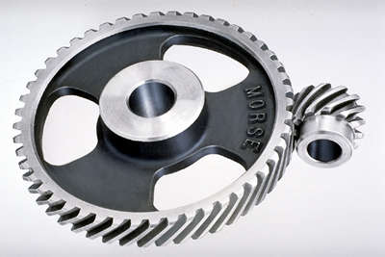
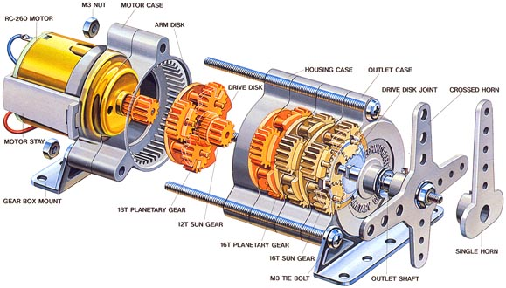
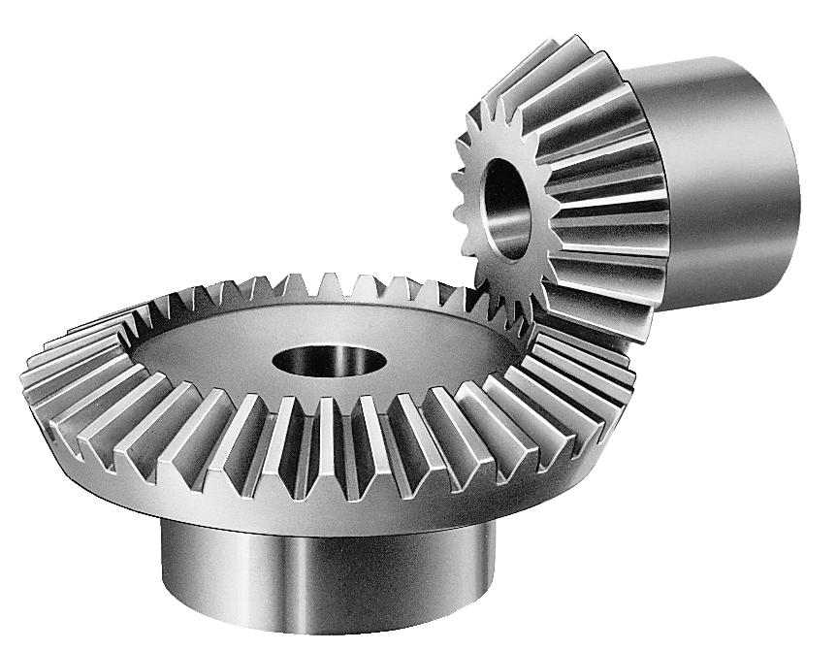
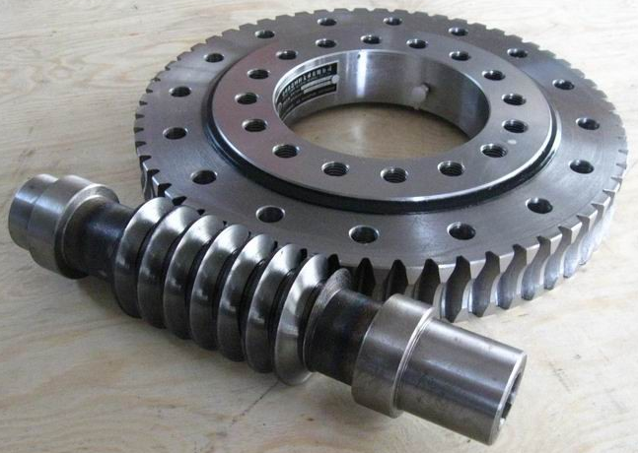
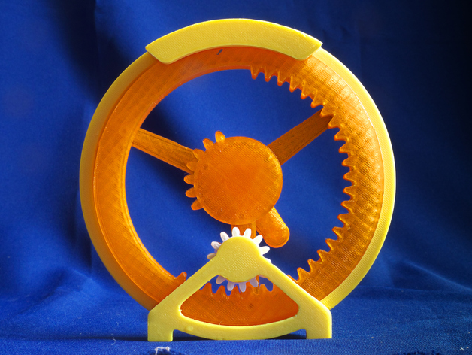
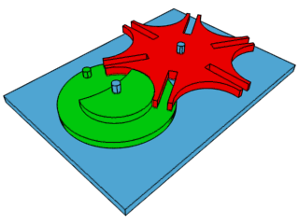
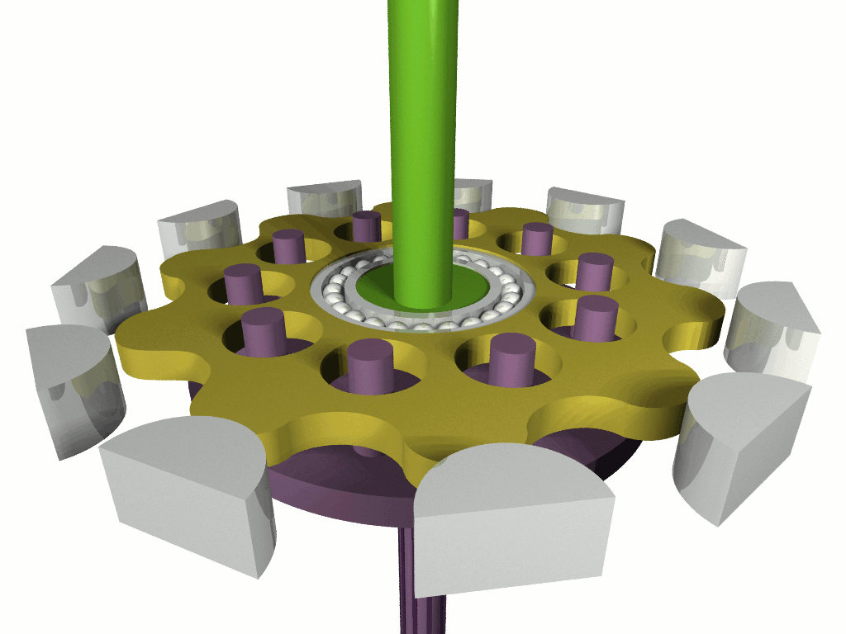
Basics – Power Transmission
Gears

Slide 17
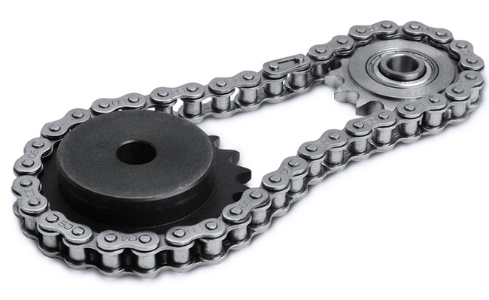
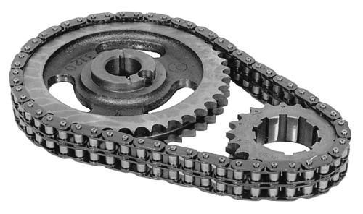
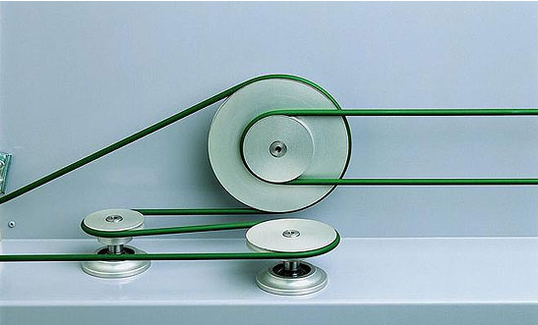
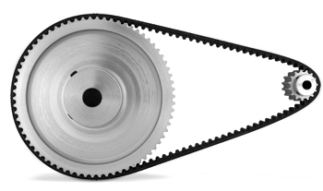
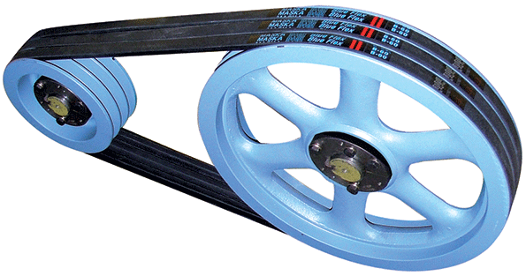
Basics – Power Transmission
Chains and Belts

Slide 18
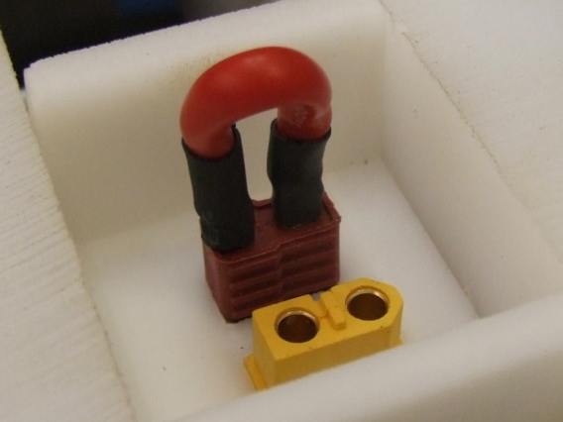
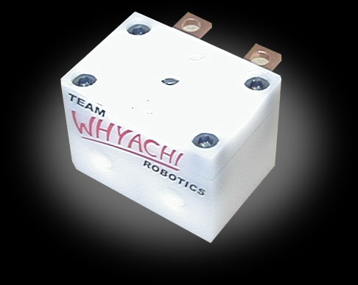
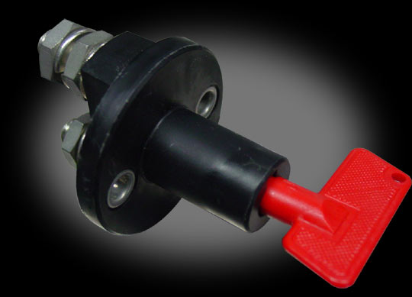
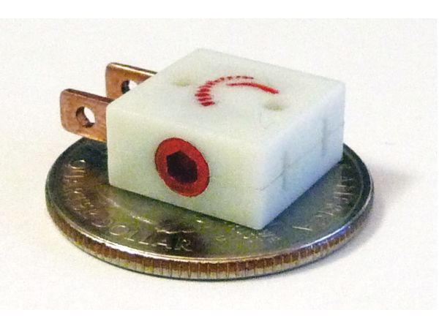
Parts Selection and Resources
Electrical Components - Kill Switches/Links
Switch Vs. Removable Link
Vendors
  Fingertech Robotics
  Robot Marketplace
  Team Whyachi

Slide 19
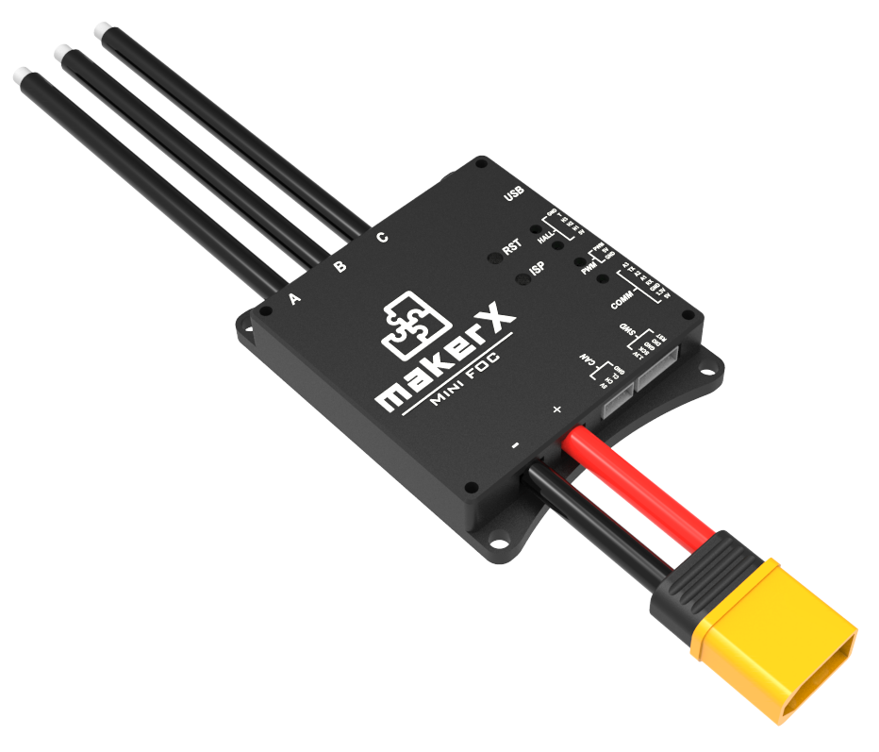
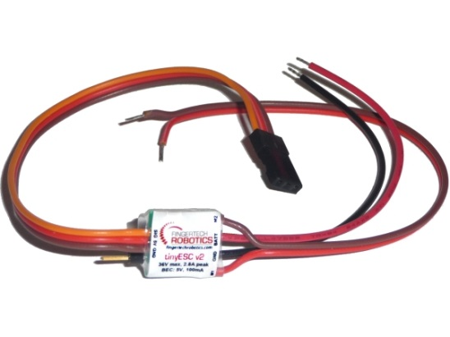
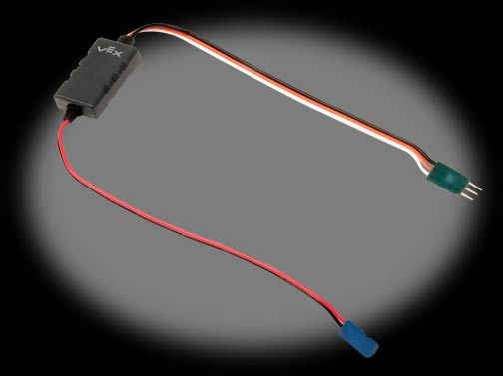
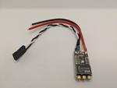
Parts Selection and Resources
Electrical Components – Motor Controllers
Vendors
  Fingertech Robotics – TinyESC
  Robot Marketplace – Wide range of products
  HobbyKing – Budget brushless escs
  Rectified Robotics – Bi-directional brushless esc (insect scale)
  VESC – Large scale brushless esc, wide range of vendors

Slide 20
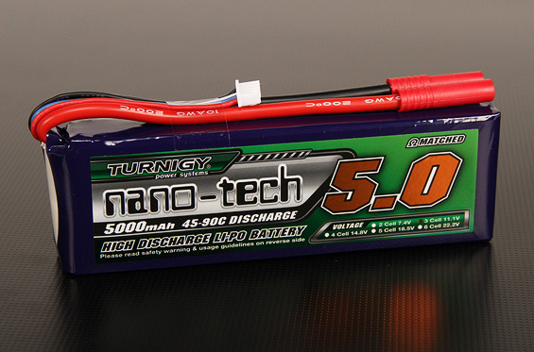
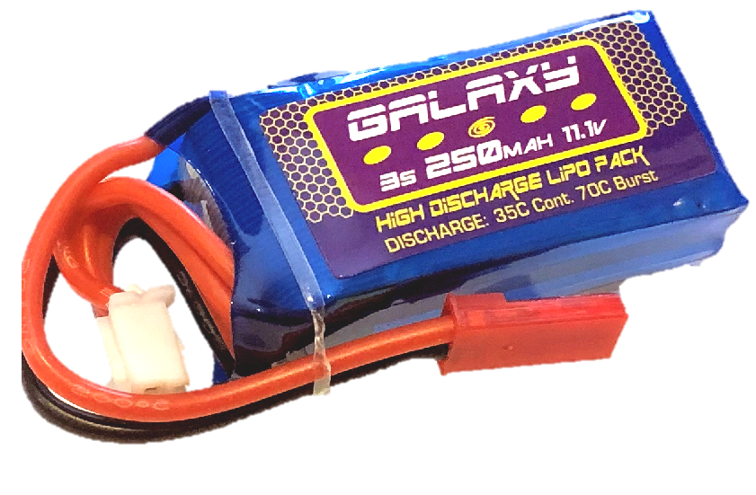
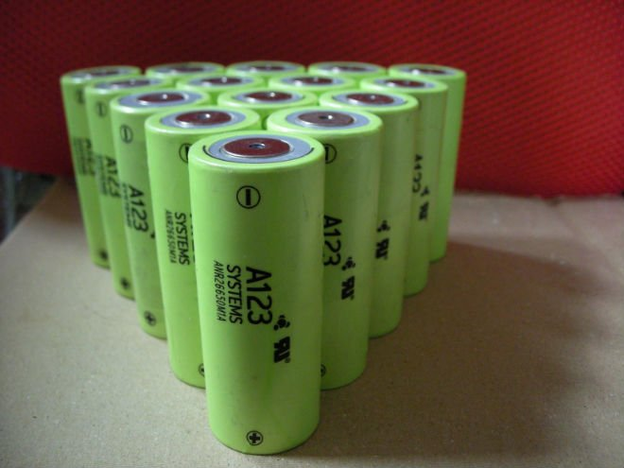
Parts Selection and Resources
Electrical Components – Batteries
Chemistries
  LiPo
  LiFe
  NiMh
  SLA
Vendors
  Hobbyking
  Robot Marketplace
  Fingertech Robotics

Slide 21
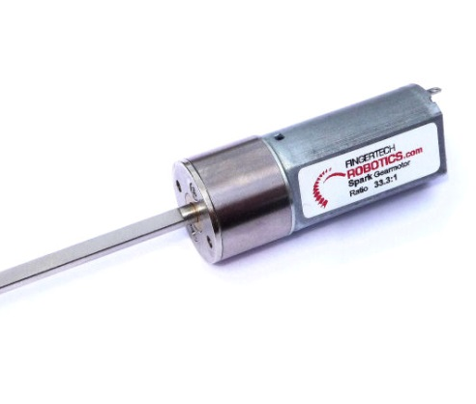




Parts Selection and Resources
Mechanical Components – Motors/Gearboxes
Fingertech Robotics – Spark gearmotor
KitBots – 1000rpm gearmotor
BotKits – 22mm gearmotor
AndyMark – Range of products
RobotMarketplace – Range of products
HobbyKing – Budget brushless motors
Rectified Robotics – Brushless gearmotor

Slide 22



Parts Selection and Resources
Mechanical Components – Servos & Actuators
ServoCity – Huge range of servos, some actuators
HobbyKing – Budget servos
SurplusCenter – Surplus actuators and more
ActuatorZone – Wide range of actuators

Slide 23









Parts Selection and Resources
Mechanical Components – Wheels
Casters
  Colsons
Foam
  Lite Flite
  Snap Wheels
Silicone
  Sumo
Air Filled
  ATVs
  Tractors
  Go-Karts

Slide 24
Parts Selection and Resources
Preferred Vendors
Xometry - https://www.xometry.com/
Fingertech Robotics - https://www.fingertechrobotics.com/
BaneBots - http://banebots.com/
Robot Marketplace - https://www.robotmarketplace.com/
Team Whyachi - http://teamwhyachi.com/
Hobbyking - https://hobbyking.com/
Rectified Robotics - https://rectifiedrobotics.com/
Andymark - https://www.andymark.com/
Kitbots - https://kitbots.com/
Botkits - https://www.botkits.com/
Servo City - https://www.servocity.com/
McMaster-Carr - https://www.mcmaster.com/
Pololu - https://www.pololu.com/
BotBitz - https://botbitz.com.au/

Slide 25



Design Resources
CAD Software
  Solidworks
    https://www.solidworks.com/support/community-download (Maker License)
  Fusion 360
    https://www.autodesk.com/products/fusion-360/pricing
  OnShape
    https://www.onshape.com/en/

Slide 26




Fabrication Resources
Maker Friendly Shops
  Xometry (Almost Everything)
    https://www.xometry.com/
  Team Whyachi (CNC machining)
    http://teamwhyachi.com/
  SendCutSend, Coremark & OshCut (Laser Cutting)
    https://sendcutsend.com/
    https://www.coremarkmetals.com/
    https://www.oshcut.com/
  Shapeways (3D Printing)
    https://www.shapeways.com/

Slide 27


Information Resources
SPARC Getting Started Guide
  http://sparc.tools/?p=131
RioBotz Combat Robot Tutorial
  https://www.amazon.com/RioBotz-Combat-Tutorial-Antonio-Meggiolaro/dp/1448697050 (Paperback)
  http://meggi.usuarios.rdc.puc-rio.br/docs/riobotz_combot_tutorial.pdf (PDF)

Slide 28






Open Questions

