Slide 1

Design For Fabrication
Julie Simancek & Mike Jeffries
Slides available for download at
NearChaos.net/DC

Slide 2
Who are we?
Julie Simancek
Professional
  BFA and MFA in Jewelry & Metalsmithing: Grand Valley State University/ Edinboro University of Pennsylvania
  Big Blue Saw-Ops and Special Projects
  SendCutSend-Technical Support Specialist
Robot Combat
  Chaos Corps team BattleBots season 2 and 3
  Sponsorship team for BBS
  Competing in robot combat since 2010
General Maker Topics
  Amatuer blacksmith
  Bench Jeweler
  Printmaker
  Fibers and Stitching
  Sculpting and Casting
Mike Jeffries
Professional
  Research Engineer for Georgia Tech Research Institute
  BS in Mechanical Engineering Technology, MS in Systems Engineering
Robot Combat
  Chaos Corps team captain BattleBots season 2 and 3
  BattleBots Match Steward - WCVII
  Competing in robot combat events since 2004
General Maker Topics
  Amatuer blacksmith
  Acceptable welder
  General metalworking

Slide 3
Topics
The What, Why, and How of Design for Fabrication
Design for Common Home Workshop Tools
  Simple Tools
  Advanced Tools
Design for COTS (Commercial Off-The-Shelf) Alteration
Design for Outsourcing
  Outsourcing Tips
  2D manufacturing
    Tabs & Slots
    Gears
  3D manufacturing
Real World Examples
  Combat Robot Parts
  Printed Rings
  Citrus Knife
  Hammer
Q&A

Slide 4
What is Design For Fabrication?
Everyone has different skills and resources
  Nobody can do everything.
Design for your personal toolbox
  Love your angle grinder? Use it where it makes sense.
  Hate woodworking? Consider metal.
Understand your limits and work around them
Outsourcing isn’t a dirty word
  Almost everything involves some level of outsourcing.
  Services exist for almost every process.

Slide 5
Why Design For Fabrication?
Save Time
  Balancing what you’re comfortable doing yourself with outsourcing the things you can’t/don’t want to do gets it done faster.
  Outsourcing some parts to a service allows you to focus your time on your strengths and make larger overall projects.
Save Money
  When the plan accounts for the tools, skills, and resources you have you’re less likely to need to re-buy materials.
  Buying multiples can get you quantity discounts.
Save Energy
  Trying to force something to work when it’s not designed for what you’ve got can lead to burn out.
Save Sanity
  Going into a project with a reality based plan works.
  Avoid the tasks you can’t stand doing. That’s what friends or outsourcing is for.

Slide 6
How Do You Design For Fabrication?
What’s in your toolbox?
  Literal tools, metaphorical tools
What’s your timeline?
  You’ve got a goal, what do you have time for?
  What parts do you have to do yourself?
  Have you built in tolerance in terms of time for mistakes or time for shipping parts to you?
Design for the tools you have
  Tolerances
  Materials
  Speed

Slide 7
Design for Common Home Workshop Tools - Simple
Manual Tools
  Fabrication tolerance: How steady is your hand?
  Material options: Easy to work materials or long lead times.
  Files are your friend.
  You can always remove more material.
  The more simple the tool is, the more skill it takes to wield. But once mastered, has more range than specialty power tools.
Handheld Power Tools
  Fabrication tolerance: Inversely proportional to speed.
  Material options: Wider material range at a reasonable pace.
  If you want to work metal, learn to love the angle grinder.
  Take advantage of jigs, guides, and fixtures.

Slide 8
Design for Common Home Workshop Tools - Advanced
Hobby Grade 3D Printer
  PLA, TPU, Nylon, and other plastics
  Can get good accuracy
  High shape complexity possible
  Layers limit strength
Drill Press
  Secure your parts
  Holes as accurate as your marking/workholding
  Drilling templates can help
Soldering Irons
  Able to pack things in tighter than crimped connections
  Don’t overheat your components
    Or your fingers
Lathes & Mills
  Can get very good accuracy
  Long learning curve
  Can be expensive and more of a commitment
Welders
  Functional welds are easy, good welds take practice
  Complex shapes in metal become practical
  Stick, MIG, and TIG all have their own strengths
Torches, Kilns, and Forges
  Heat opens up a lot of material shaping options
  Anneal, harden, and/or temper your metals
  Apply specialized finishes
  Require special safety measures for your shop

Slide 9
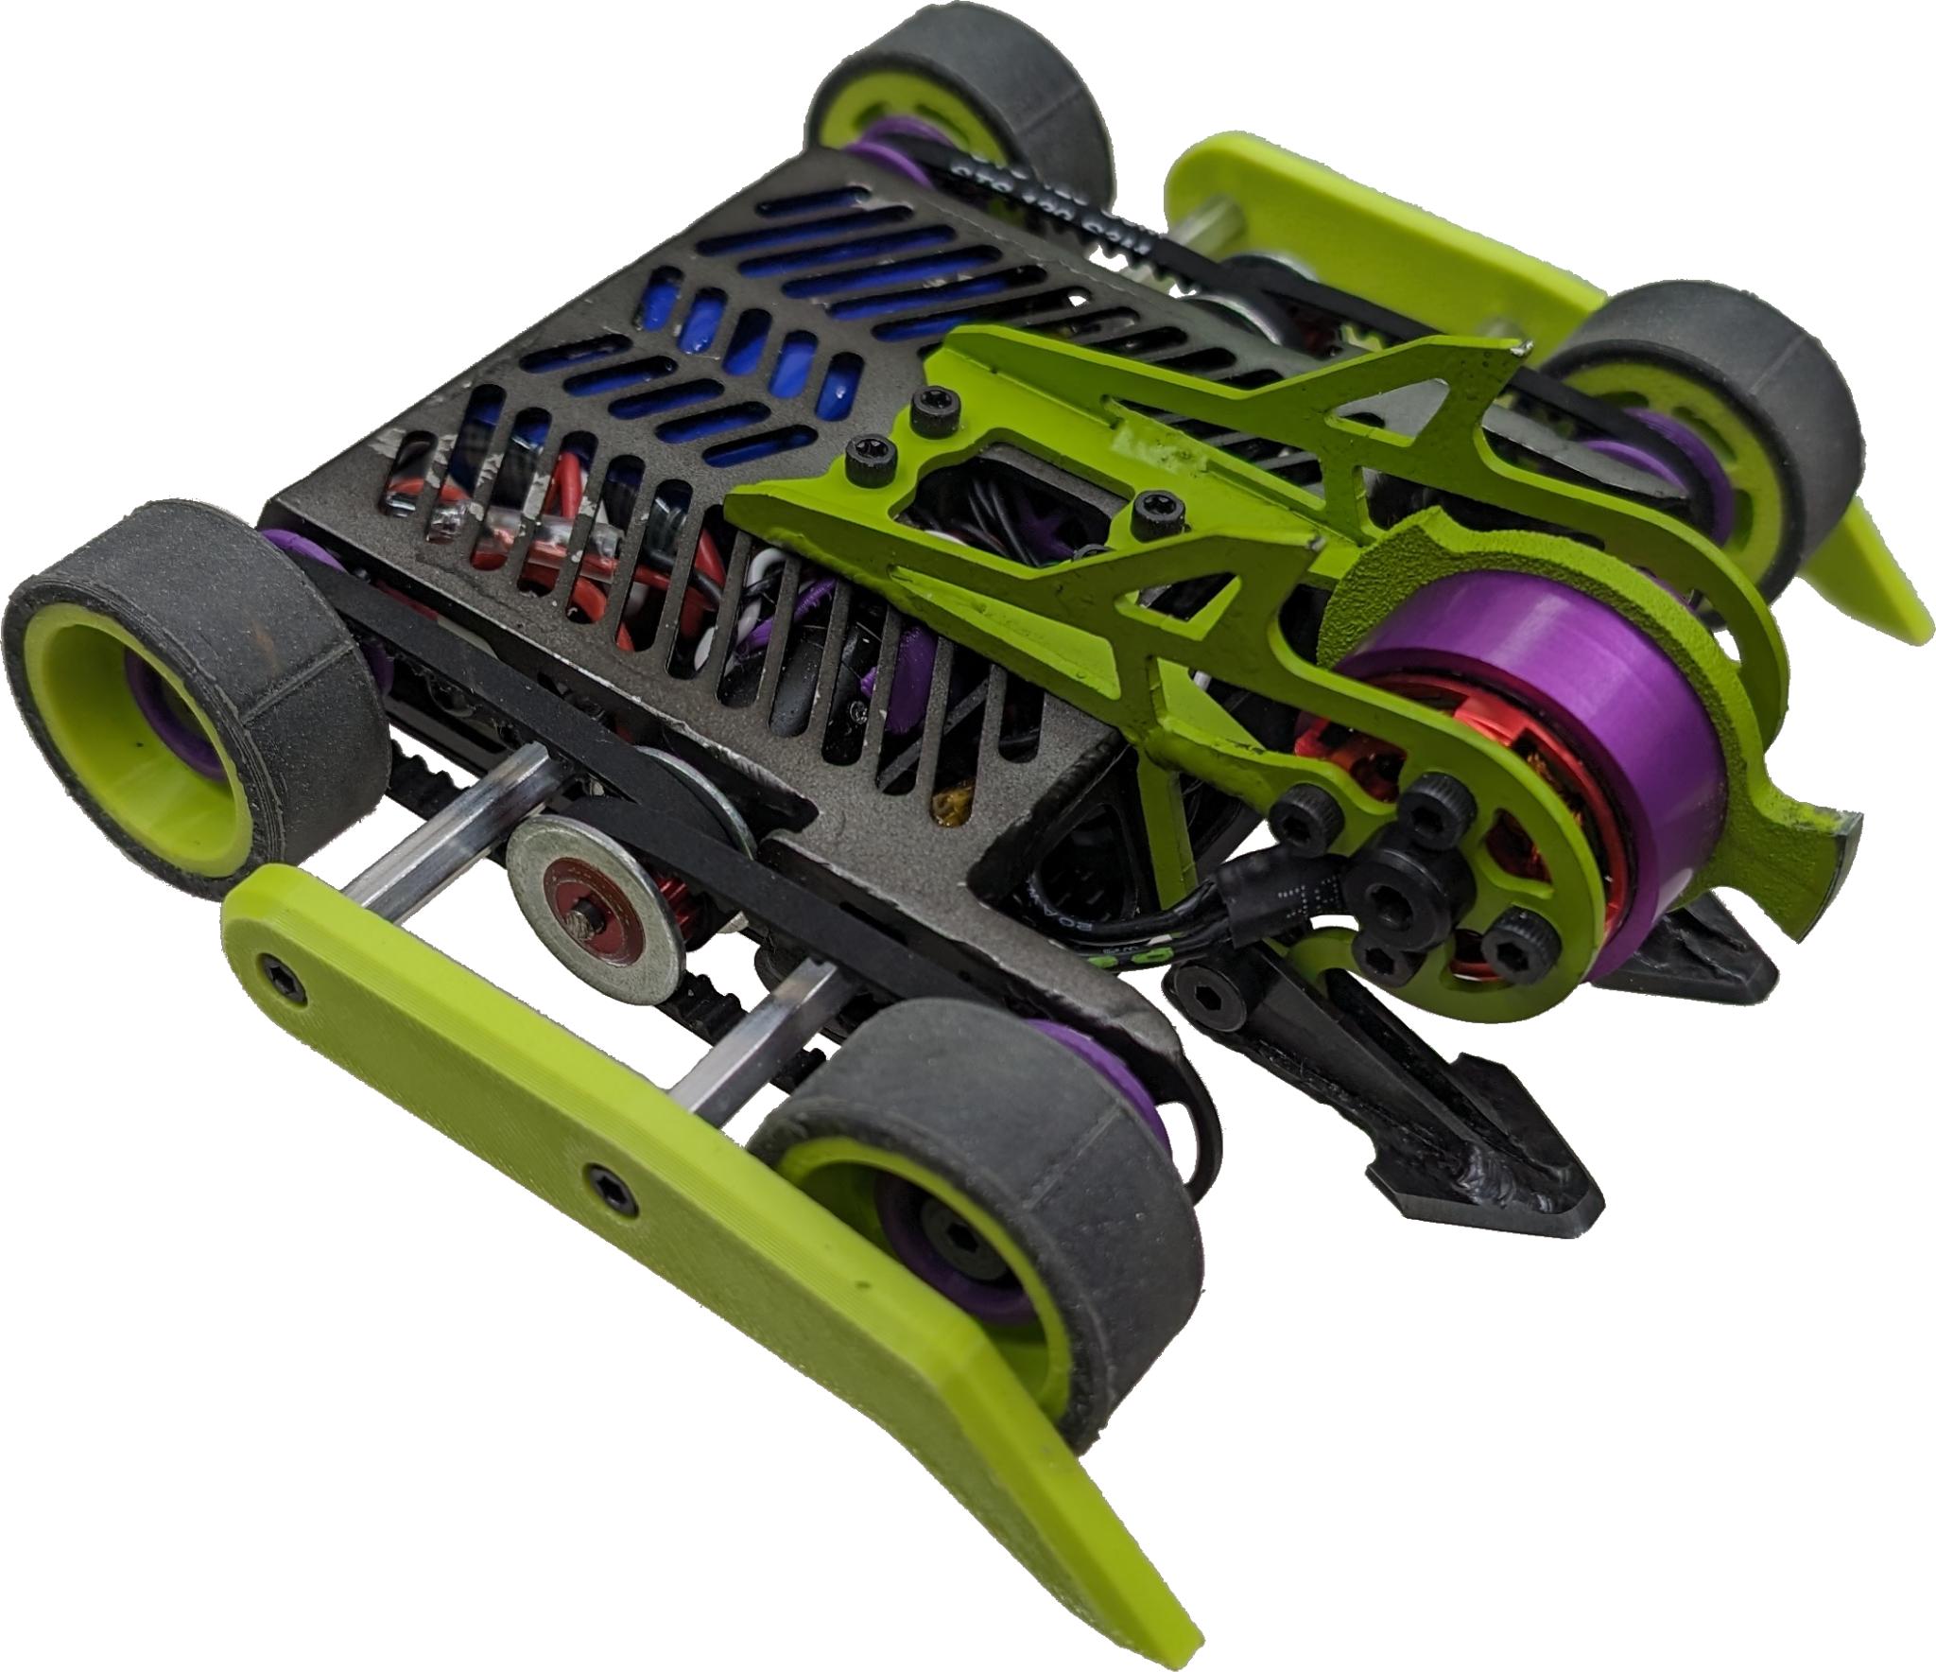
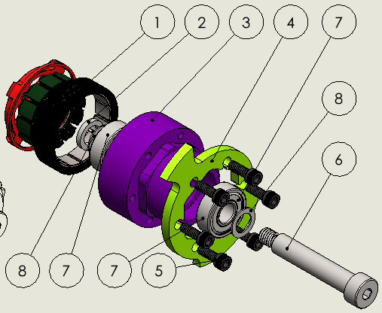
Design for COTS Alteration
COTS?
  Commercial Off The Shelf
It may not be the right thing, but it might be a good starting point
  Take advantage of the features, function, and tolerancing built into the base part.
  Reduce fabrication variables.
  Minimizes custom part count.
Adaptors are your friend
  Two wrong things can make the right thing.

Slide 10



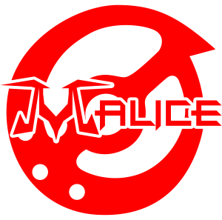
Design for Outsourcing
Identify your parts
  Figure out what you can’t do in-house.
  Break that down into parts that are small enough that you can likely get that part delivered with minimal hand finishing required for integration.
Identify your process
  Could the part be done through different processes?
    What changes are needed from process to process?
  Update your designs to suit your chosen method.
    Each process has its own strengths and limitations.
Identify your vendor
  Different vendors will have areas they’re strong/weak even within a category.
  Where do you want your parts made?
  Does that service publish their guidelines so you can plan for the limitations of their services?
  Cost, material options, tolerances, lead time, and post processing should all be considered.
Order long lead time parts first
  Lock down the long lead part designs, use the short lead parts for last minute changes.
Example vendors
  SendCutSend - US based laser cutting, waterjet cutting, CNC milling, bending, hardware installation and finishing.
  PCBWay - China based PCBs, machining, molding, printing and more.
  P3D Creations - US based milling, turning, finishing, etc.
  Team Malice - Yes, the BattleBots team. 3D Printing and CNC Routing mainly. COTS parts and part kits focused on combat robots.

Slide 11
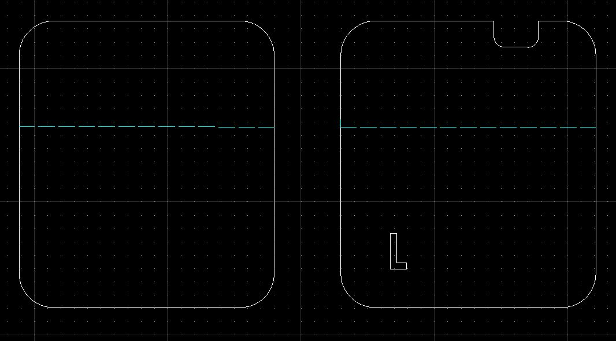
Visual Orientation Cues for Bending
Tabs and profiled slots that visually orient the part make it easier for the person bending your part to get it in the right orientation every time.
This plate is also asymmetric, but the notch and the cutout L make orientation a lot easier to eyeball.
This plate has an asymmetric bend placement and no indication for orientation.

Slide 12
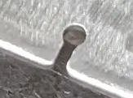
How to save money using a service.
The most expensive part of your parts is going to be time, not the material.
  Time spent cutting the parts outweighs the cost of the material unless you are cutting precious metals like silver and gold. So plan for fast.
Keep your file size as small as possible and remove anything extraneous.
  No empty layers, blocks, and minimize nodes/endpoints whenever possible.
No large nests of parts. If you need 25 pcs, upload one profile and do qty 25 in the cart.
  Large nests or nests with parts all bridged together force the machine to slow down, so the quoting software is going to crank up the price on files that have these.
  Large nests = large files which increases the likelihood of errors, incorrect cutting, and missing parts.
Piercing the sheet takes time. If you have a hole really close to the edge, make a slot between the two instead.
  The .032” between the edge of the part and the hole isn’t going to have much holding power. Putting a .045” slot between the hole edge and the part edge won’t really change the screws holding power, but it will cut faster by removing a pierce point.

Slide 13


Picking a material and hardware.
Going with a stock material in a common thickness makes it easier to get in on the next nest for cutting.
Know why you’re picking a specific grade of material
  Do you need 7075/2024? Will 5052 or 6061 get the job done?
  What environment are you putting the parts in?
  How strong does it really need to be?
Stacking parts for thickness and getting something common like all .125” 6061 AL parts in your order will likely have it shipping faster.
Using the same hardware throughout the assembly means you save on buying fasteners.
  Unless you collect little green boxes this is a good thing.
  Having an extra bolt for when one gets dinged or to modify for a tool purpose can save time during assembly.

Slide 14

Don’t cut screens, mesh, or lace.
The PCs running the fiber lasers, waterjets, and CO2 lasers out there aren’t gaming computers with tons of memory. If you can’t easily upload it to the company’s website, it is going to crash out the software before the machine starts cutting.
The punch presses that punch screens and mesh have specific tooling designed to keep the resulting sheet flat. Modern fiber lasers, waterjets, and CO2 lasers do not. So parts with lots of holes and material removed will start to bow and warp. Parts that warp intensely in the machine can get caught on the cutting head and get taken for a ride while being turned into metal spaghetti.
Make a frame and weld or fasten screen into it.
Same goes for fairy wings, labyrinths, wave guides, electrical traces, etc.
NO SCREENS!

Slide 15
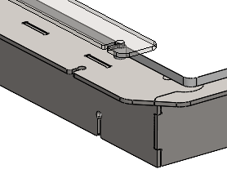
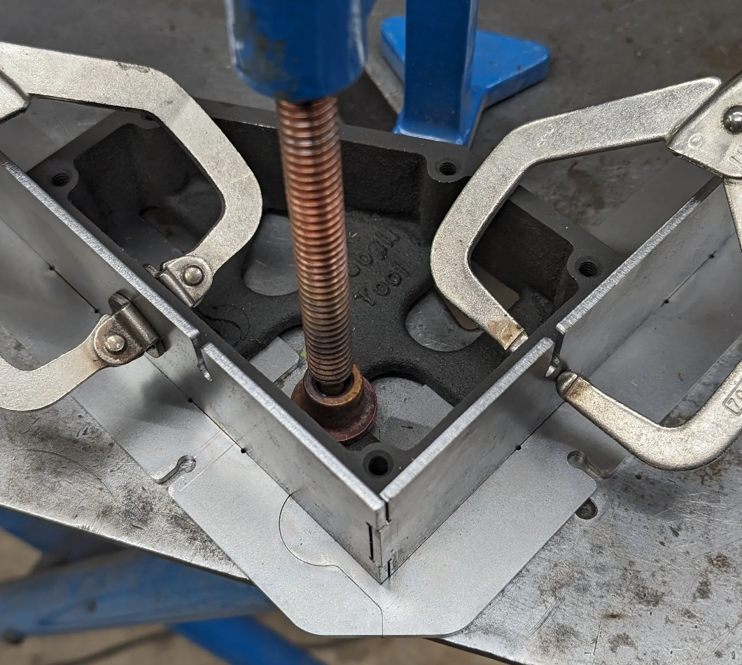
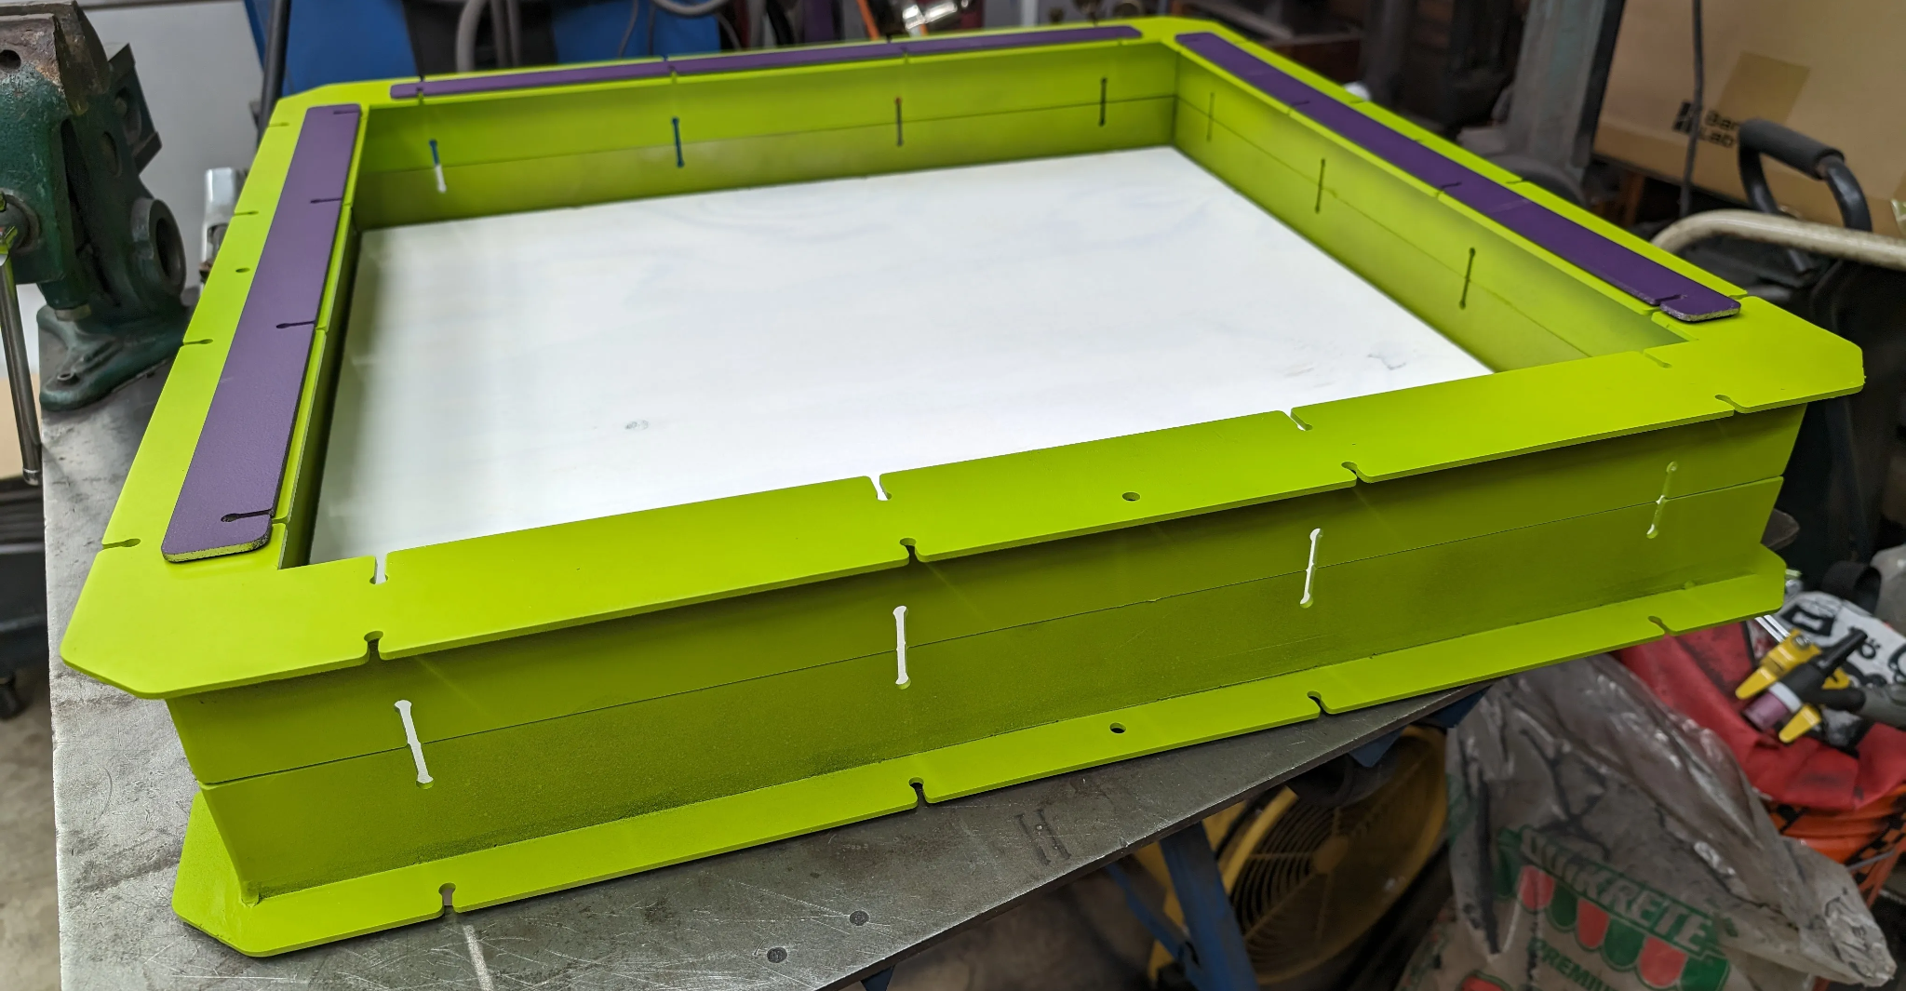
Tabs and Slots for easy welding
Why?
  Slots and tabs act as alignment features to help locate parts in space
  Can be done in a way to ensure parts won’t fit together incorrectly
How?
  Design around nominal sheet thickness for tab thickness
    The tighter you make the slot to this the more risk you’ll need to hand finish, but it’ll ensure a less sloppy fit
  Pick either the slot or tab for a standard dimension, then offset the other for your tolerance/clearances
  If you’re feeling fancy, you can add puzzle-like features to further aid in alignment and increase weld area length

Slide 16
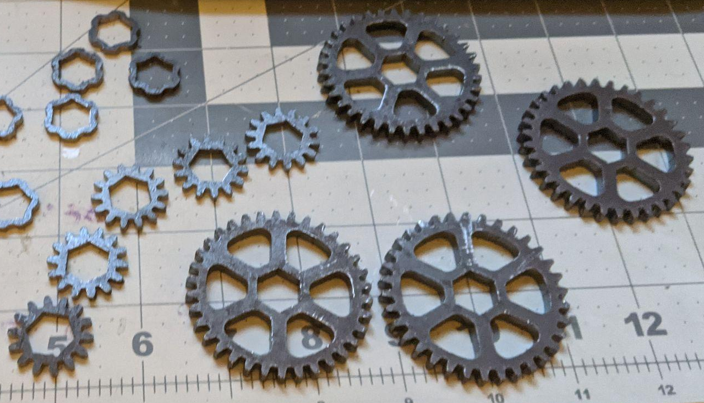
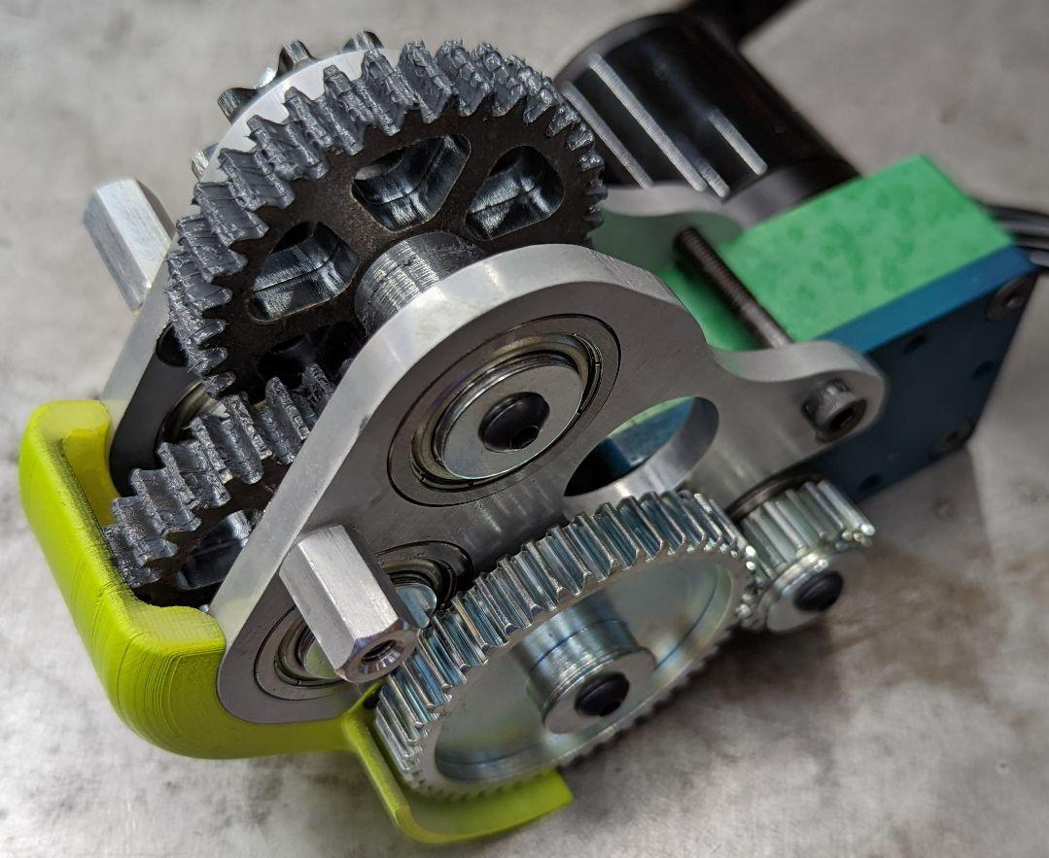
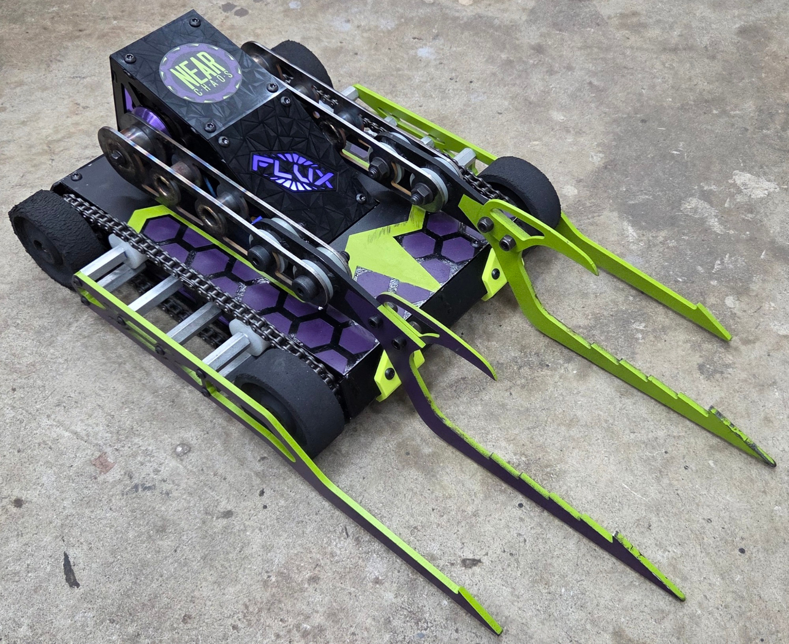
Need a Gear or small feature? Stacked Parts in thinner material.
Benefits
  Reduces impact of taper
  Allows small features to be accurate
  Reduced heat-affected zone (HAZ)
  Less cleanup
Tips
  Include keying/alignment features
  Integrate weight reduction in 2d profile
  Use the largest viable pitch
  Use different thicknesses for mating gears
    This offset helps ensure load is transferred evenly
  Use pre-hardened materials
In depth write-up at https://nearchaos.net/2022/02/2d-profile-gearmaking/

Slide 17
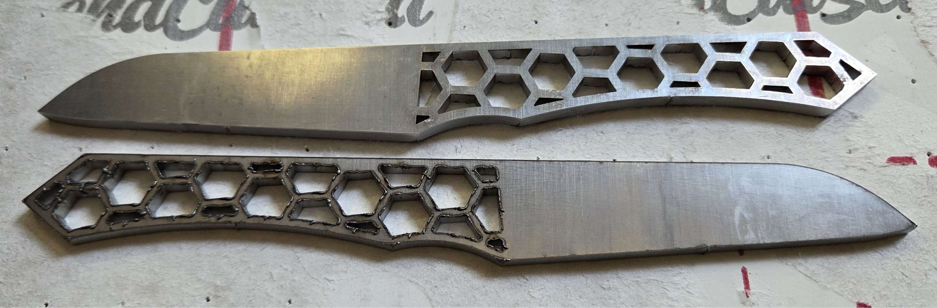
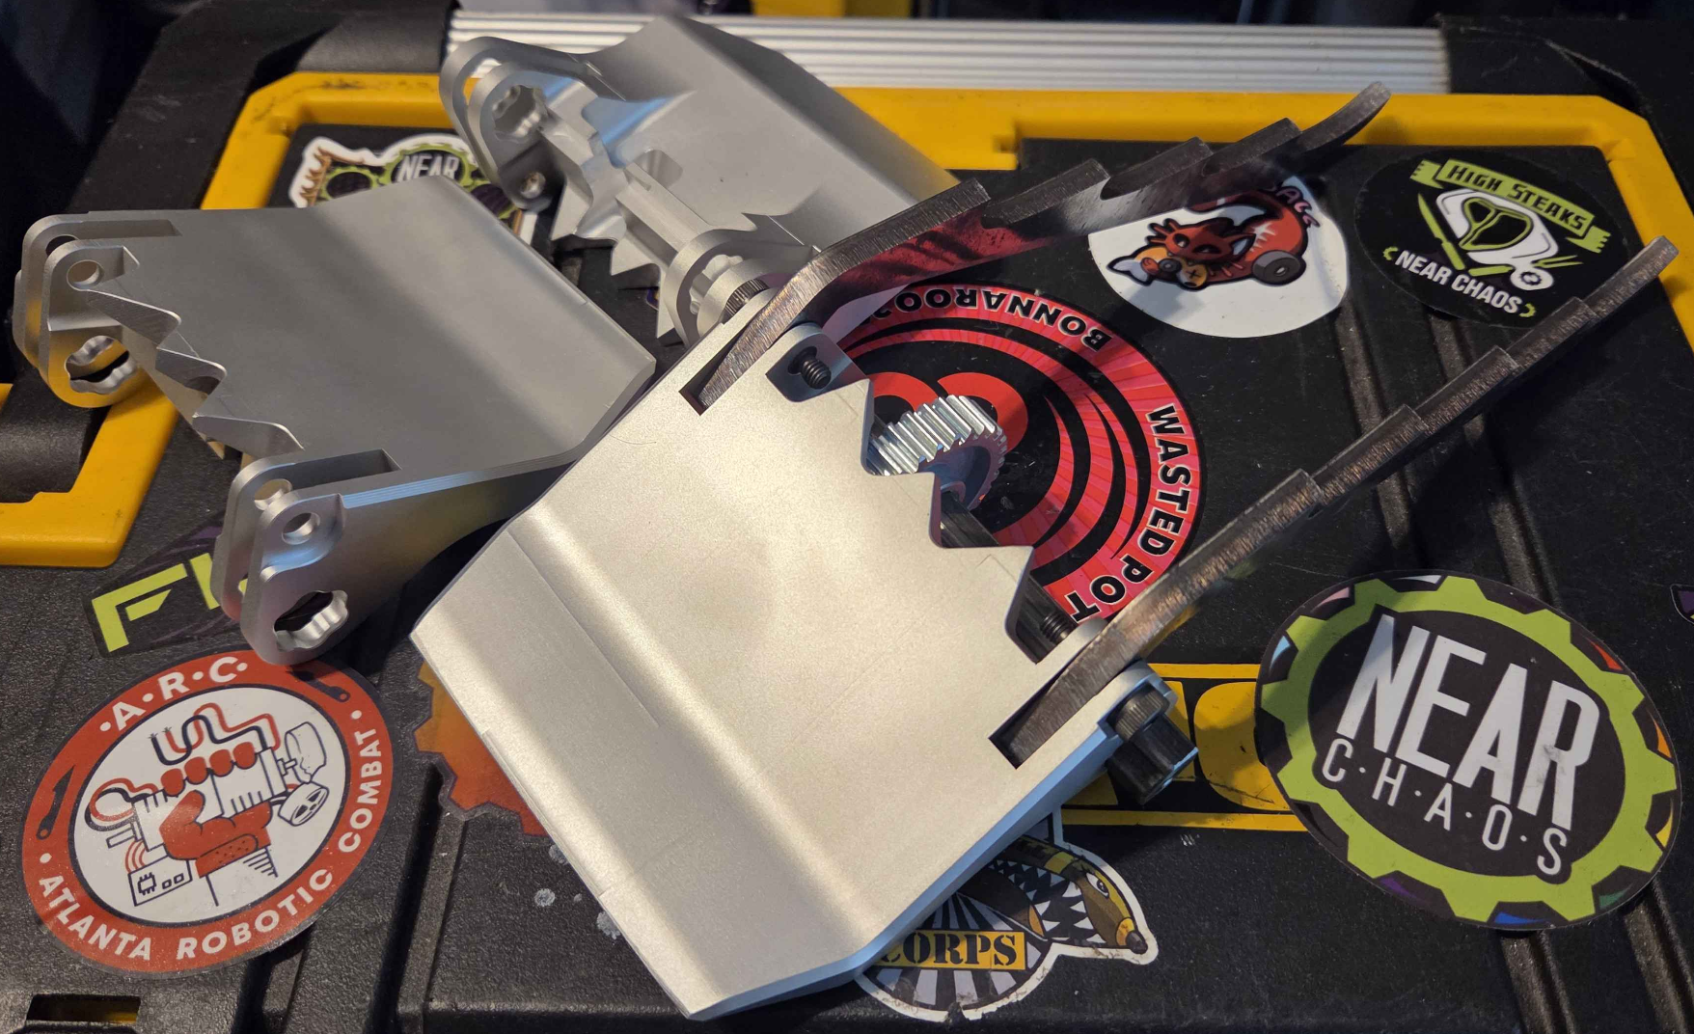
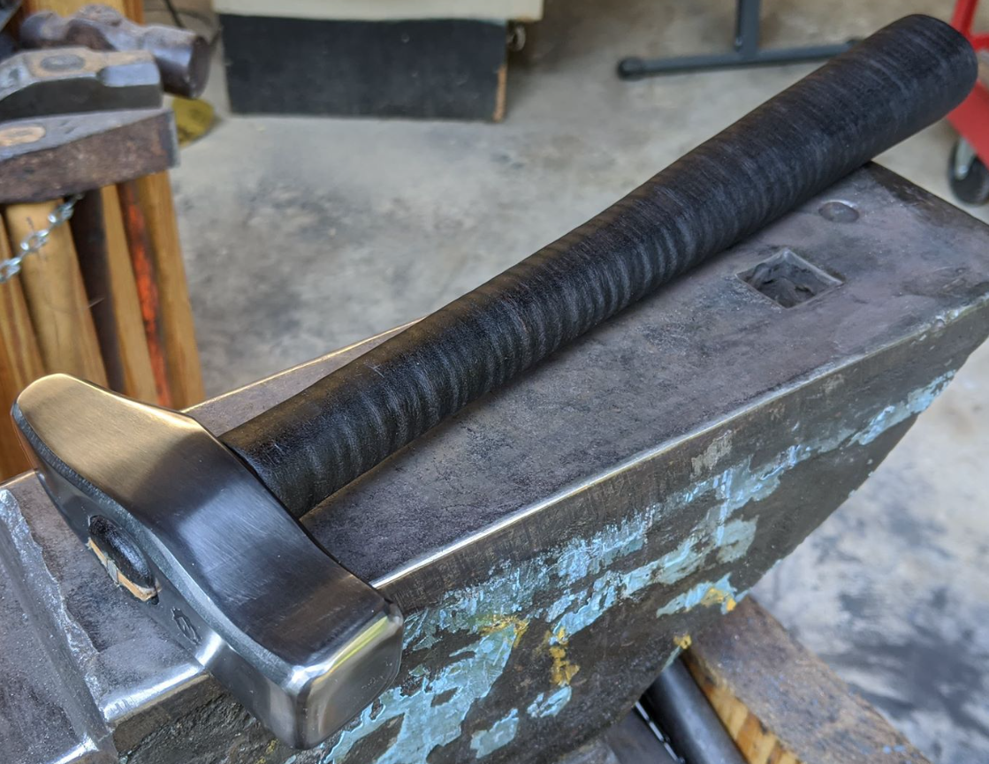
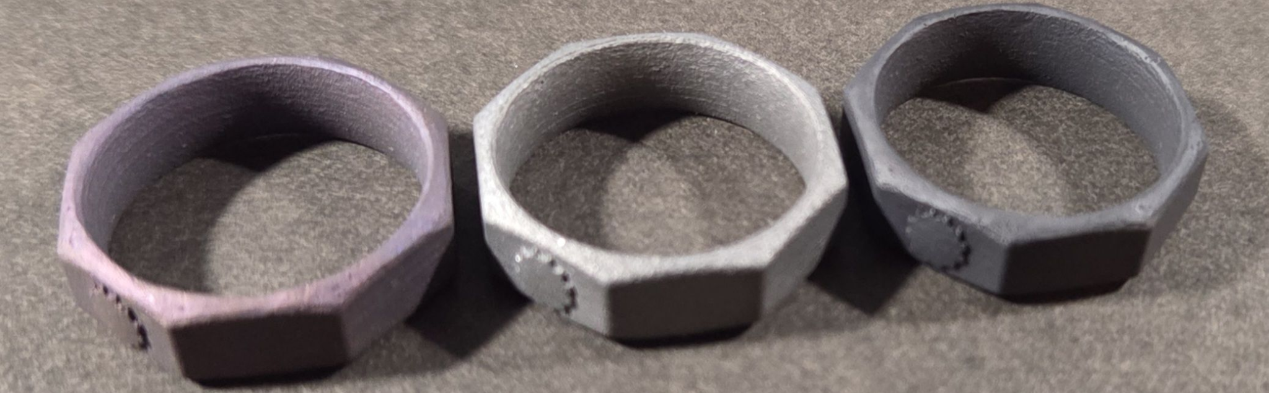
Example Projects

Slide 18
Open Questions
Got something specific you’re trying to make?
Not sure where to get a thing?
We have prizes for good questions, ask away!
Slides available for download at
NearChaos.net/DC

