Slide 1
Robot Combat 101
Mike Jeffries
Near Chaos Research
Mike@NearChaos.net
http://nearchaos.net/
https://www.facebook.com/NearChaosResearch
https://twitter.com/NearChaos
https://www.instagram.com/nearchaosmike/
https://www.twitch.tv/nearchaosmike
https://www.youtube.com/c/MikeNCR

Slide 2
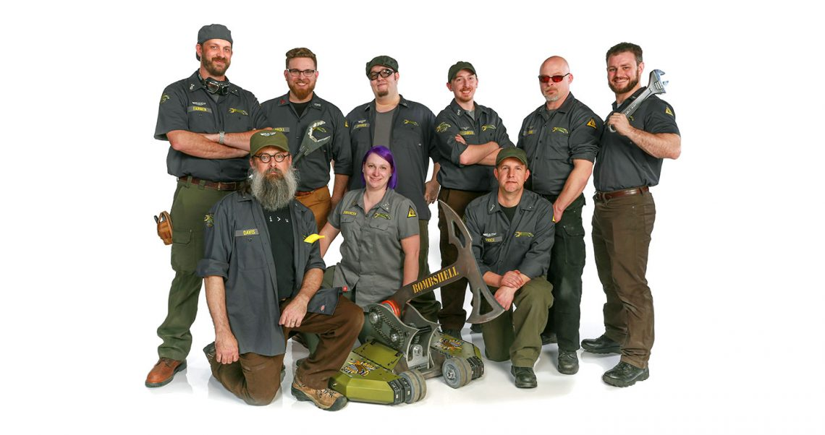
Who Am I?
Captain & Driver – Bombshell, Battlebots 2016 and 2018
Head of Near Chaos Research
Independent Rules Consultant, BattleBots (2021-Present)
Match Steward, BattleBots (2022)
Robot Battles Minion (2012-Present)

Slide 3
Agenda
Finding Events
Rules
General Rules
Robot Battles Rules
Highlighted Robot Battles Rules
Plastic Ant Rules
Parts of a Combat Robot
Basics
Wiring
Power Transmission
Parts Selection & Resources
Design Resources
Information Resources
Open Questions

Slide 4
Finding Events
Robot Combat Events
Registration for events all over the world
https://www.robotcombatevents.com/
BuildersDB
Database of past and upcoming events and robots
https://buildersdb.com/
Norwalk Havoc Robot League
Frequent events with large prize pools in Norwalk, CT
https://nhrl.io/
Robot Battles
1lb and 3lb full combat
12lb and 30lb sumo style combat
Typically takes place during MomoCon and Dragon Con
http://robotbattles.com/

Slide 5
General Rules
SPARC
http://sparc.tools/
Most events in North America use the SPARC rules as written or with slight modifications
If you use these rules as your baseline, you’ll be legal at most events

Slide 6
Robot Battles Rules
Weight Classes
1lb and 3lb compete in an arena
12lb and 30lb compete in an open environment
Full rules at http://robotbattles.com/rules.htm
Spinning weapons on 1lb and 3lb robots are not tip speed limited
Spinning weapons on 12 and 30lb robots are limited to a tip speed of 20ft/s
Tip Speed = RPM x Diameter x .00436
Frankenstein Rule
If a vehicle proves sufficiently offensive to the audience, the audience may, at their discretion, light torches, take pitchforks in hand, and throw the robot and its operator in the nearest creek or large body of water.
Bad Idea Rule
If, during the design of your robot, you think that something would be a bad idea, then just don't do it.

Slide 7
Highlighted Robot Battles Rules
Vehicles may be powered by any source socially acceptable for indoor use; all vehicles should be electrically powered. No internal combustion engines will be allowed. All power sources must be 100% contained in the vehicle and packaged appropriately for the expected abuse.
All vehicles, must, at the beginning of each combat, be capable of movement of at least one foot beyond the base radius of the robot in a reasonable amount of time.
Operable vehicles in the one and three pound weight classes must, at full extension, be able fit through the arena pushout(s) in any orientation.
All robots with active weapons must have a Master Kill Switch that deactivates the weapon immediately. The robot or attachments on the robot must not move when radio signal is lost or tether is cut. This is for the safety of the audience and the other competitors.

Slide 8
Parts of a Combat Robot
Chassis
Frame
Armor
Electronics
Transmitter/Receiver
Motor controllers
Battery
Wires
Power switch
Locomotion
Wheels
Drive motors
Belts/pulleys & Chains/sprockets
Weapon
Motor
Controller
Mechanism

Slide 9
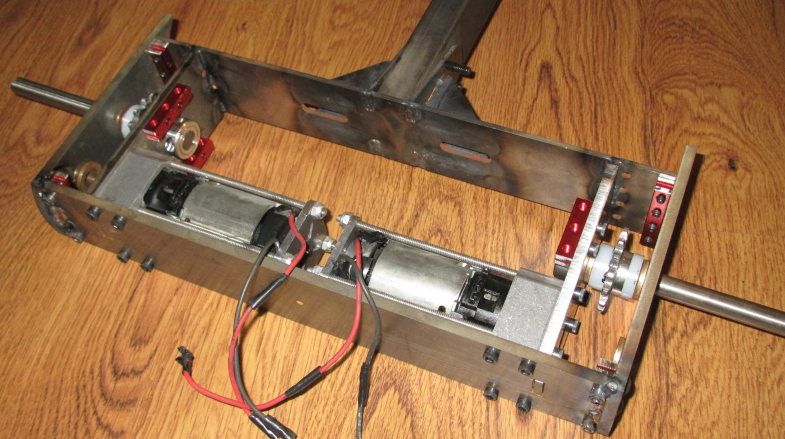
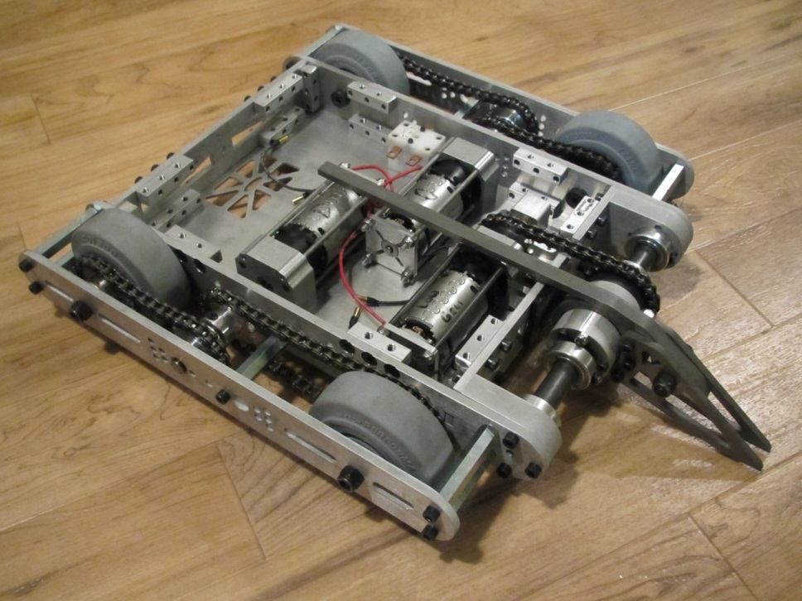
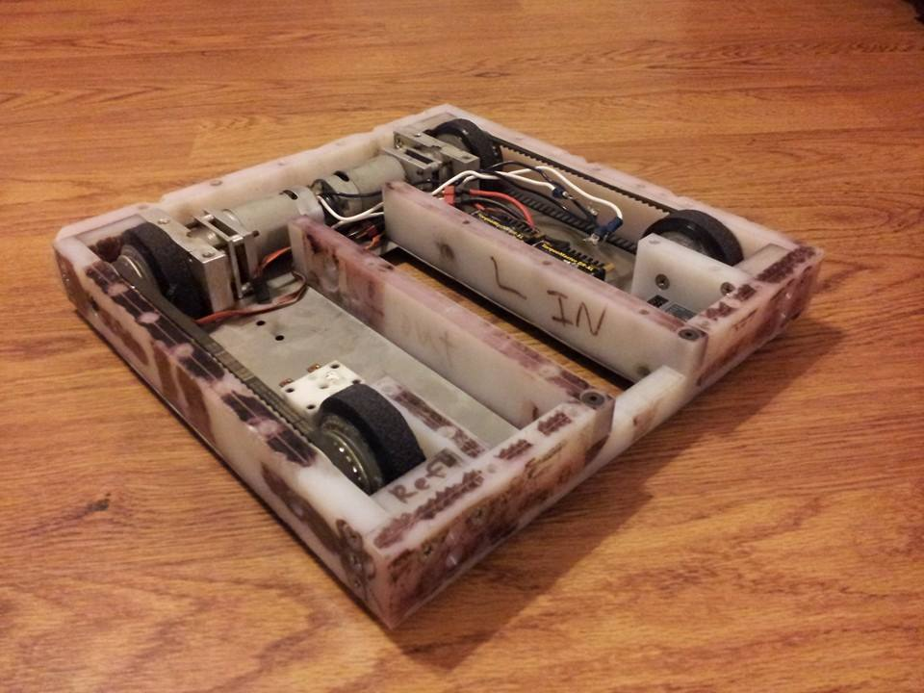
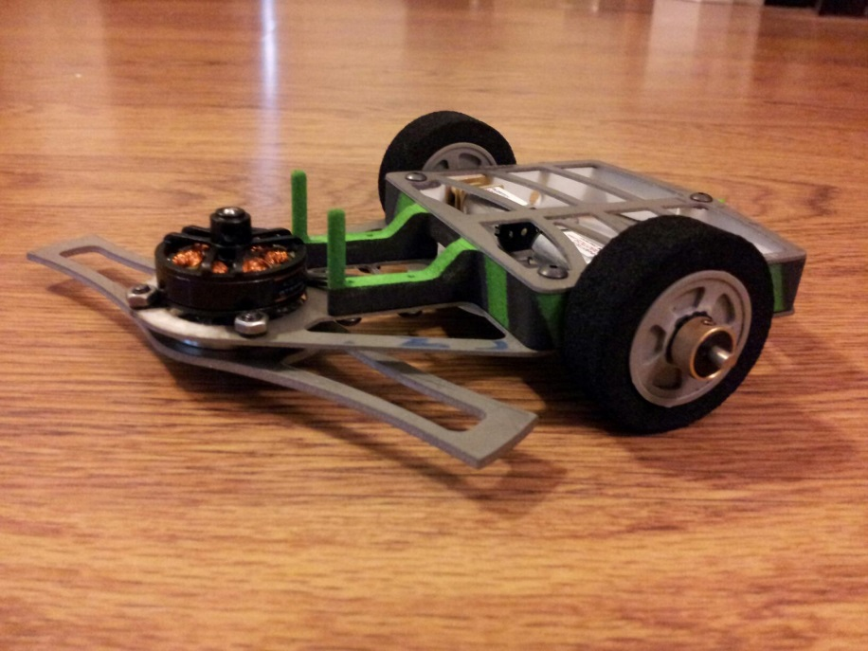
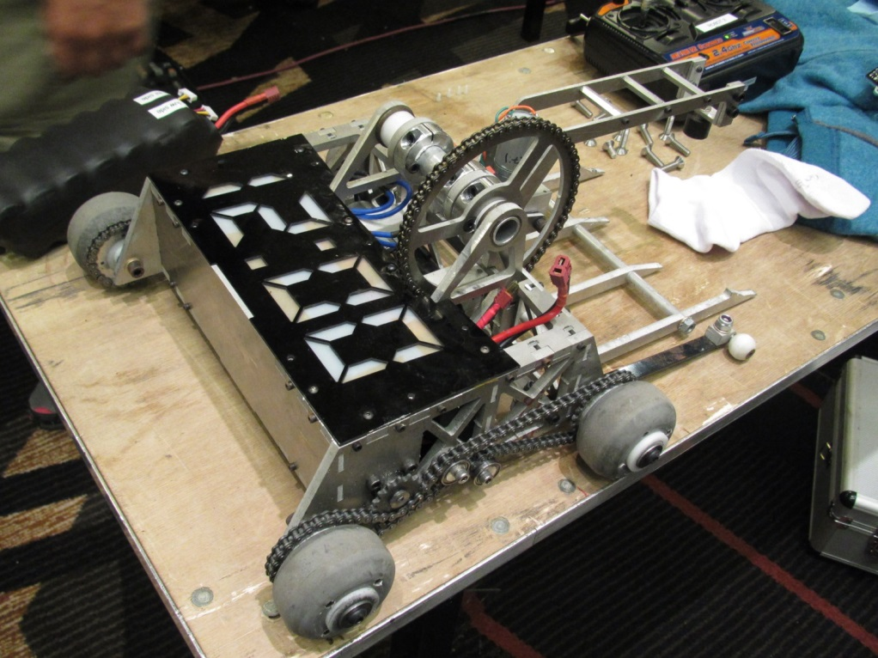
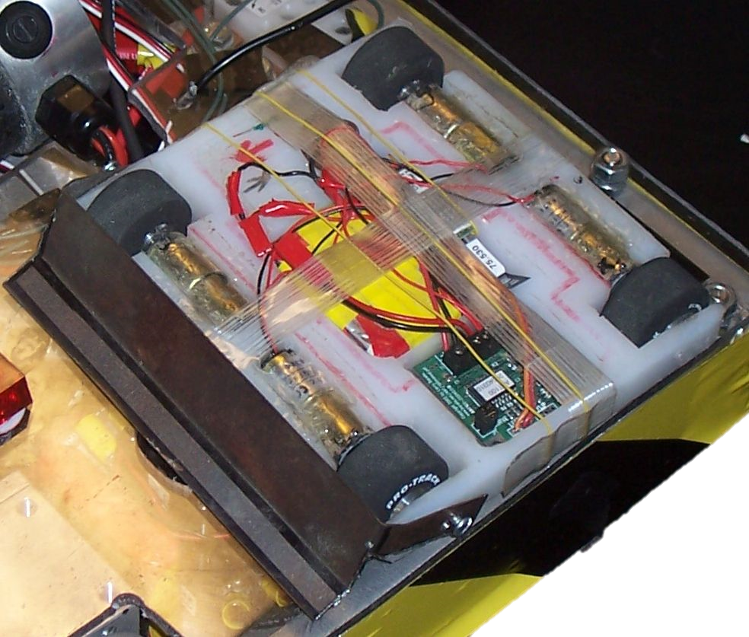
Basics – Chassis
Welded
Nutstrip/Slot & Tab
Tapped Plates
3D Printed
T-Nut
Unibody

Slide 10
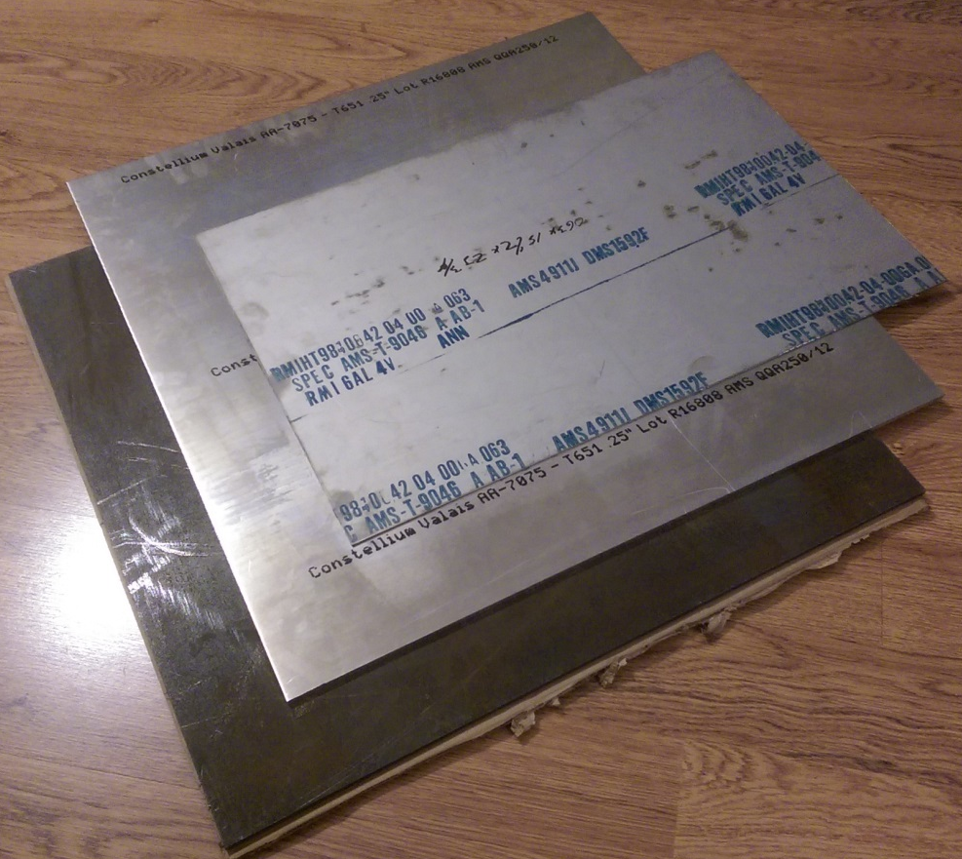
Basics – Materials
Metals
Plastics
Woods
Composites
Vendors
McMaster-Carr
Online Metals
Metal Supermarkets
ePlastics
FibreGlast
Ebay
DragonPlate

Slide 11
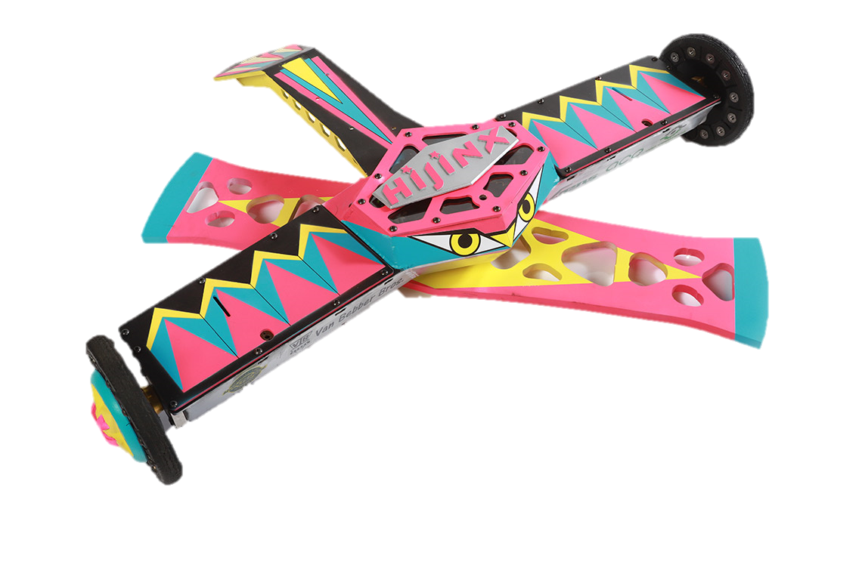
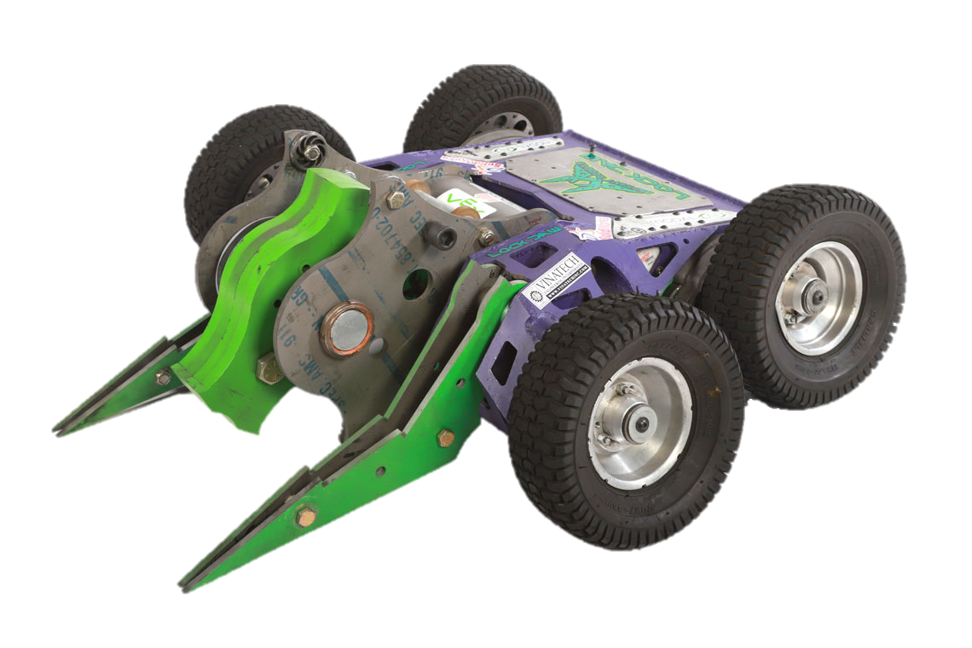
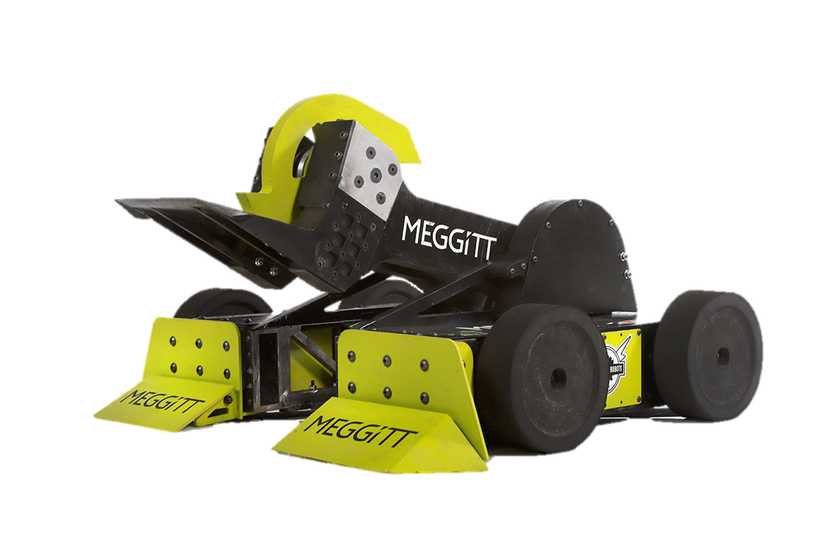
Basics – Materials
Metals
Steel
4130
AR*00
S7
Other
Aluminum
6061
7075
Other
Titanium
6al4v (Grade 5)
Magnesium
AZ31B

Slide 12
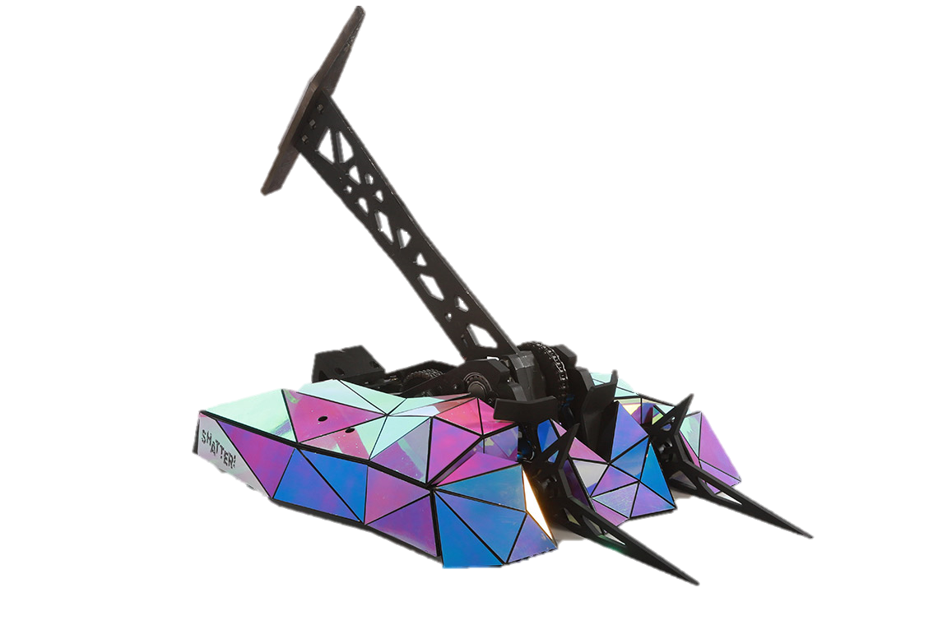
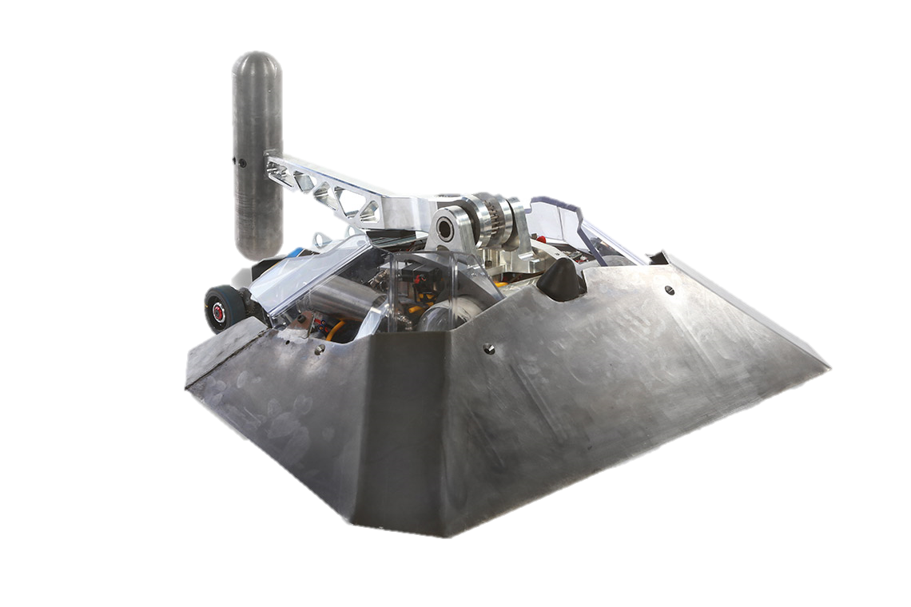
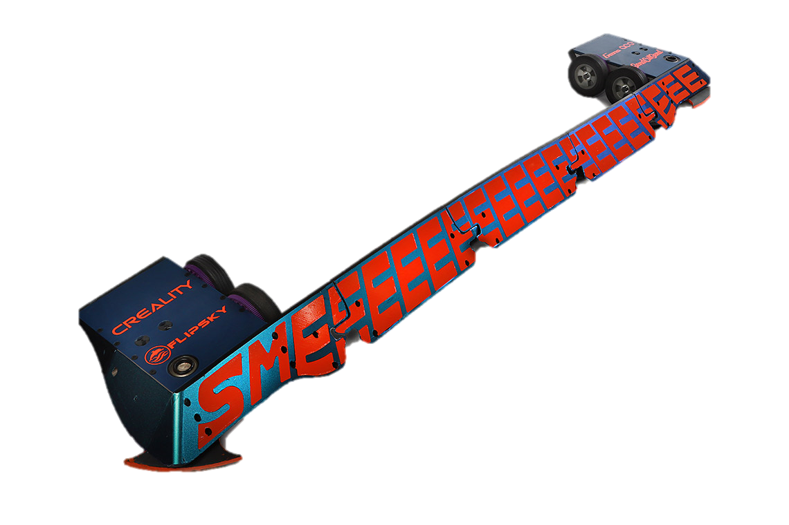
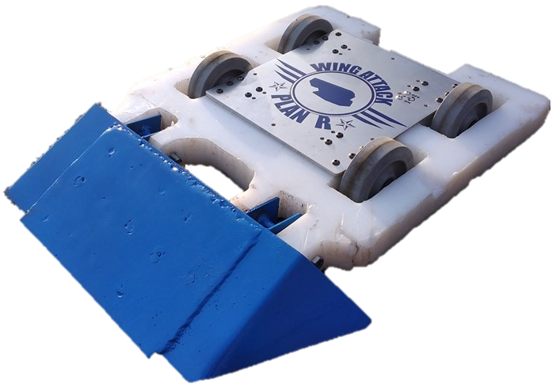
Basics – Materials
Plastics
UHMW-PE
HDPE
Polycarbonate
Nylon
Acetal/Delrin
PTFE/Teflon

Slide 13
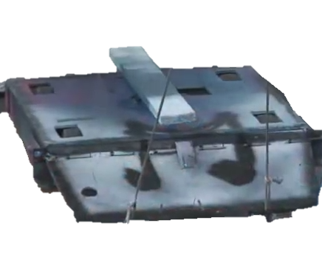
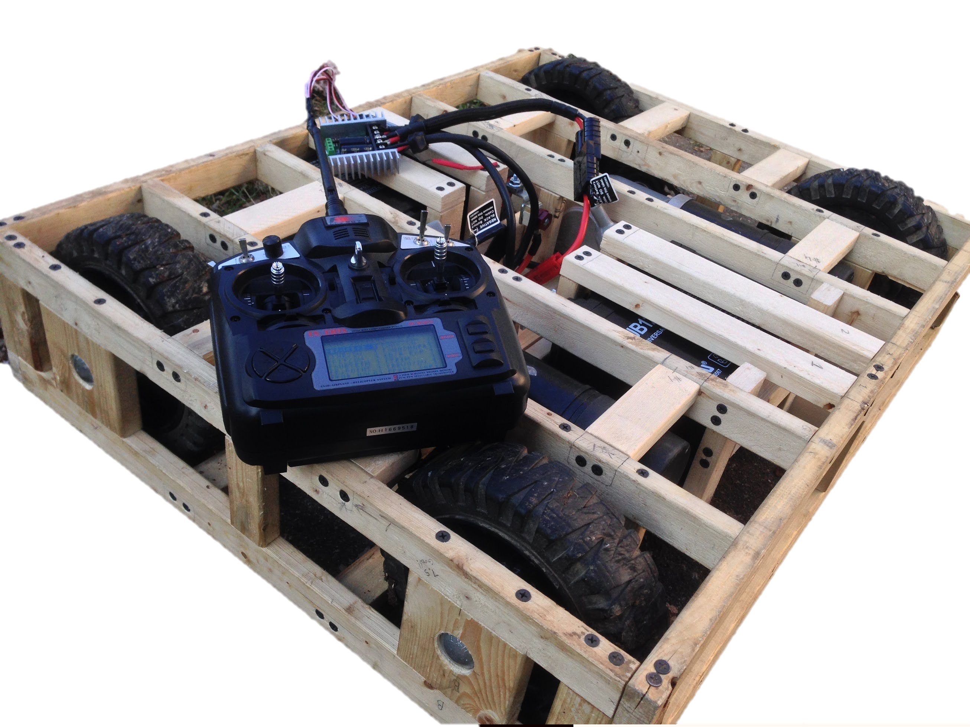
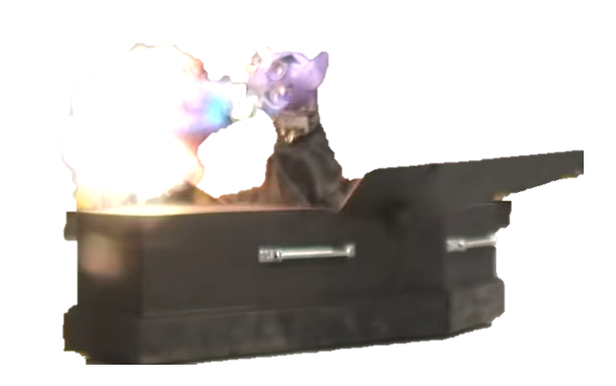
Basics – Materials
Woods
Baltic Birch Plywood
Lumber

Slide 14
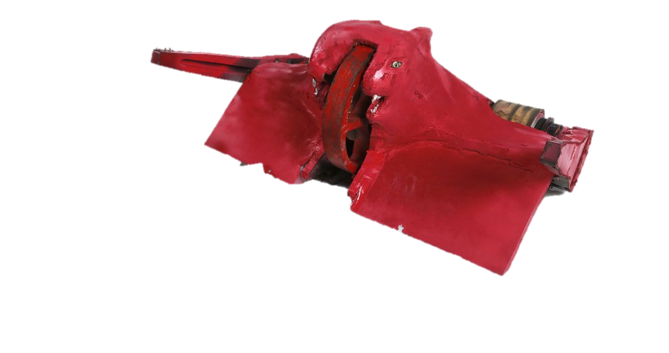
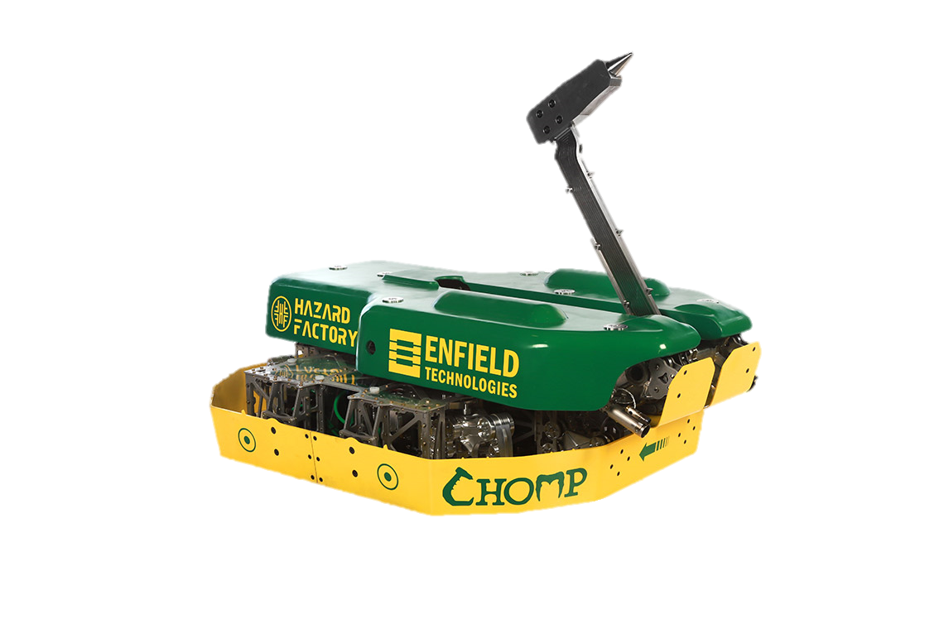
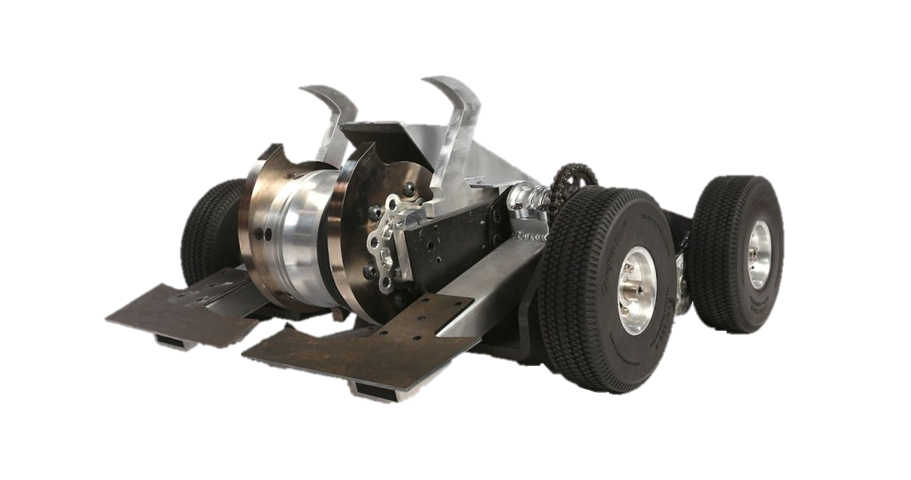
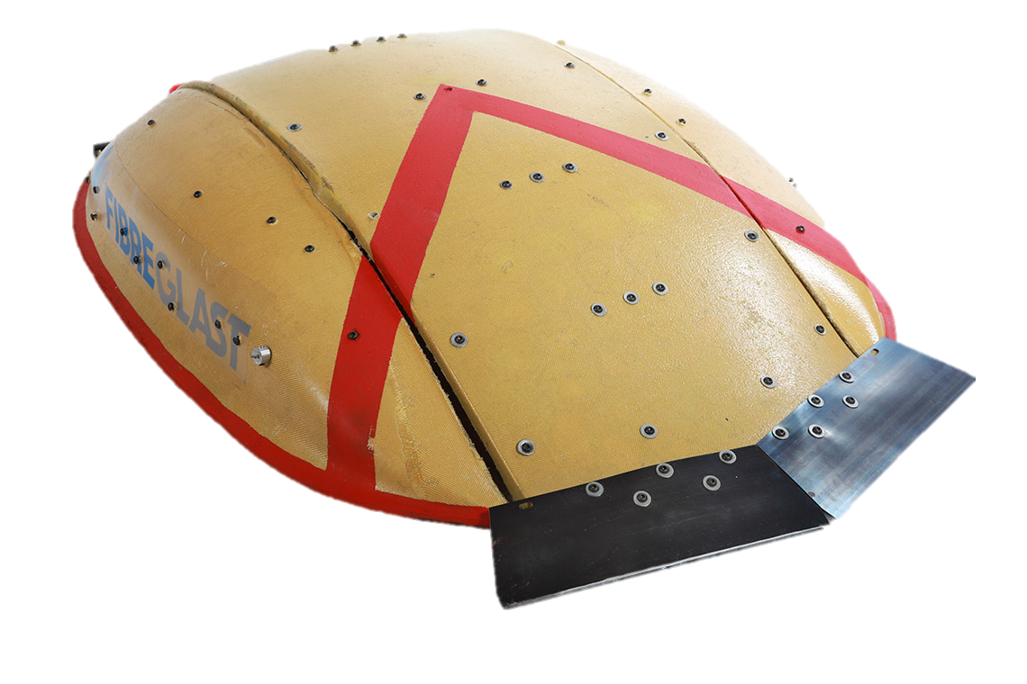
Basics – Materials
Composites
Fiberglass
Carbon Fiber
Kevlar
Garolite
Hybrid

Slide 15
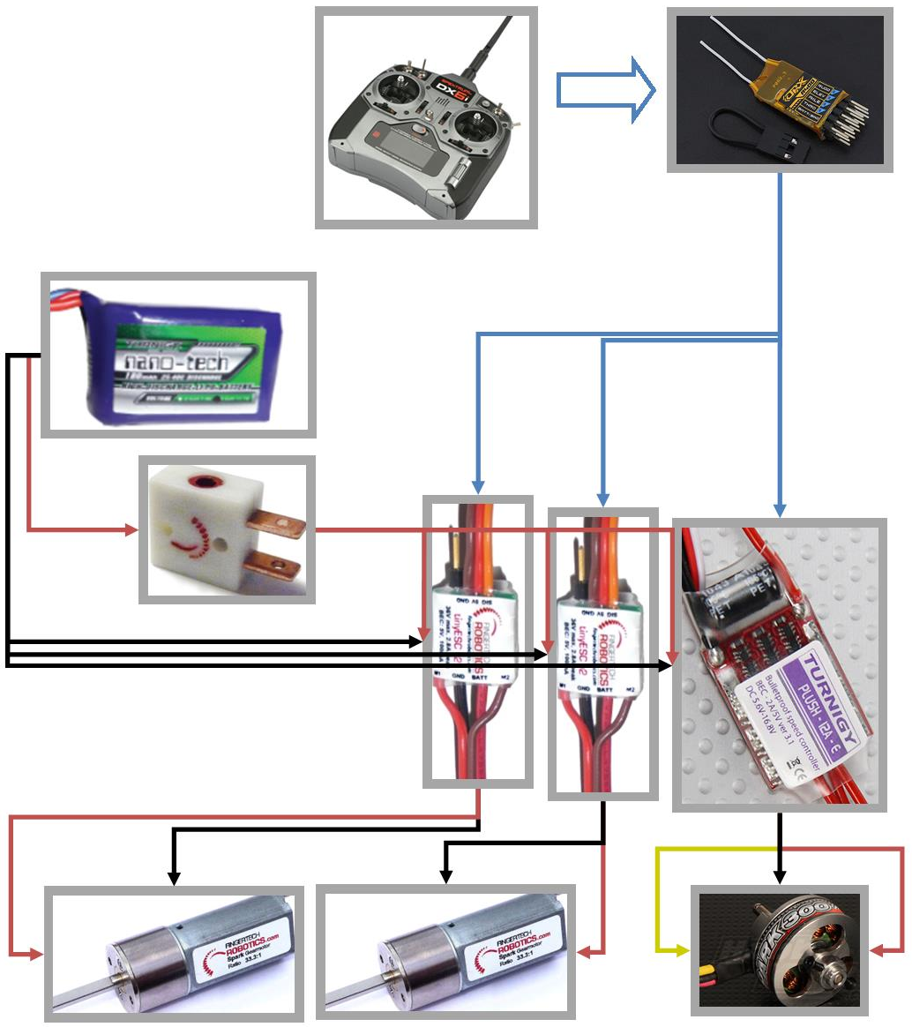
Basics – Wiring
Signal
TX to RX (wireless)
RX to ESCs
Power
Battery to Switch/Link
Switch/Link to ESCs
ESCs to Motors

Slide 16
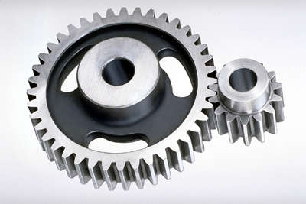
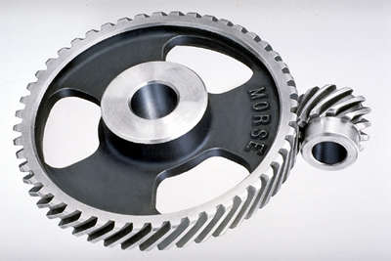
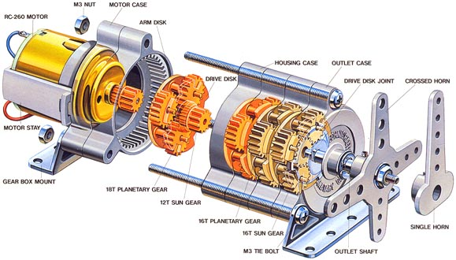
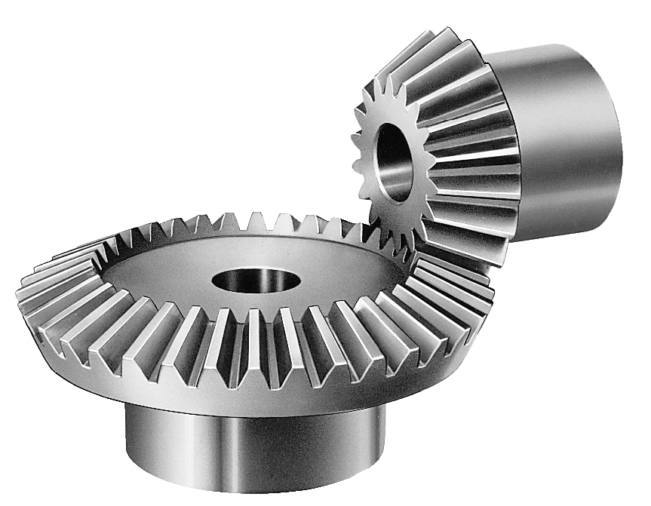
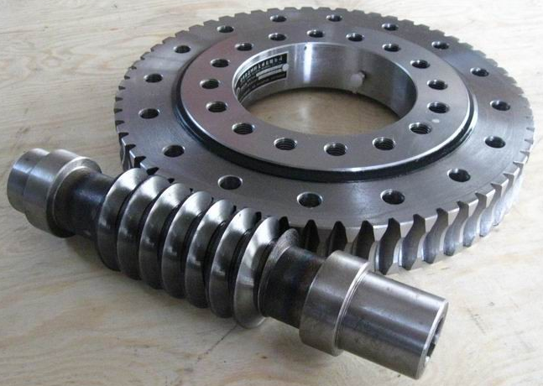
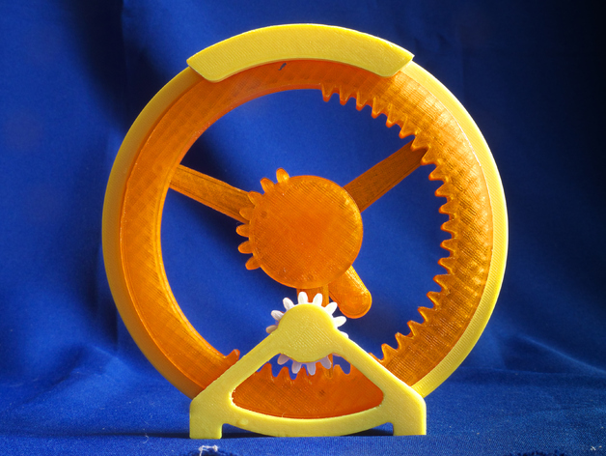
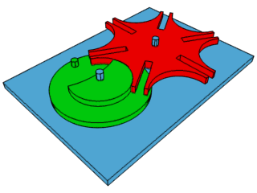
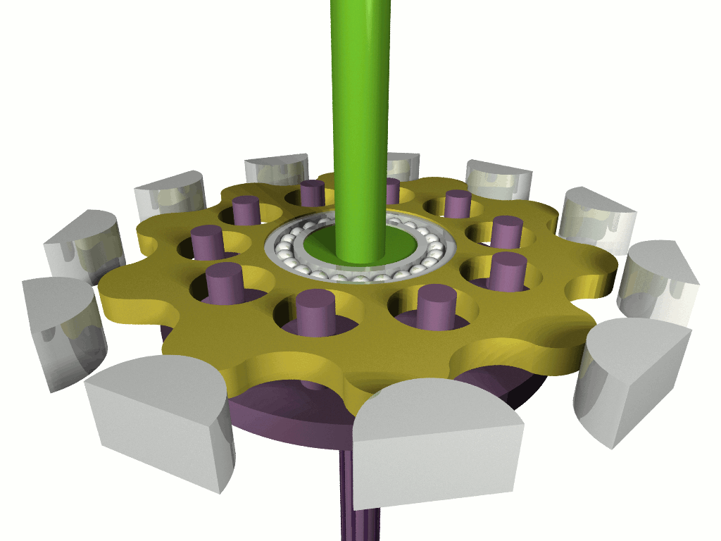
Basics – Power Transmission
Gears

Slide 17
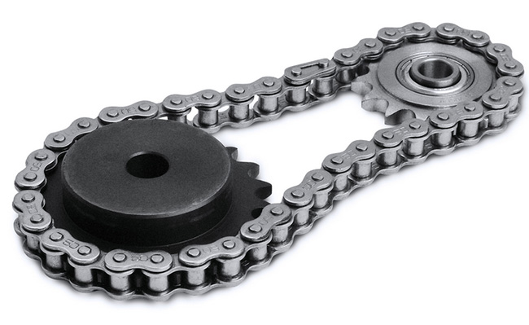
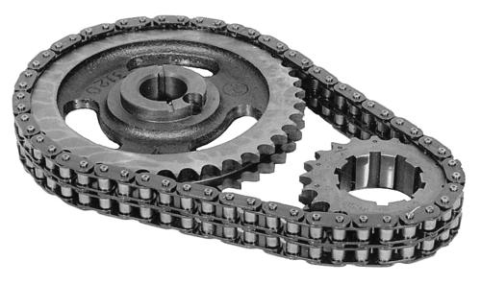
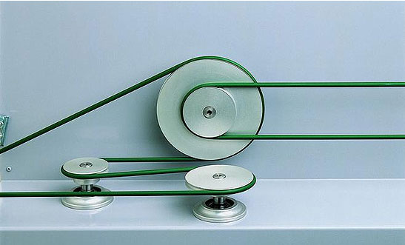
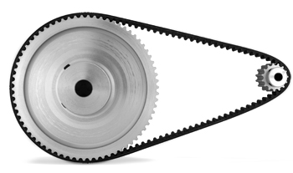
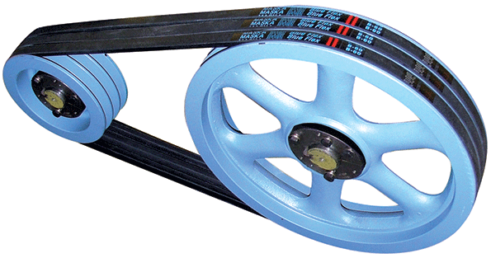
Basics – Power Transmission
Chains and Belts

Slide 18
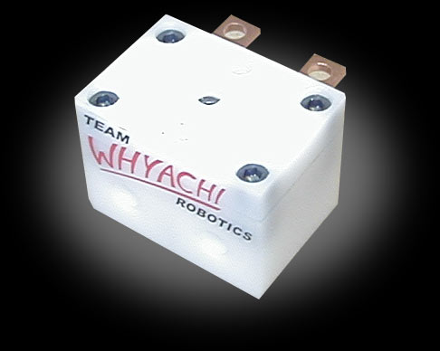
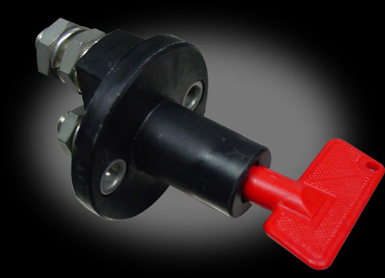
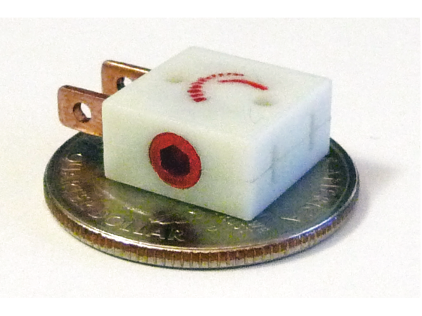
Parts Selection and Resources
Electrical Components - Kill Switches/Links
Switch Vs. Removable Link
Vendors
Fingertech Robotics
Robot Marketplace
Team Whyachi

Slide 19
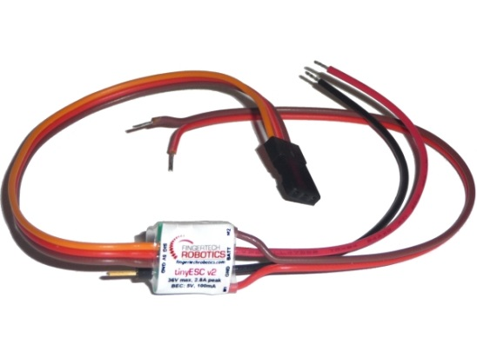
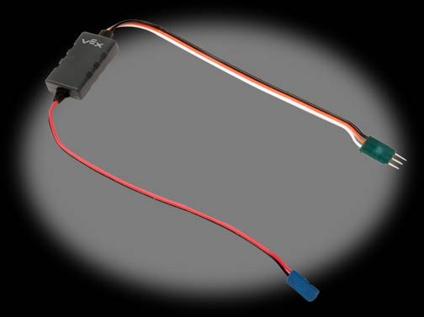
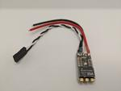
Parts Selection and Resources
Electrical Components – Motor Controllers
Vendors
Fingertech Robotics – TinyESC
Robot Marketplace – Wide range of products
HobbyKing – Budget brushless escs
Rectified Robotics – Bi-directional brushless esc (insect scale)
VESC – Large scale brushless esc, wide range of vendors

Slide 20
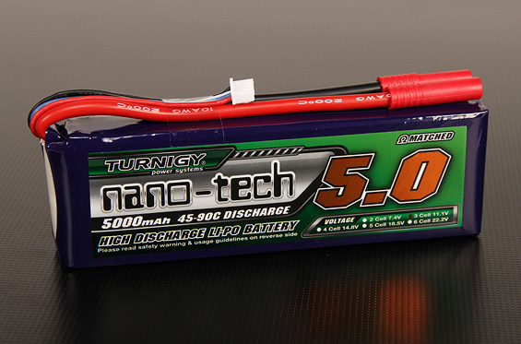
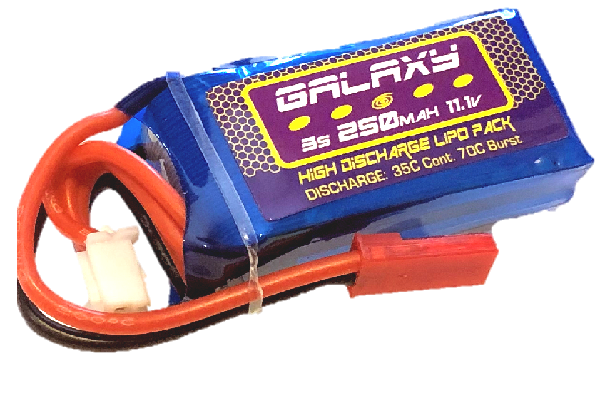
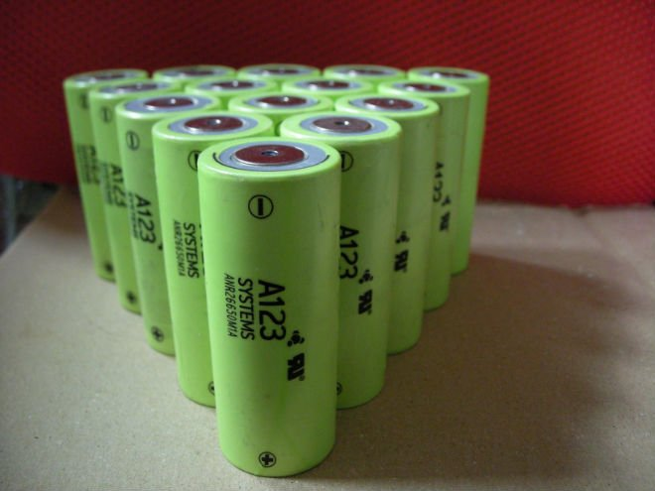
Parts Selection and Resources
Electrical Components – Batteries
Chemistries
LiPo
LiFe
NiMh
SLA
Vendors
Hobbyking
Robot Marketplace
Fingertech Robotics

Slide 21
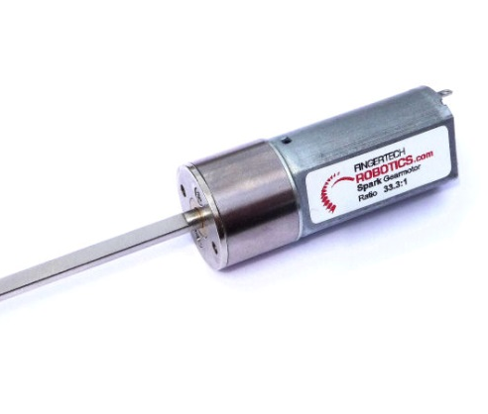
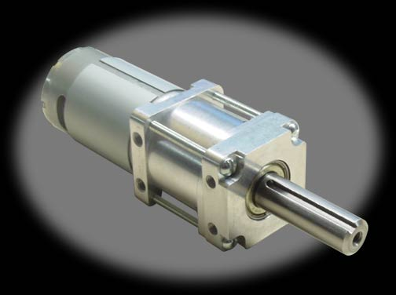
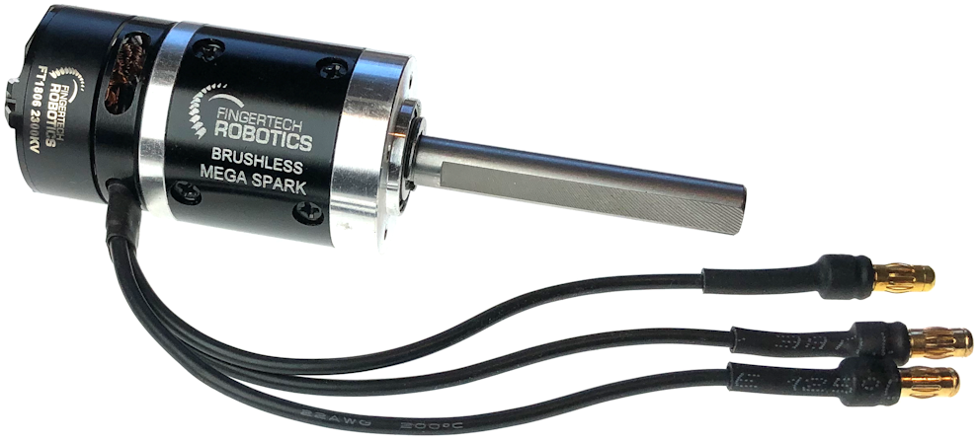
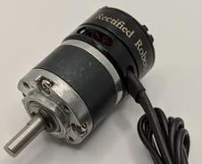
Parts Selection and Resources
Mechanical Components – Motors/Gearboxes
Fingertech Robotics – Spark gearmotor
KitBots – 1000rpm gearmotor
BotKits – 22mm gearmotor
AndyMark – Range of products
RobotMarketplace – Range of products
HobbyKing – Budget brushless motors
Rectified Robotics – Brushless gearmotor

Slide 22
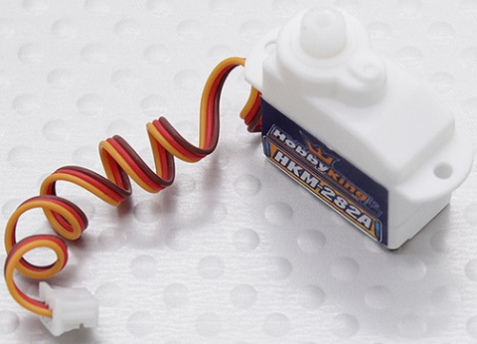
Parts Selection and Resources
Mechanical Components – Servos & Actuators
ServoCity – Huge range of servos, some actuators
HobbyKing – Budget servos
SurplusCenter – Surplus actuators and more
ActuatorZone – Wide range of actuators

Slide 23
Parts Selection and Resources
Mechanical Components – Wheels
Casters
Colsons
Foam
Lite Flite
Snap Wheels
Silicone
Sumo
Air Filled
ATVs
Tractors
Go-Karts

Slide 24
Parts Selection and Resources
Preferred Vendors
Xometry - https://www.xometry.com/
Fingertech Robotics - https://www.fingertechrobotics.com/
BaneBots - http://banebots.com/
Robot Marketplace - https://www.robotmarketplace.com/
Team Whyachi - http://teamwhyachi.com/
Hobbyking - https://hobbyking.com/
Rectified Robotics - https://rectifiedrobotics.com/
Andymark - https://www.andymark.com/
Kitbots - https://kitbots.com/
Botkits - https://www.botkits.com/
Servo City - https://www.servocity.com/
McMaster-Carr - https://www.mcmaster.com/
Pololu - https://www.pololu.com/
BotBitz - https://botbitz.com.au/

Slide 25
Design Resources
CAD Software
Solidworks
https://www.solidworks.com/support/community-download (Maker License)
Fusion 360
https://www.autodesk.com/products/fusion-360/pricing
OnShape
https://www.onshape.com/en/

Slide 26
Fabrication Resources
Maker Friendly Shops
Xometry (Almost Everything)
https://www.xometry.com/
Team Whyachi (CNC machining)
http://teamwhyachi.com/
SendCutSend, Coremark & OshCut (Laser Cutting)
https://sendcutsend.com/
https://www.coremarkmetals.com/
https://www.oshcut.com/
Shapeways (3D Printing)
https://www.shapeways.com/

Slide 27
Information Resources
SPARC Getting Started Guide
http://sparc.tools/?p=131
RioBotz Combat Robot Tutorial
https://www.amazon.com/RioBotz-Combat-Tutorial-Antonio-Meggiolaro/dp/1448697050 (Paperback)
http://meggi.usuarios.rdc.puc-rio.br/docs/riobotz_combot_tutorial.pdf (PDF)

Slide 28
Open Questions

