Slide 1
How To Get On BattleBots
Mike Jeffries
Near Chaos Research
Mike@NearChaos.net
http://nearchaos.net/
https://www.facebook.com/NearChaosResearch
https://twitter.com/NearChaos
https://www.instagram.com/nearchaosmike/
https://www.twitch.tv/nearchaosmike
https://www.youtube.com/c/MikeNCR

Slide 2
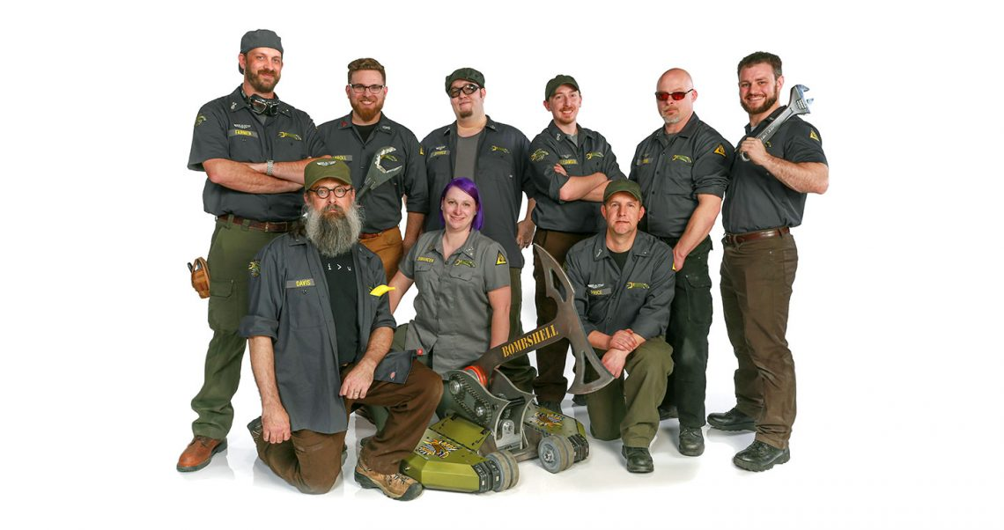
Who Am I?
Captain & Driver – Bombshell, Battlebots 2016 and 2018
Head of Near Chaos Research
Independent Rules Consultant, BattleBots (2021-Present)
Match Steward, BattleBots (2022)
Robot Battles Minion (2012-Present)

Slide 3
Key Factors
Build a Bot That
Puts On a Good Fight
Looks Great
Is Original
Build a Team
Prove it
Register

Slide 4
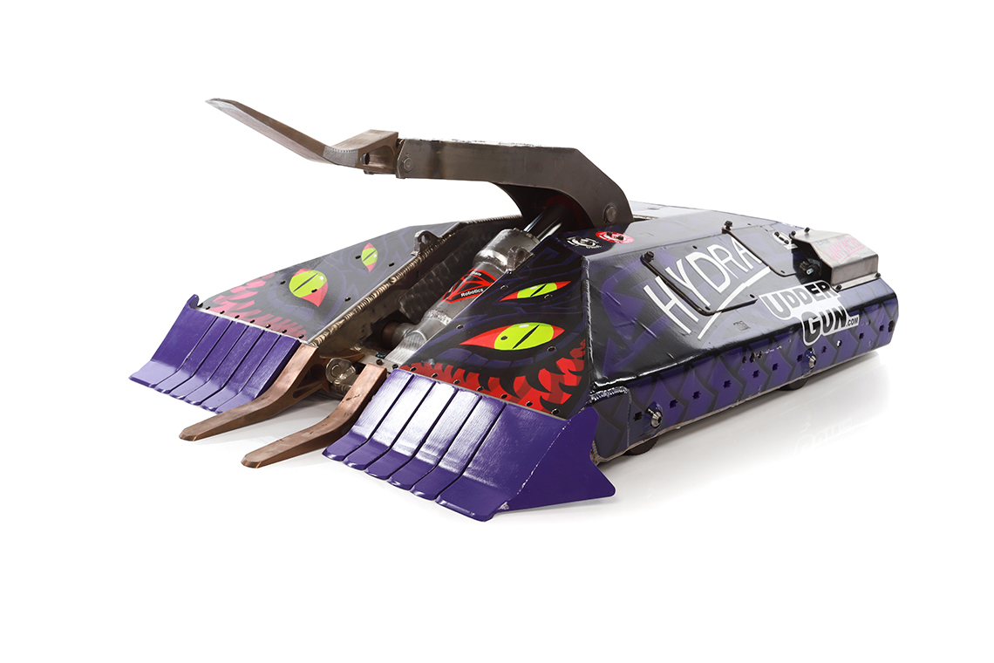
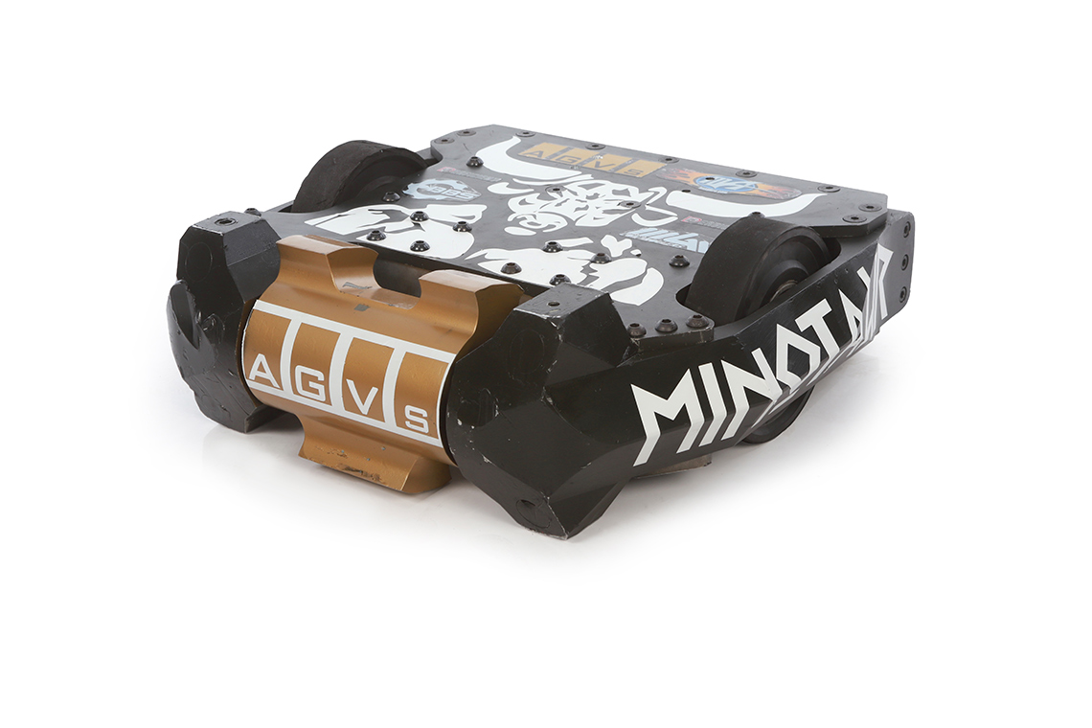
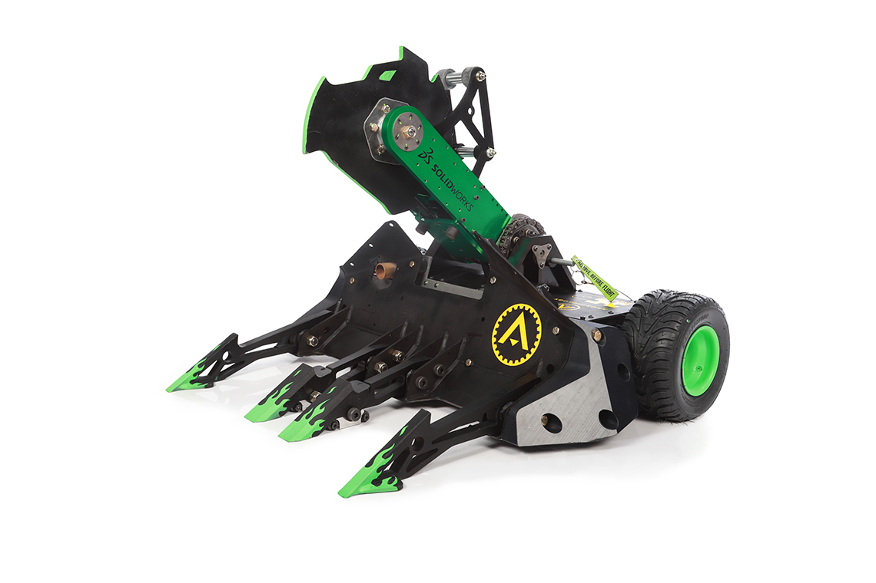
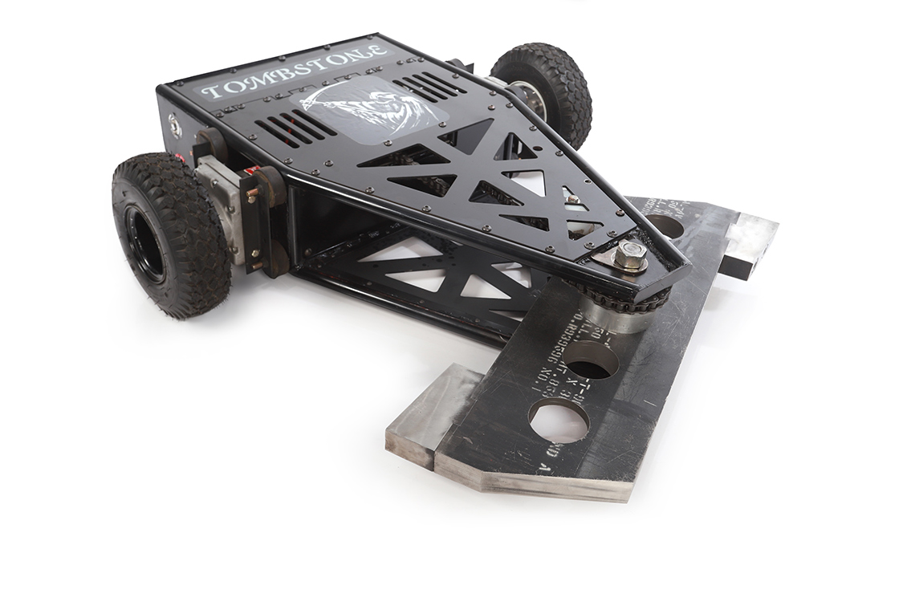
Build a Bot That…
Puts On a Good Fight
text

Slide 5
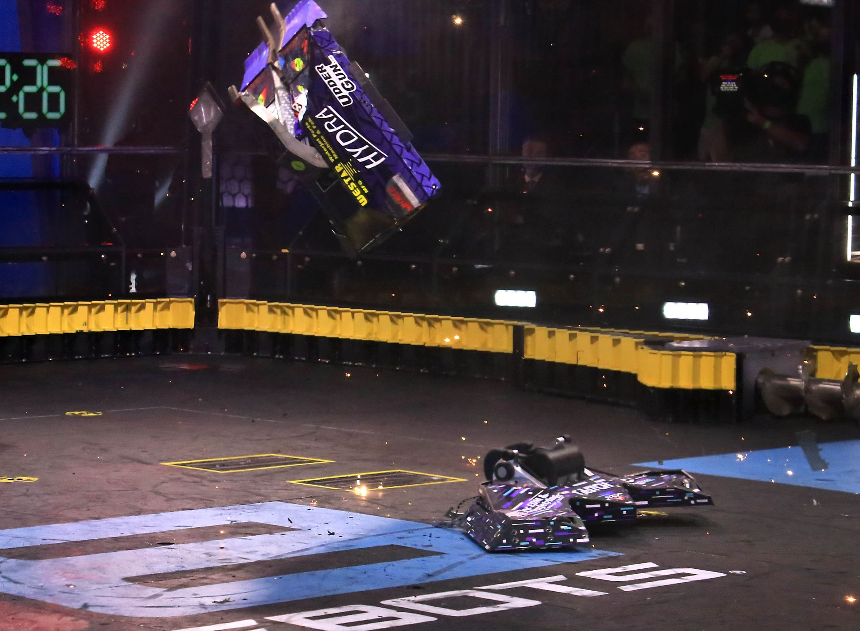
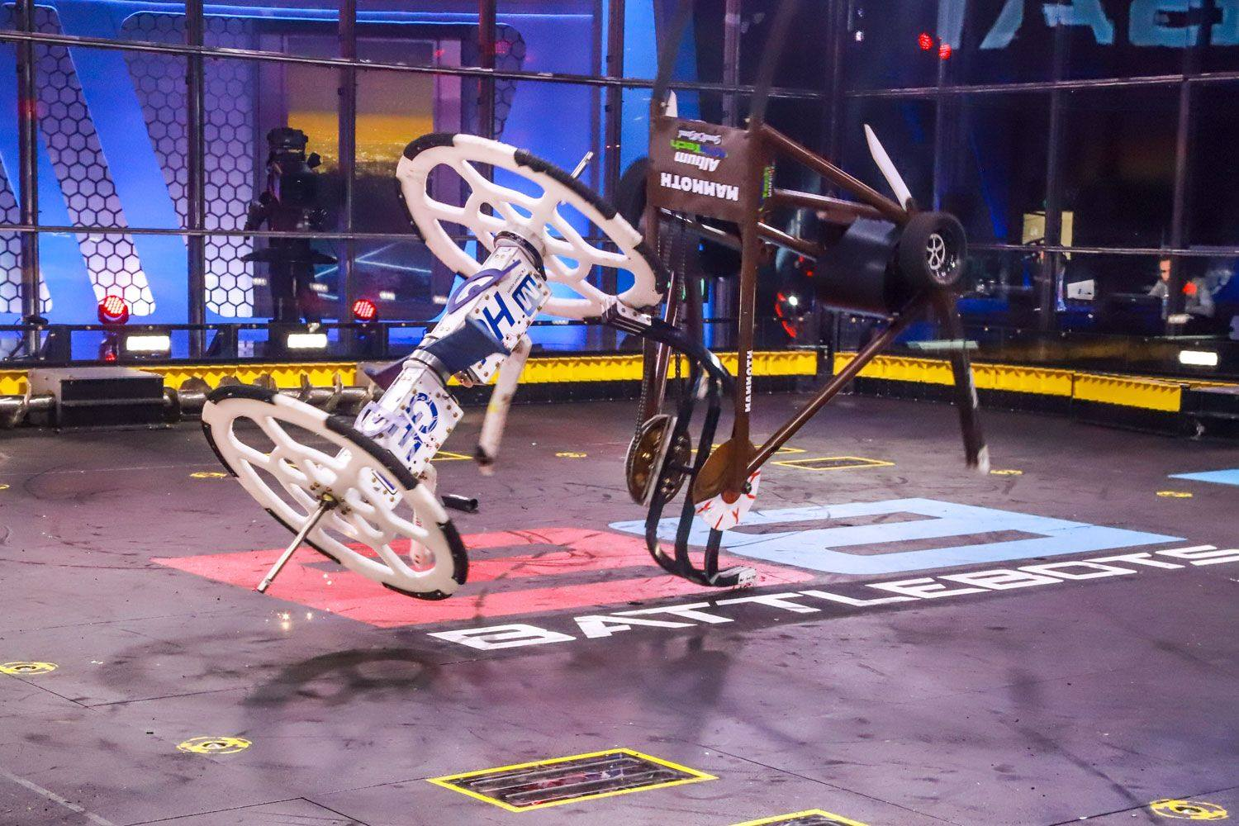
Build a Bot That…
Creates Classic Moments
text

Slide 6
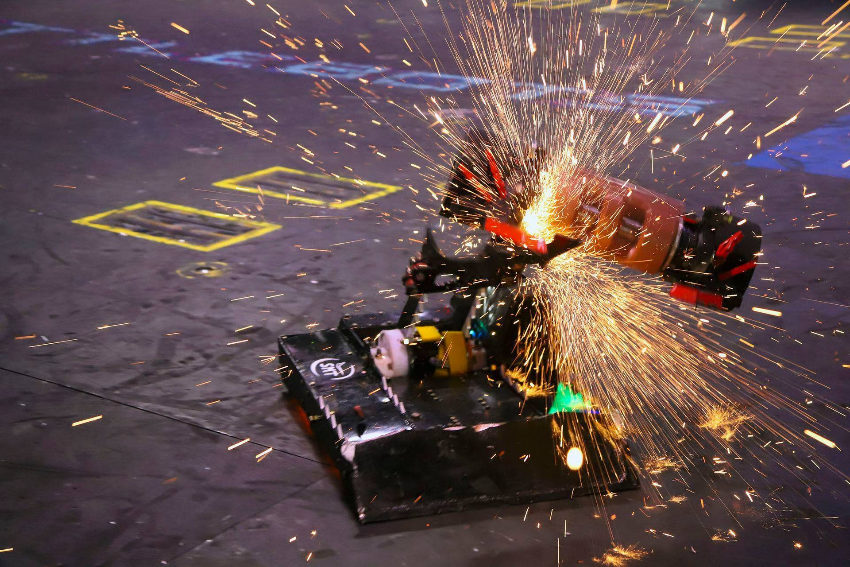
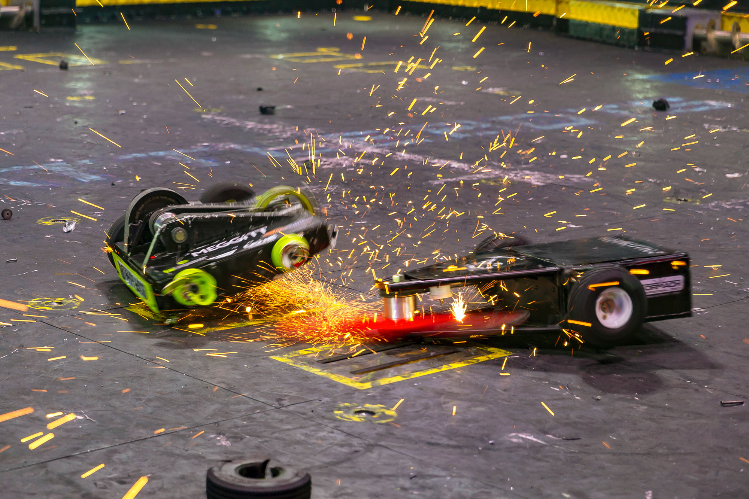
Build a Bot That…
Can Survive a Full BattleBots Tournament
text

Slide 7
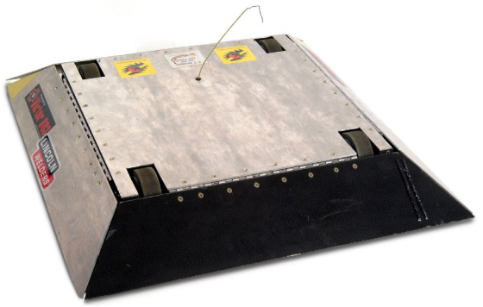
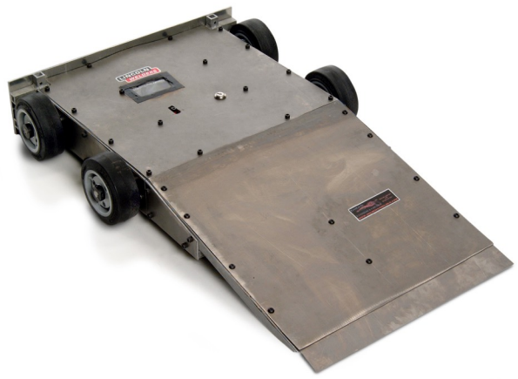
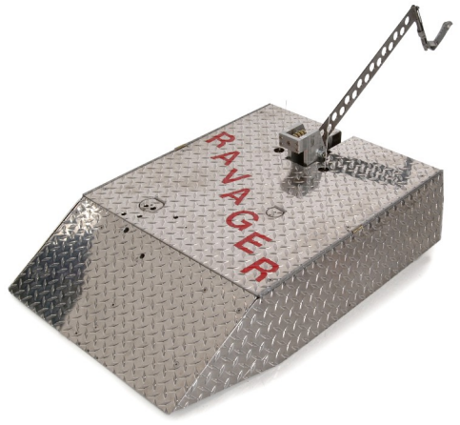
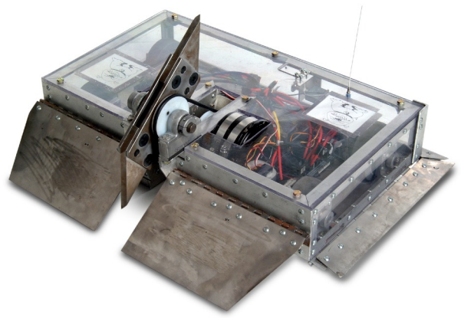
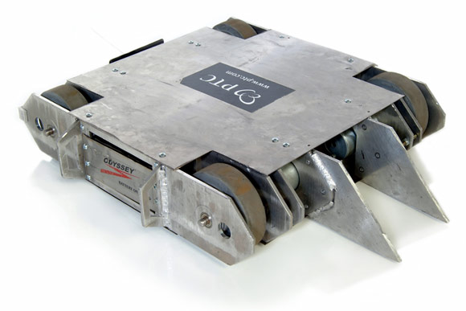
Build a bot that…
Isn’t a Silver Box
text

Slide 8
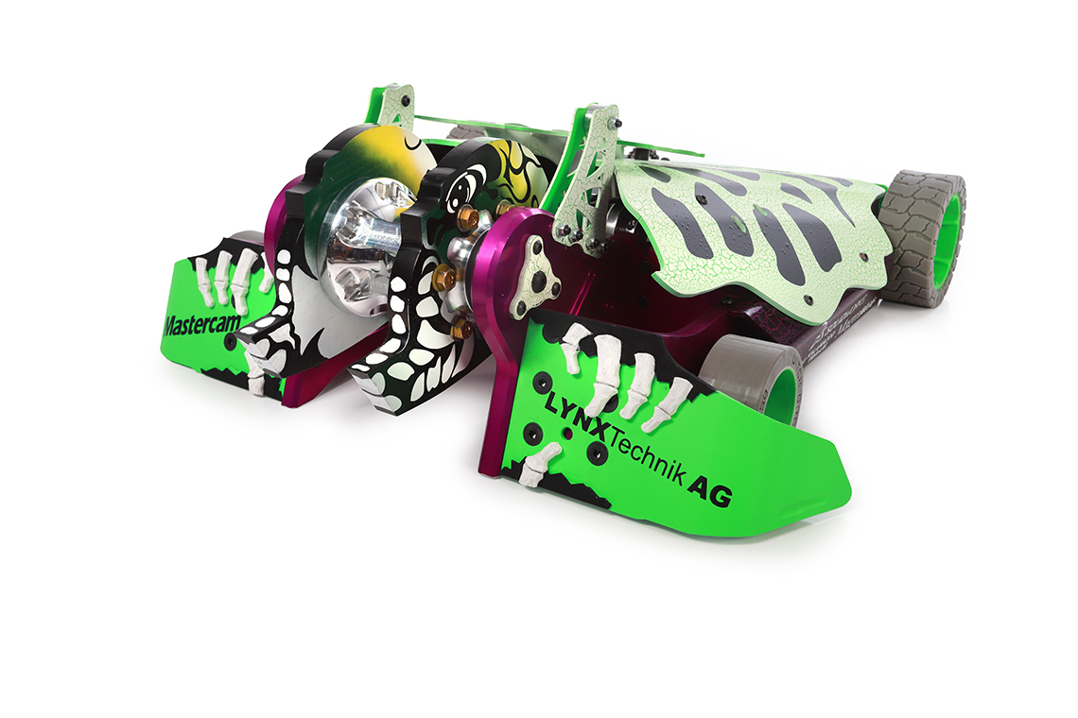
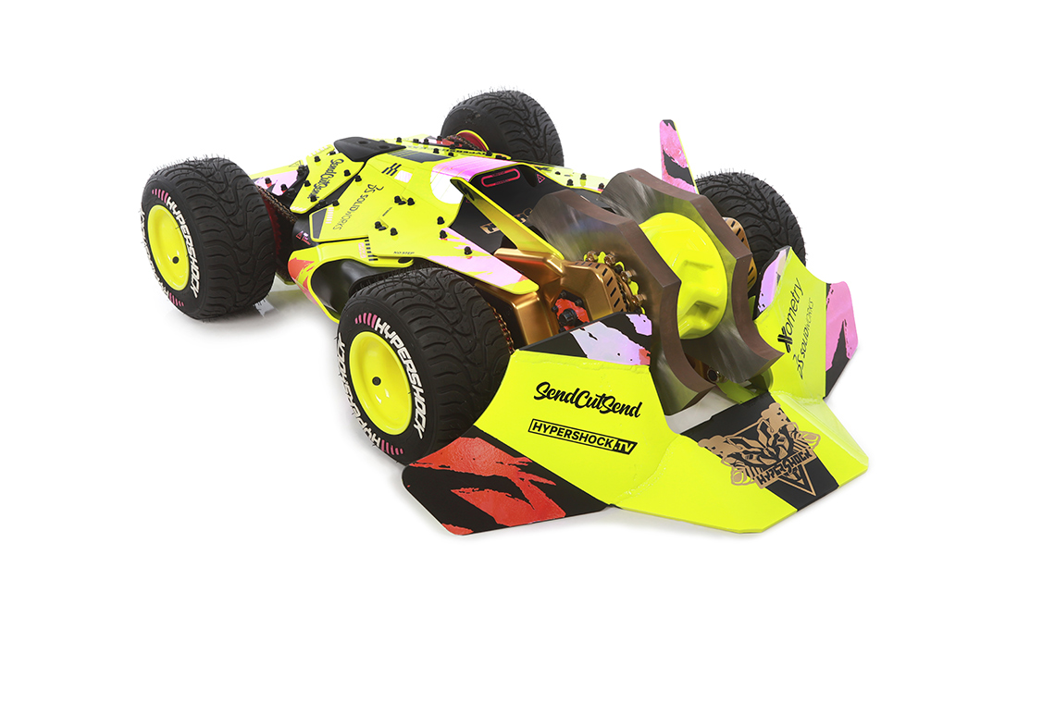
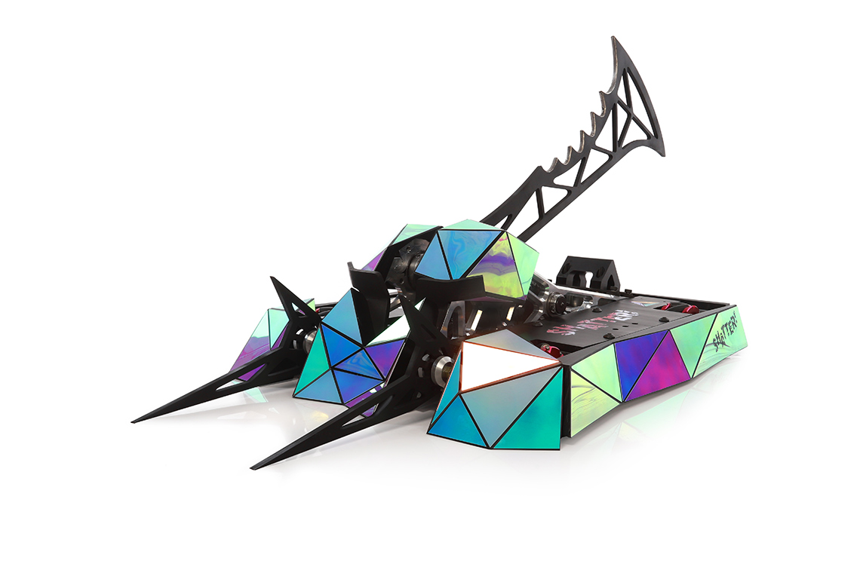
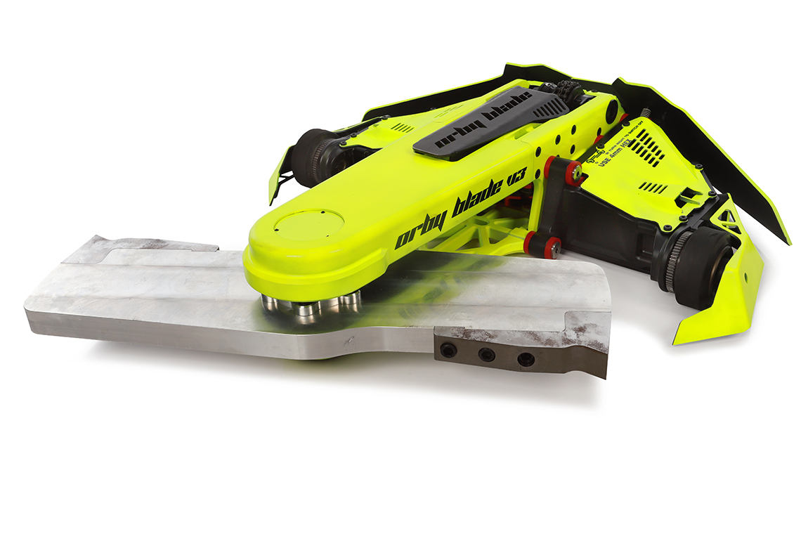
Build a Bot That…
Looks Great
text

Slide 9
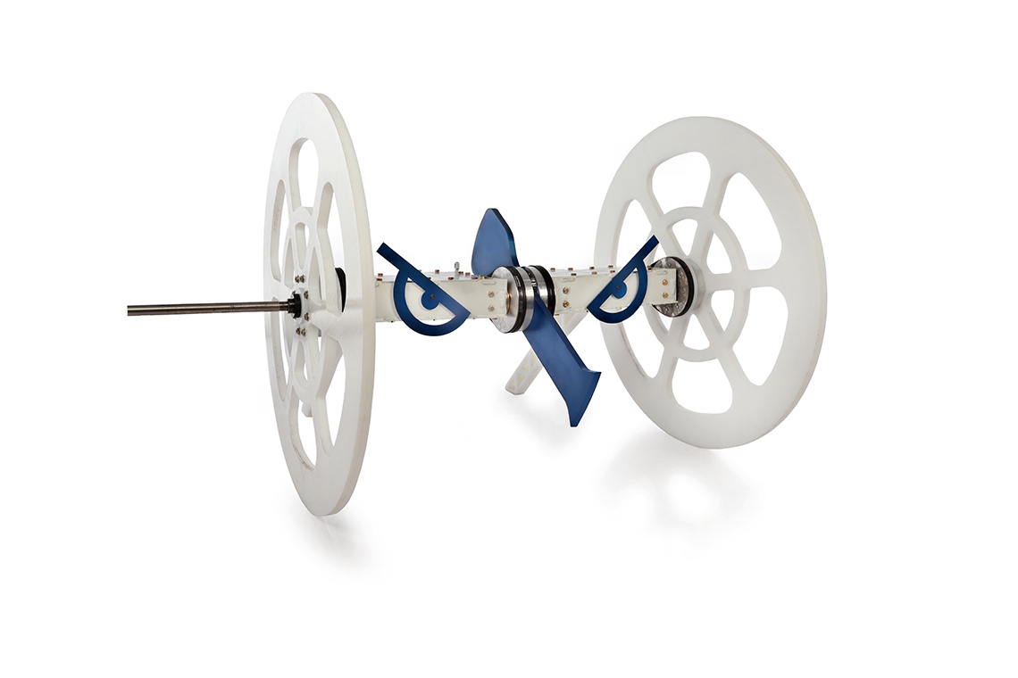
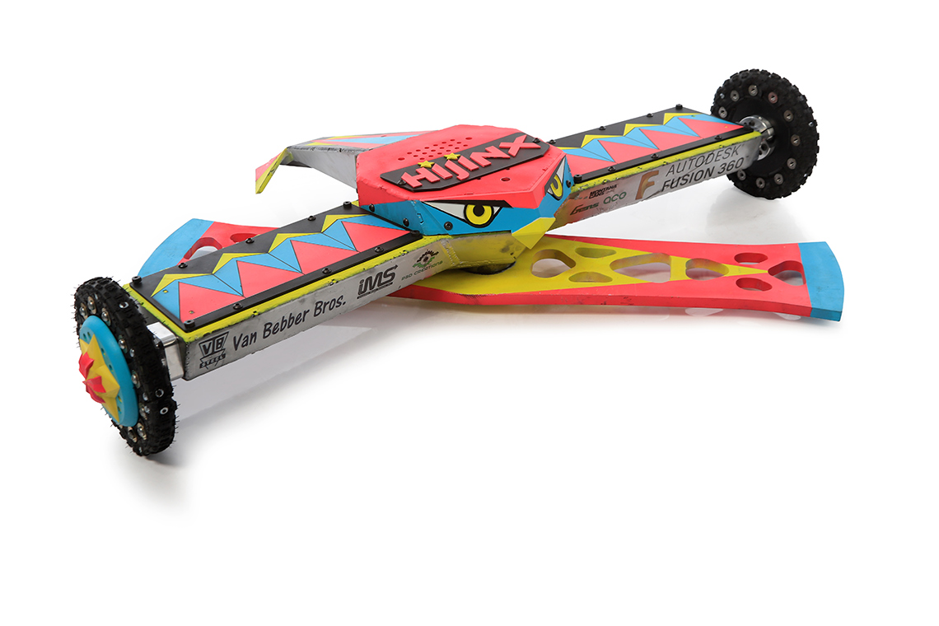
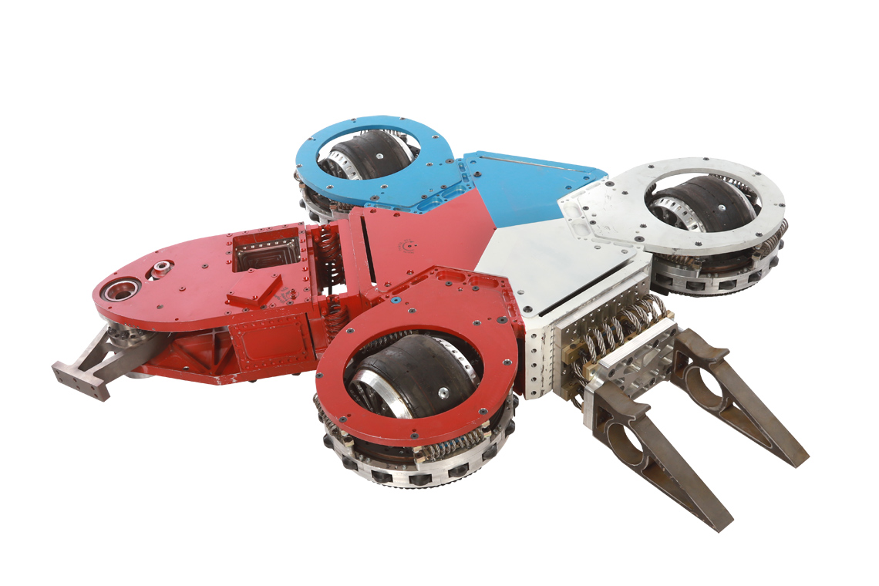
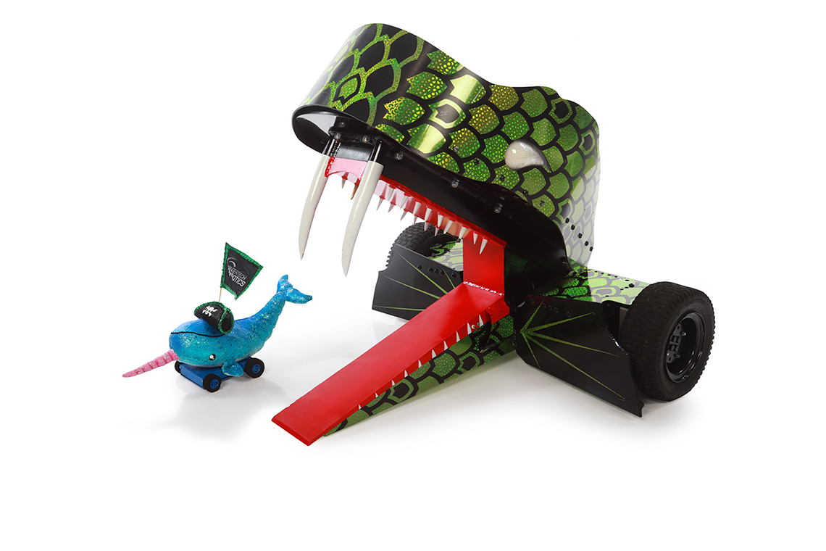
Build a Bot That…
Has An Interesting Shape
text

Slide 10
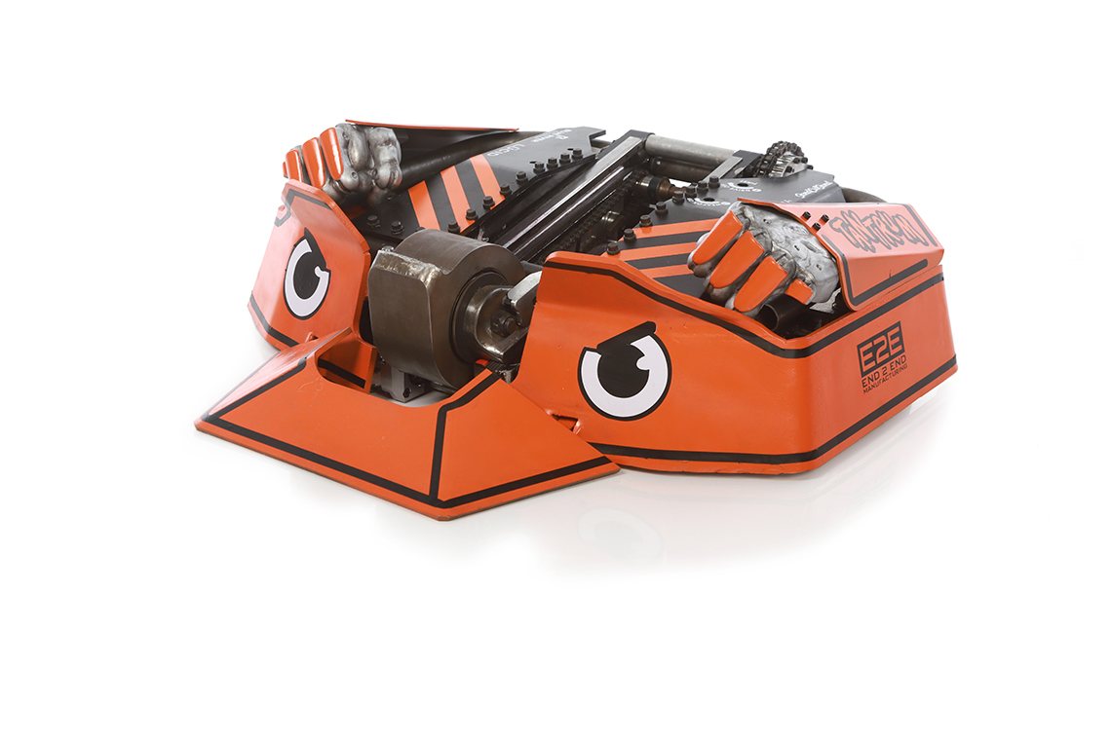
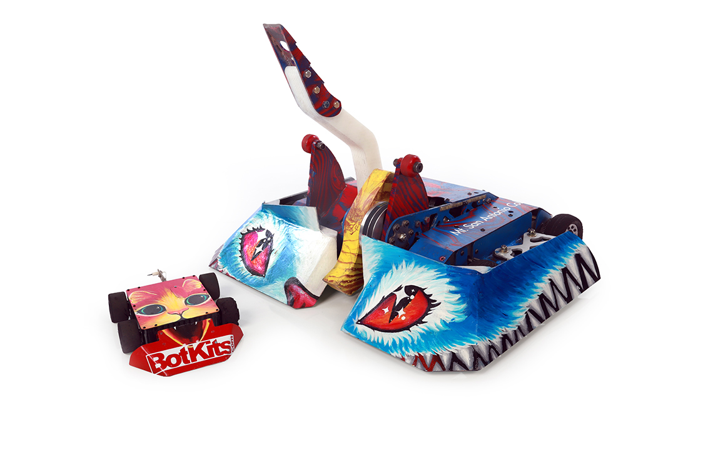
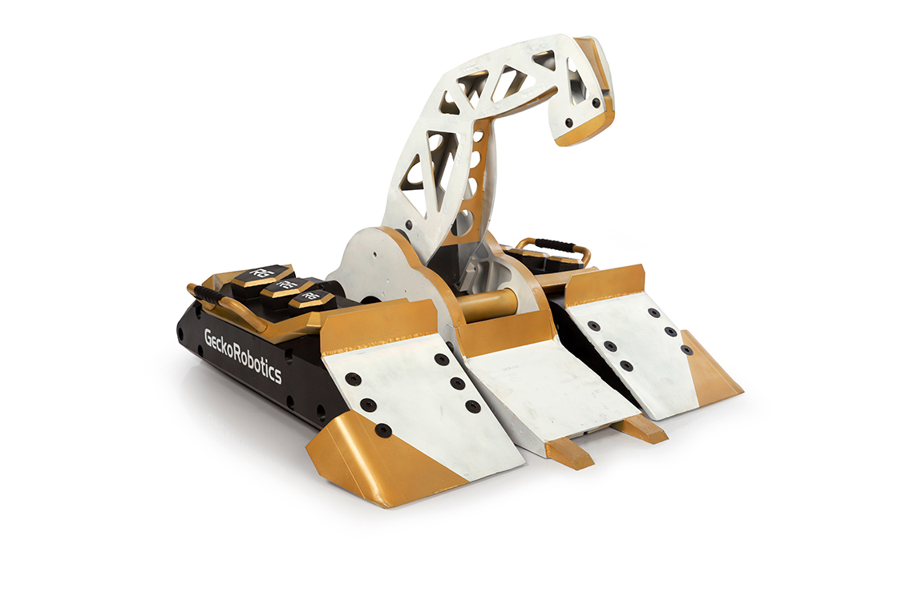
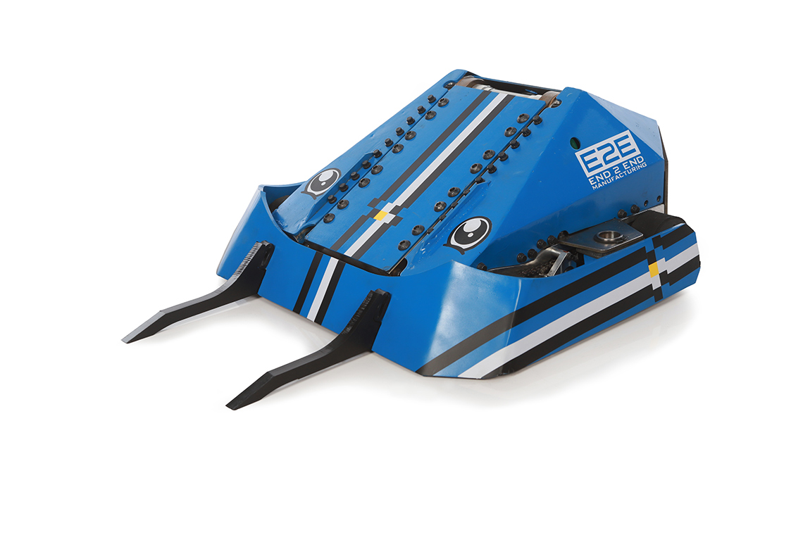
Build a Bot That…
Has Personality
text

Slide 11
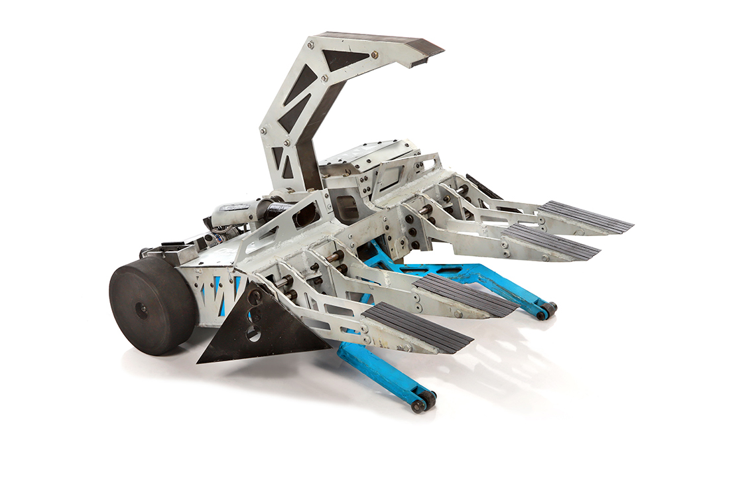
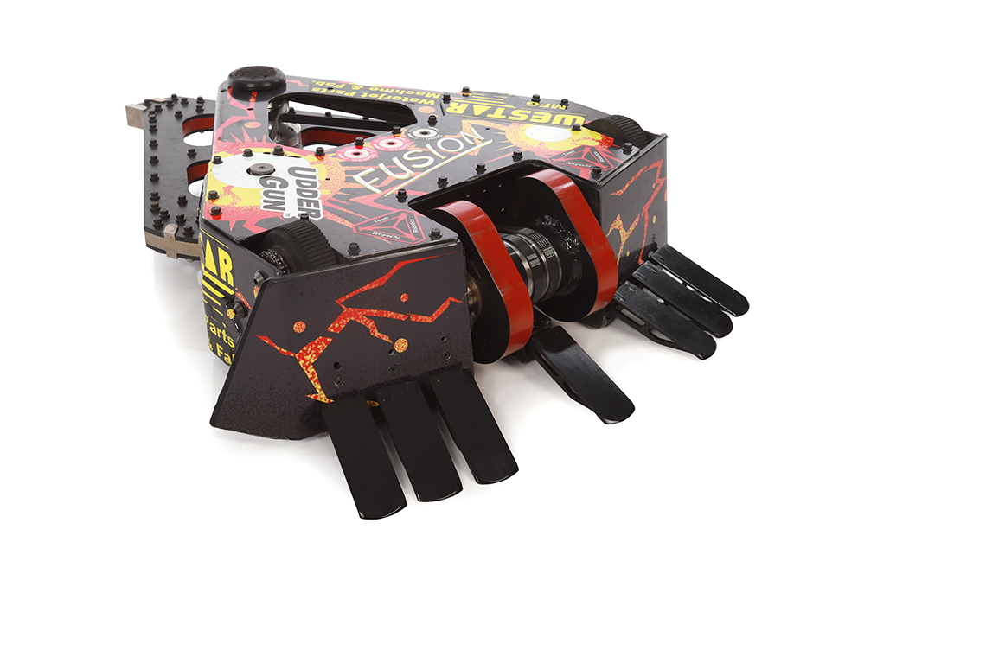
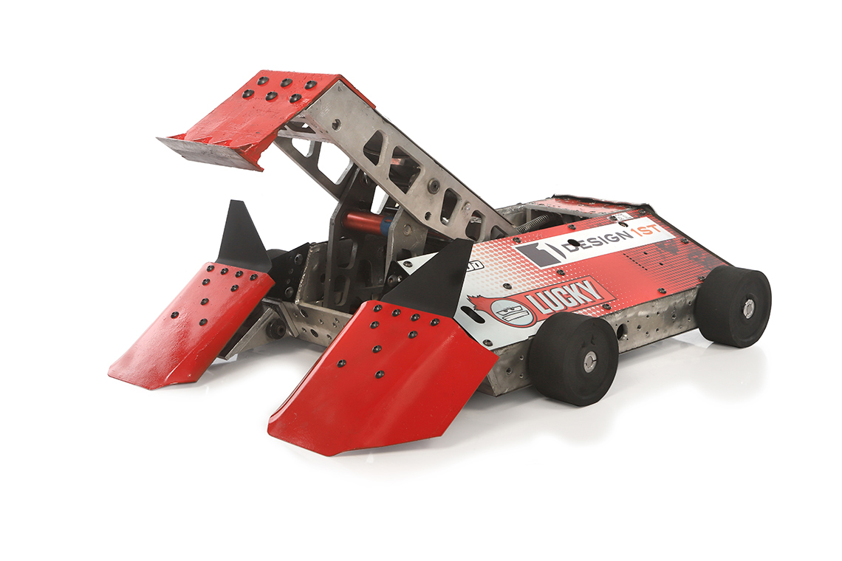
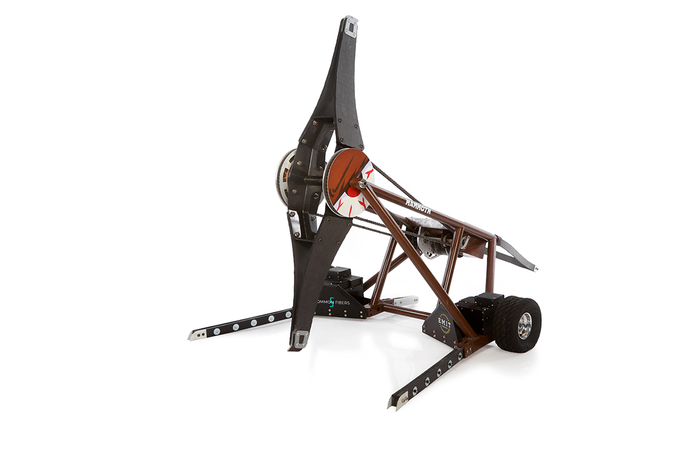
Build a Bot That…
Is Original
text

Slide 12
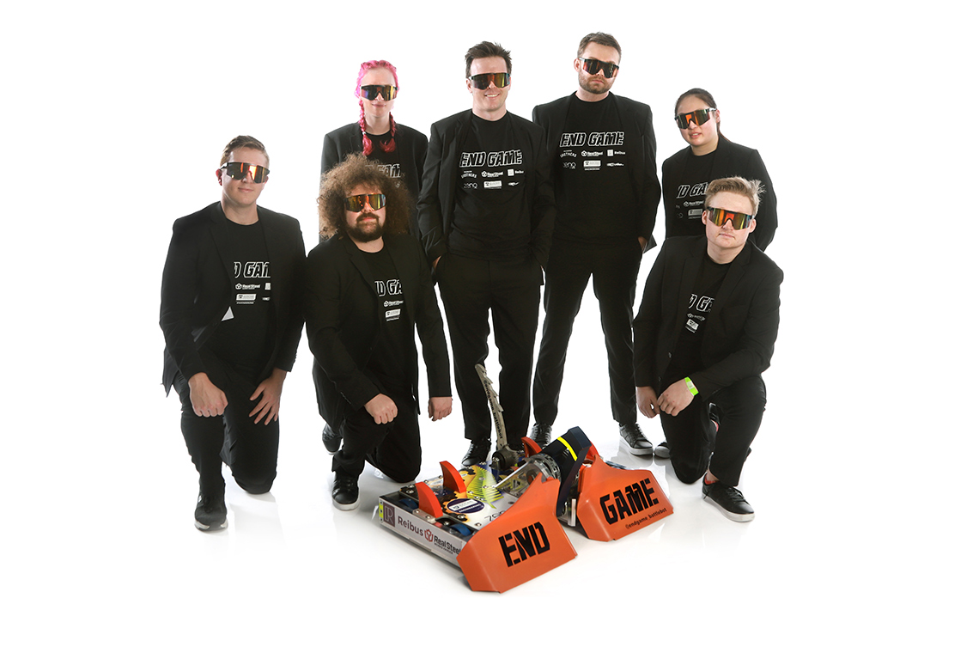
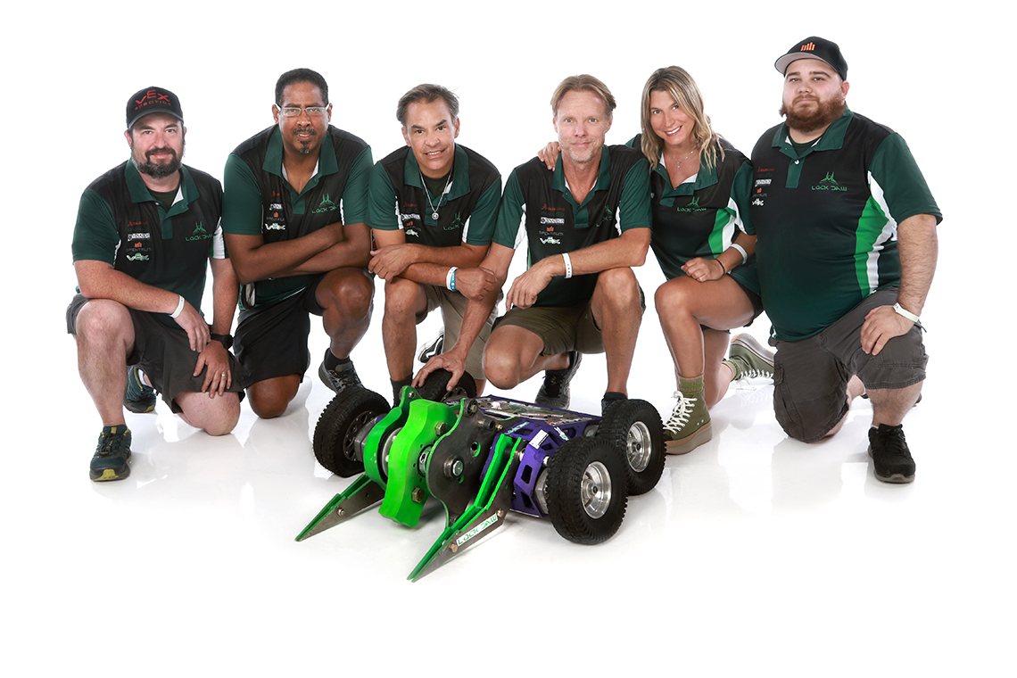
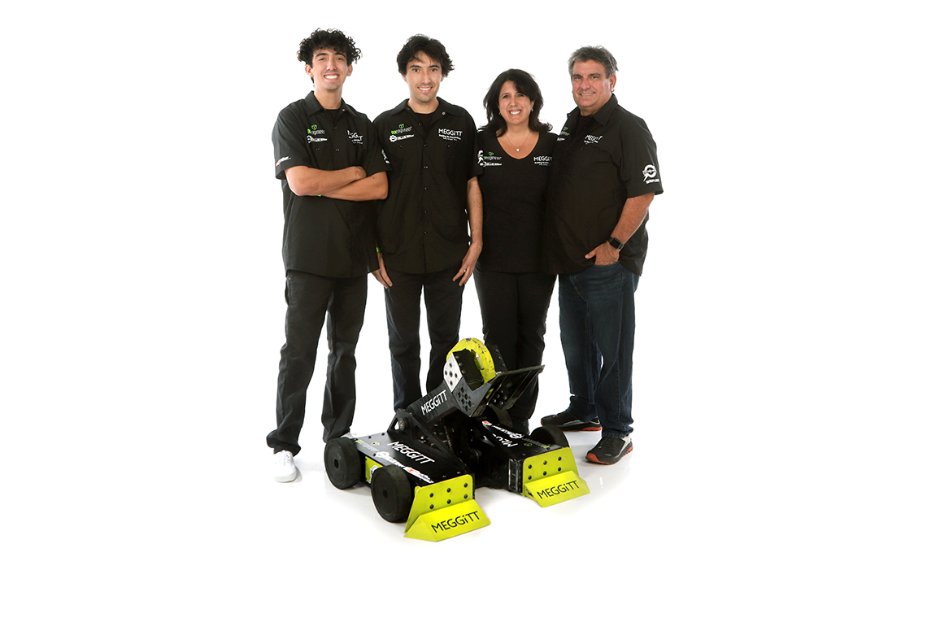
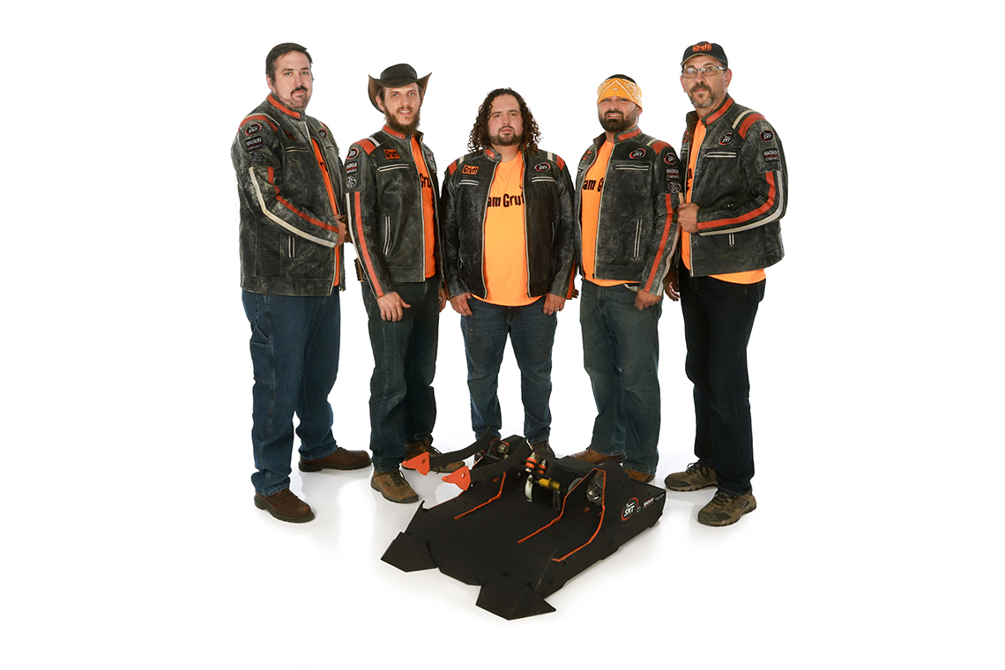
Build a Team…
Of Problem Solvers
text

Slide 13
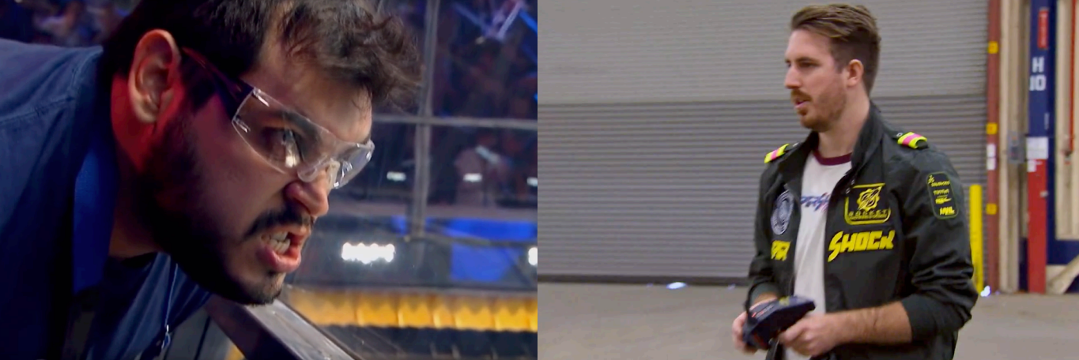
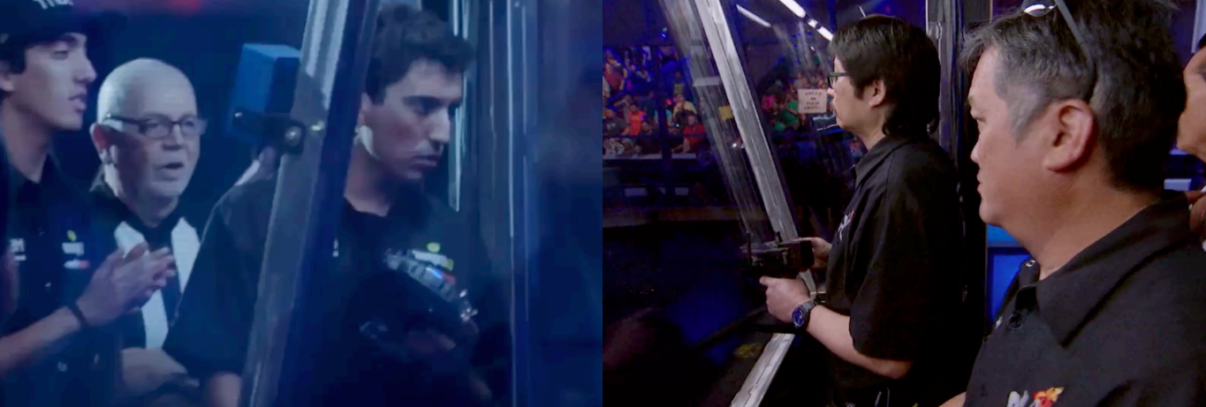
Build a Team…
With a Top Driver

Slide 14
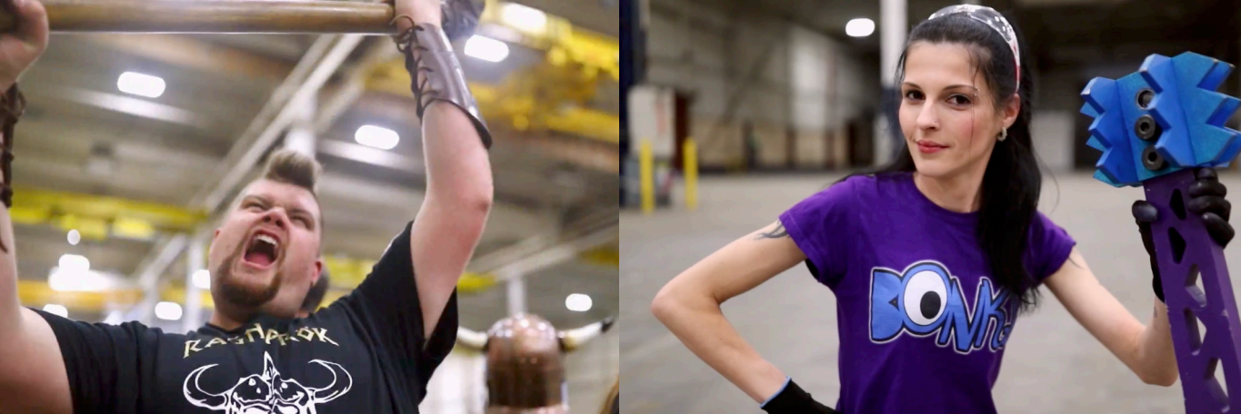
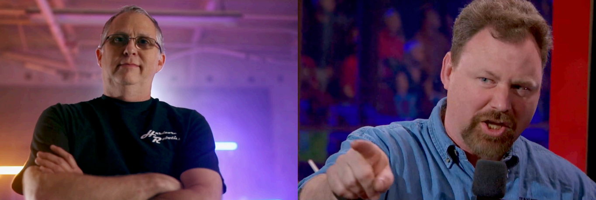
Build a Team…
That Will Show Their Personality on TV

Slide 15
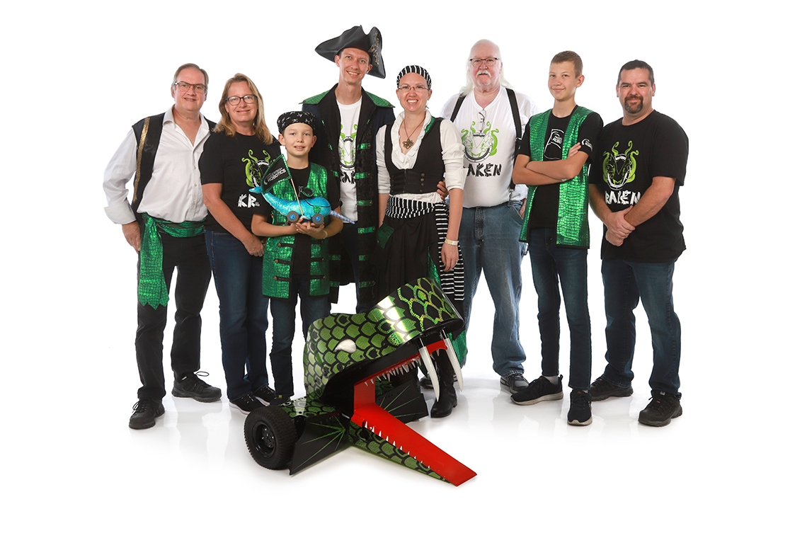
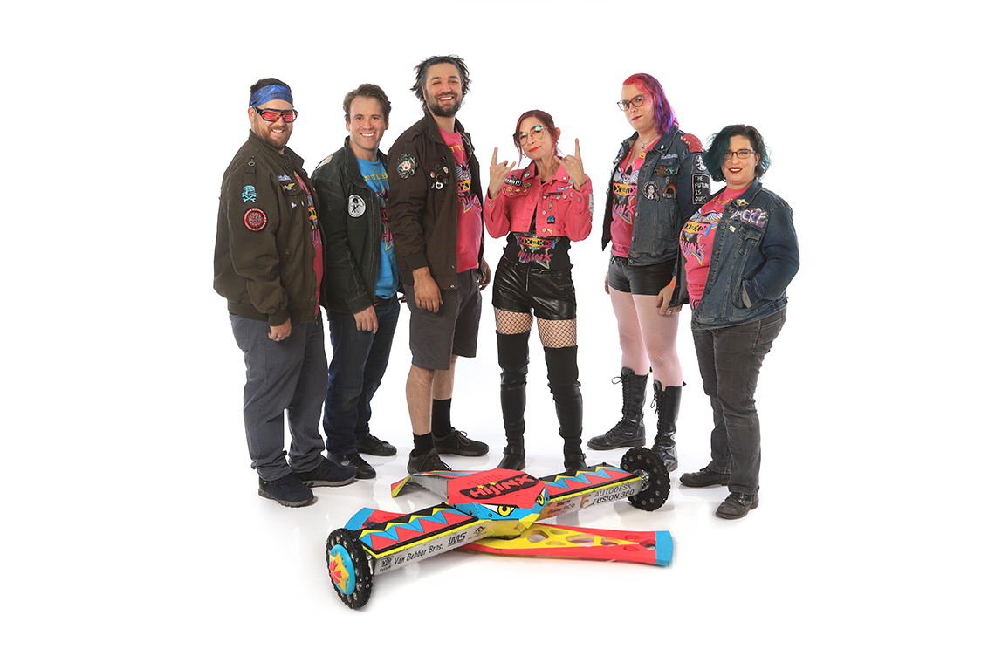
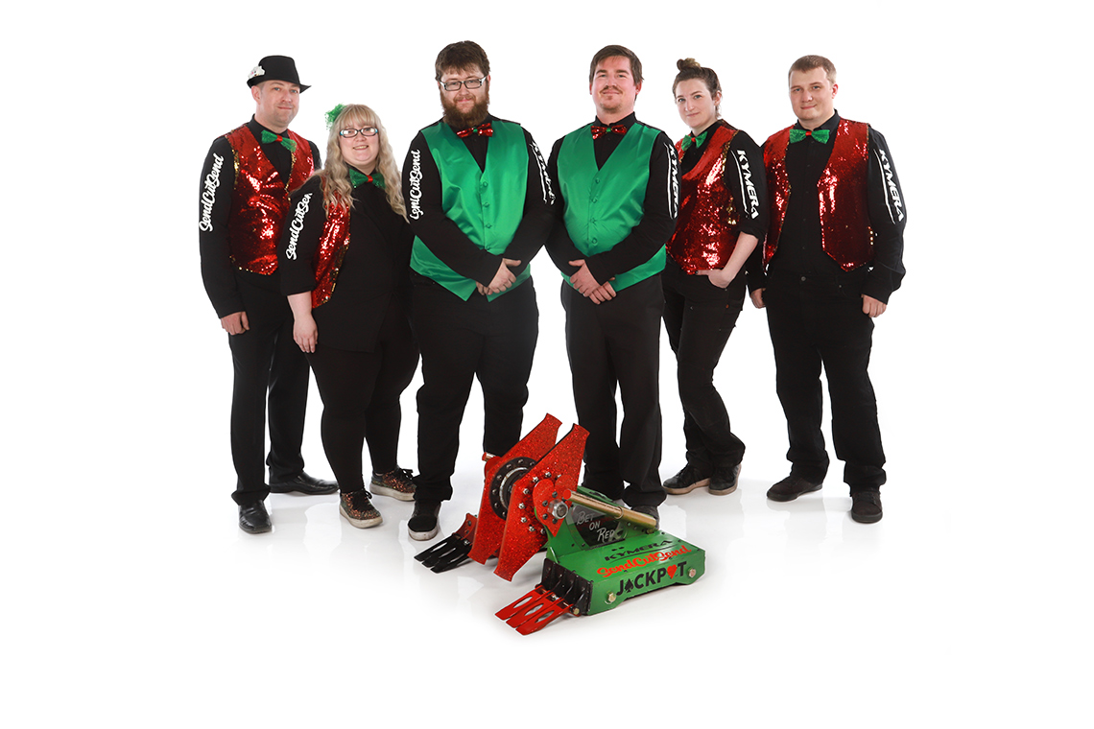
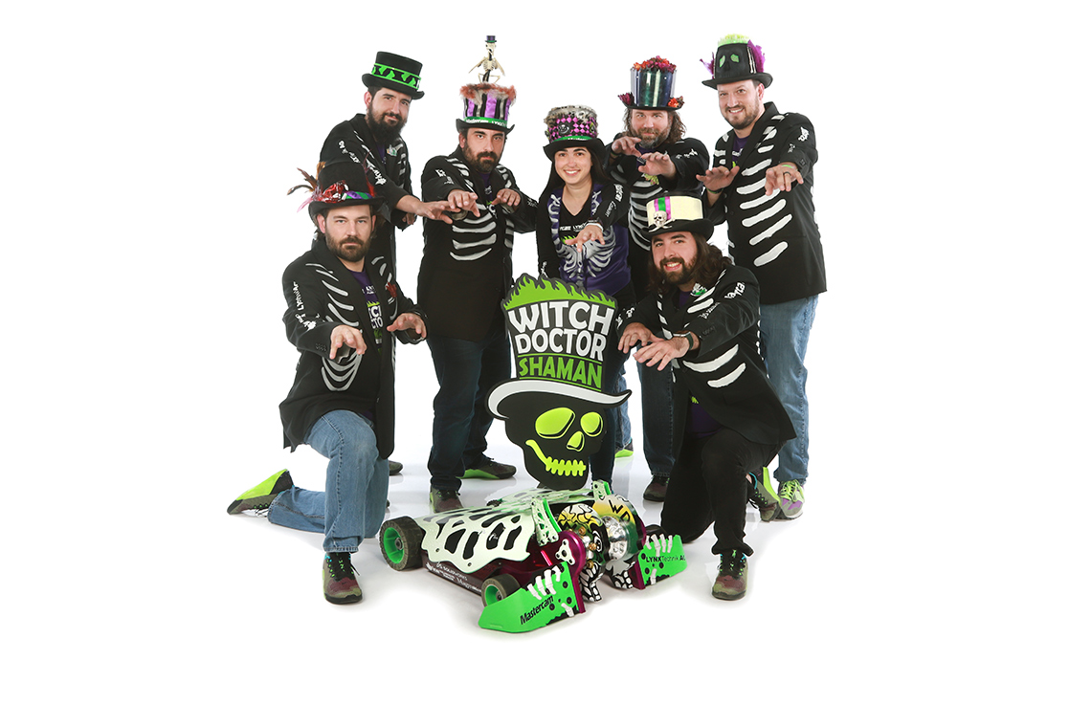
Build a Team…
That Will Dress To Impress
text

Slide 16
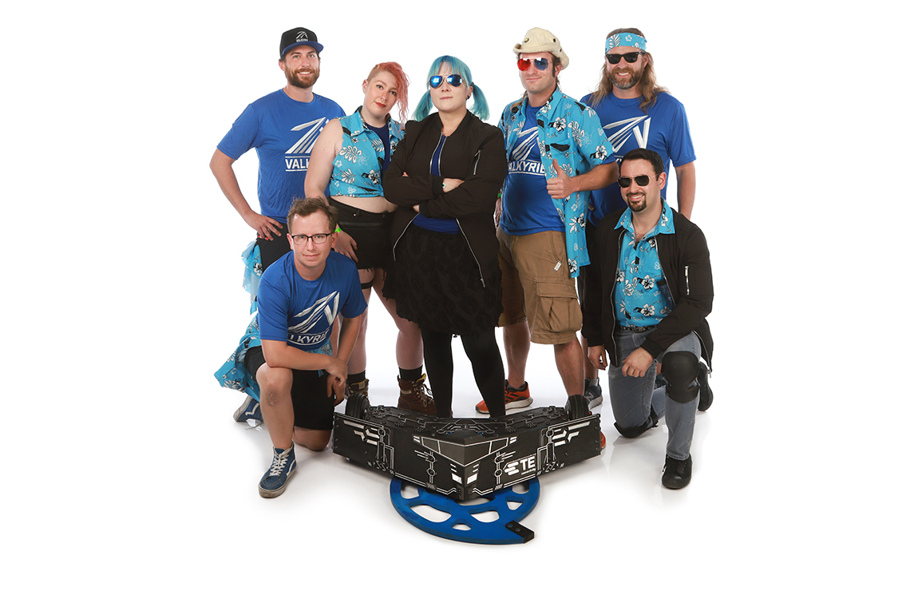
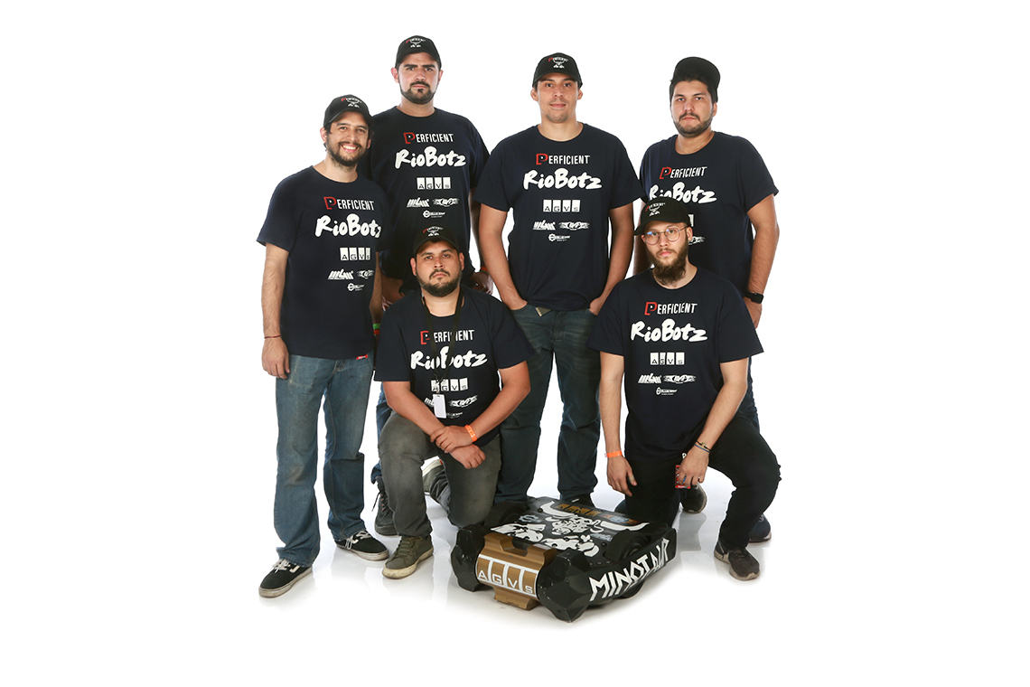
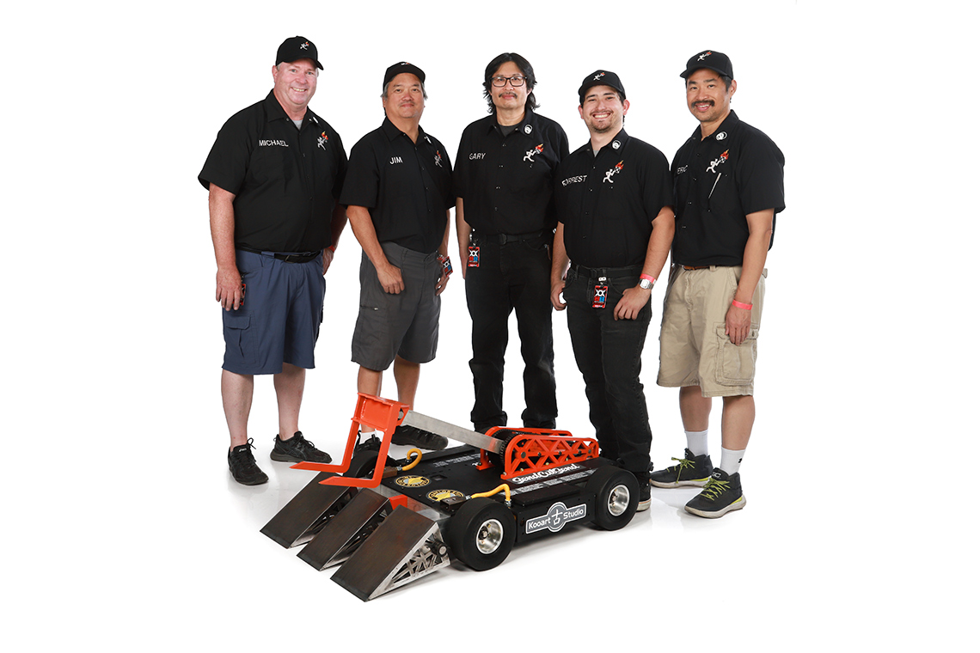
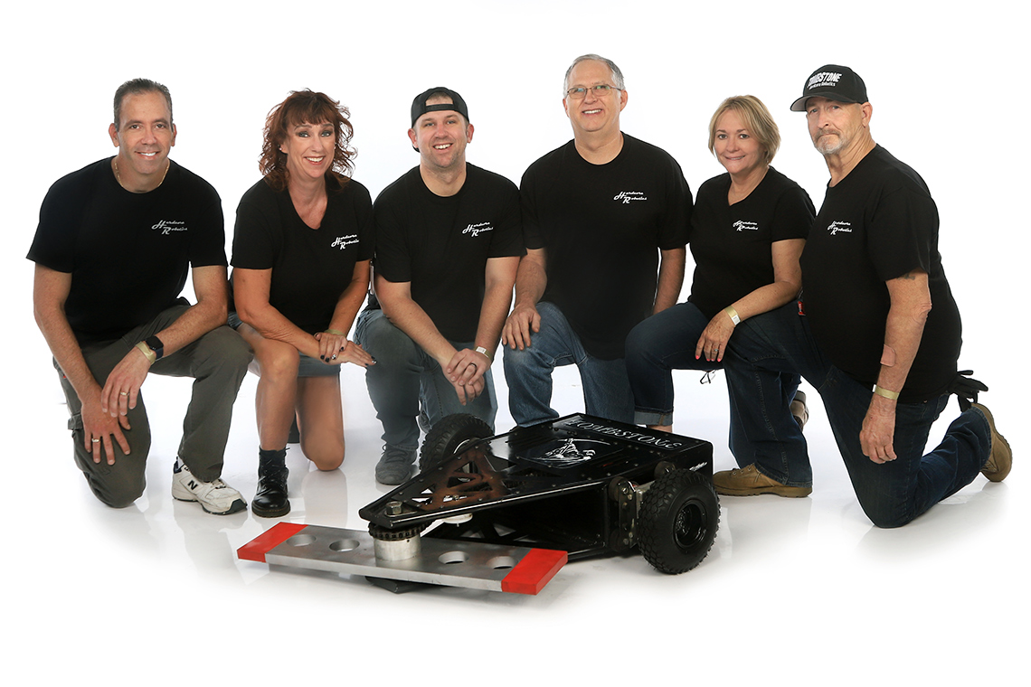
Build a Team…
That Will Be Authentic
text

Slide 17
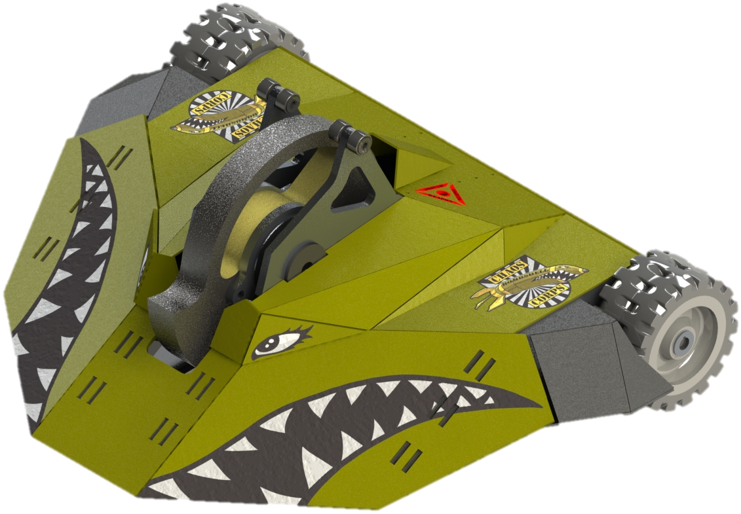
Prove It
Register
http://registration.battlebots.com/
Start your application for the 2023 season now
Include beautiful renderings of your bot
Create a team video showing us how (if chosen) you will hit the key factors
Have fun with the video, show your personality!
Need Help?
Check out https://battlebots.com/build/
Stick around for the Robot Combat 101 panel

Slide 18
Important Disclaimer
Designing, building, and testing robots are inherently dangerous activities that should only be conducted by trained professionals and/or qualified engineers. No minors should engage in any of these activities without the proper supervision of an adult who is either a trained professional or a qualified engineer. You fully assume the risk of any and all liability, injury, loss, damage, or death that may be caused to you and/or any third party in connection with your engagement in any robot designing, building, and/or testing activities. BattleBots, its partners, and licensees assume no liability whatsoever in connection with your engagement in these activities, and further make no representations and/or warranties, whether express or implied, with respect to your safety and/or your eligibility for any future seasons of BattleBots.
Furthermore building a robot is time consuming and expensive. Anyone may apply for BattleBot at registration.battlebots.com, but we recommend that you do not start building your robot until you are notified by BattleBots that your application has been accepted, and you have completed other entry procedures that will be required by our broadcast partners. If you decided to build before this, you do so at your own risk. BattleBots Inc. and its affiliates reserve the right to reject any application for any reason and without explanation.
No dates have been set yet for the 2023 season, but we recommend completing your
application early.
Good luck!

Slide 19
Additional Insight
Starting with a 250lb bot is hard mode
Find and attend local events if possible
Build smaller bots to make your mistakes cheaper and not on national television
Talk to builders
Prototype, Prototype, Prototype
Build prototypes early to validate ideas before it’s too late
Creates the chance to swap components if the existing parts aren’t working
Great content for social media

Slide 20
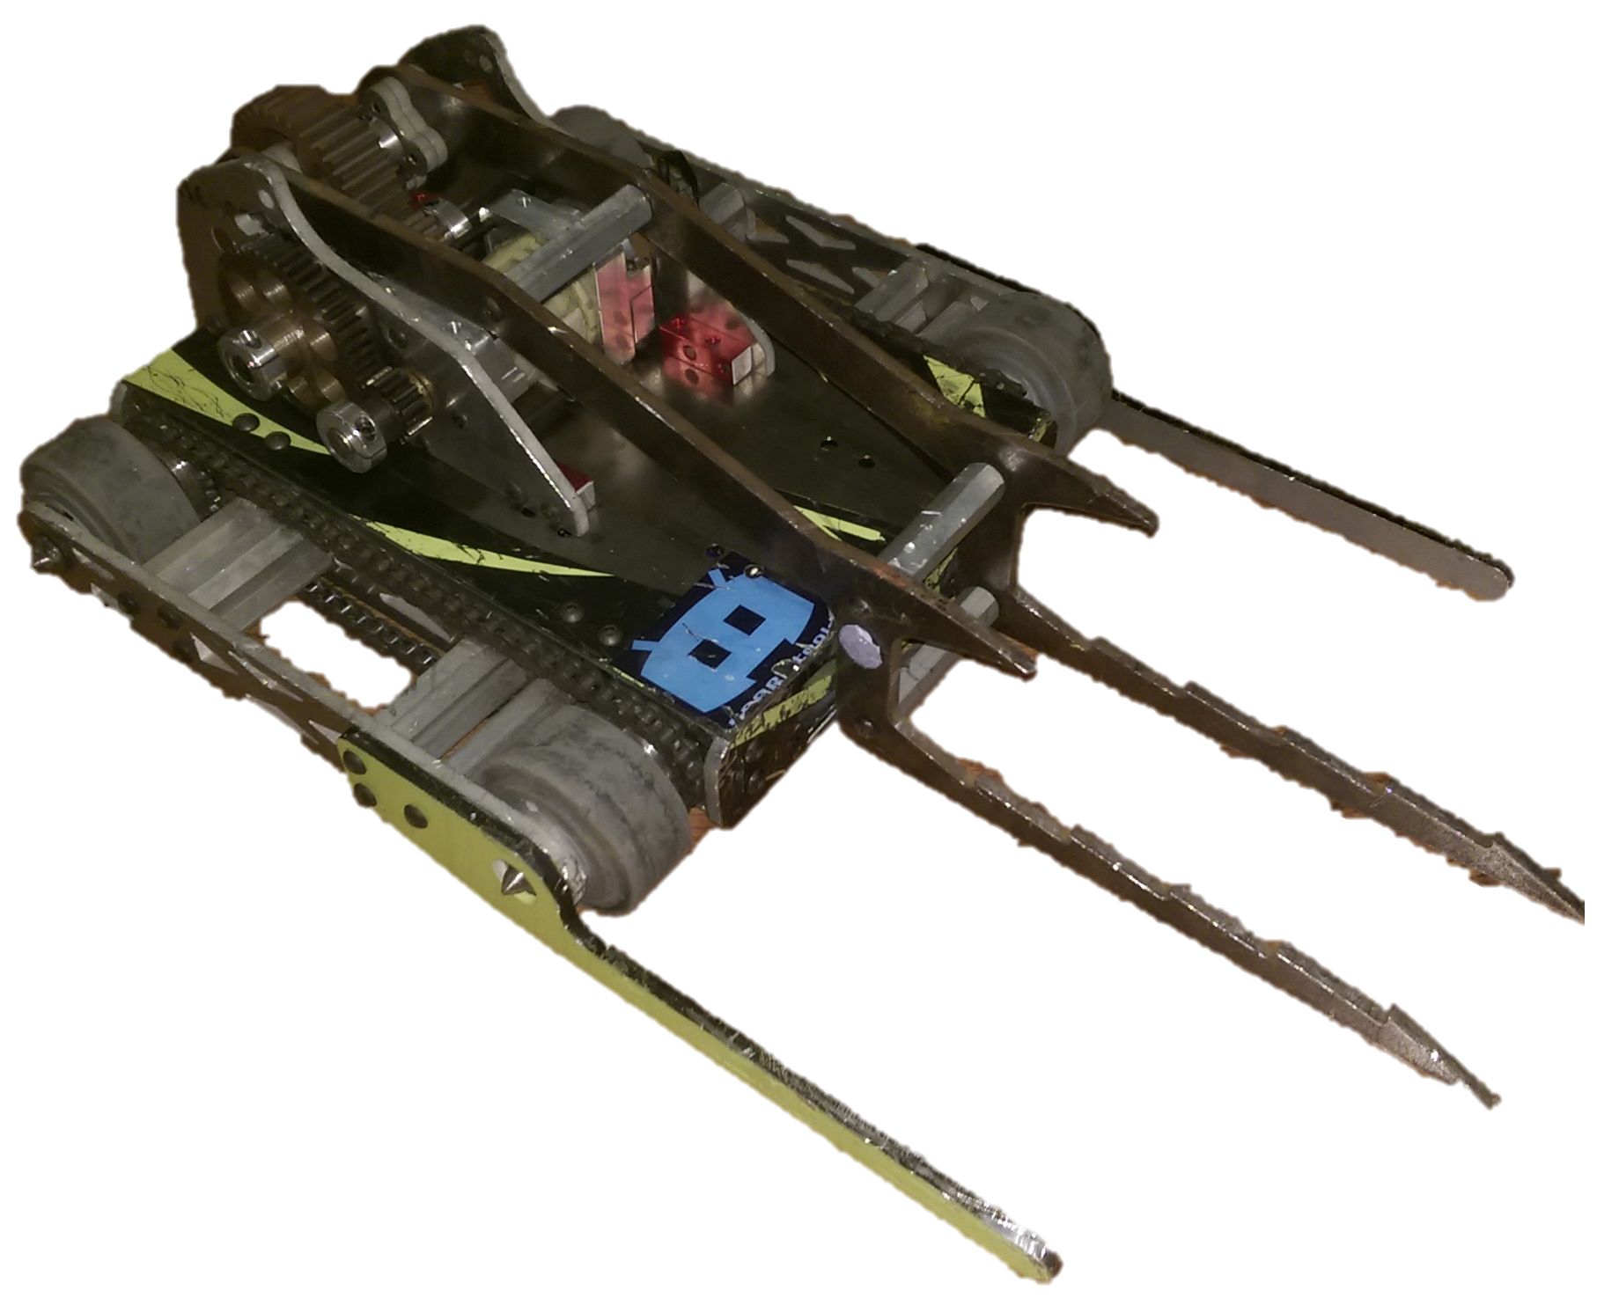
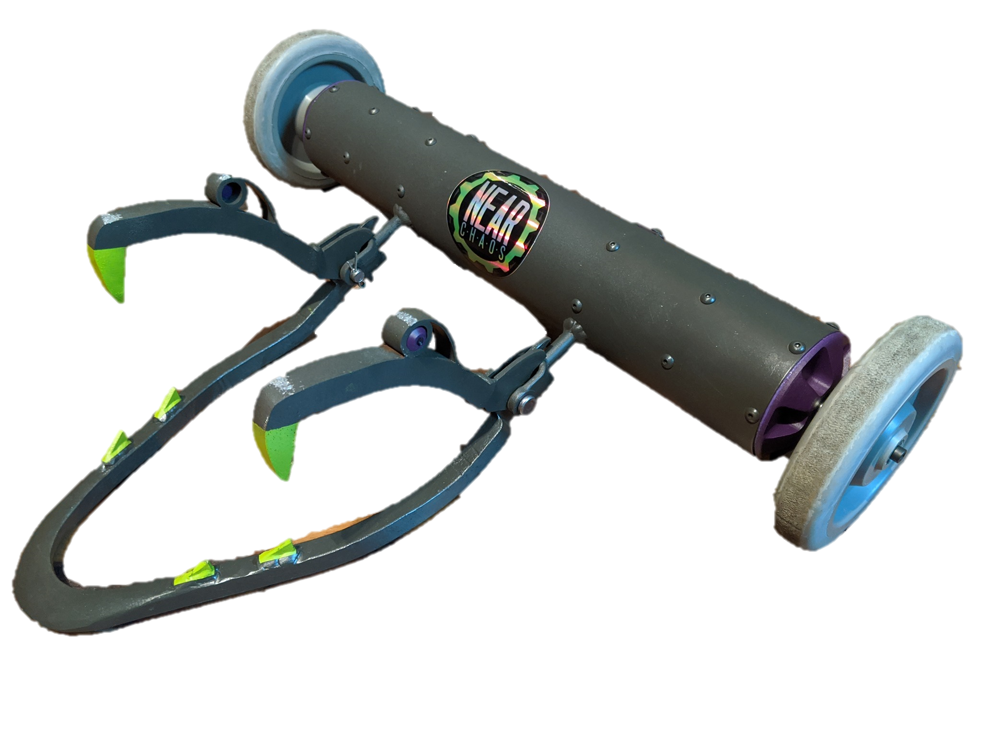
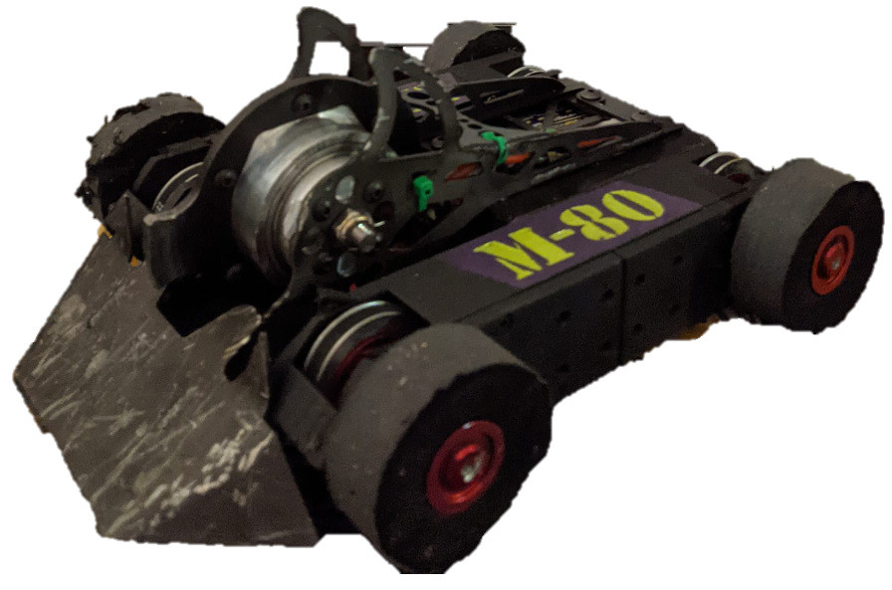
Open Questions

